Slide 1
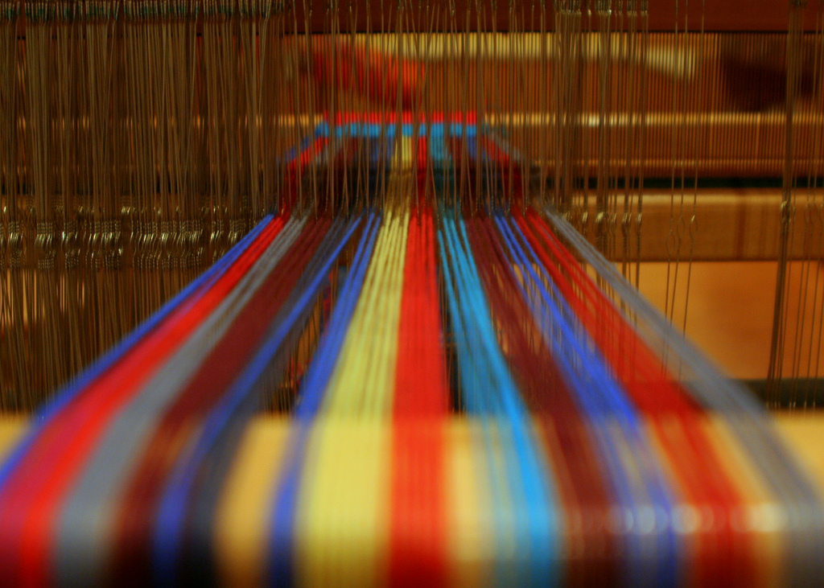
Advanced Programming Issues
JAI and Threads
Courtesy ndanger at http://www.flickr.com/photos/ndanger/ http://www.flickr.com/photos/ndanger/2744507570/ distributed under CC license http://creativecommons.org/licenses/by-sa/2.0/deed.en

Slide 2
Concurrency
Concurrency (parallelization) occurs when more than one process is executing at the same time.
Computing systems often have multiple cores (or cpus) which can function simultaneously.
Many of the filters presented in this text can be made much more efficient through the use of concurrency.
Java uses threads as parallel processes within a program.

Slide 3
Thread
Thread is a Java class that represents a thread
The Thread class contains three primary methods
void run() – the code that should be executed in parallel with others
void join() – block and wait for the thread to complete its run
void start() – allocate system resources for the Thread and execute the

Slide 4
Image processing filters
Common technique is to divide an image into tiles. The tiles are assigned to threads that process the tile.
Must control the tiling such that a tile is never assigned to multiple threads and that all tiles are assigned.
Construct an ImageTiler object.
The tiler accepts a BufferedImage and dimensions of the tiles. It then serves as a synchronized (thread save) iterator that dispenses tiles via the next method.

Slide 5
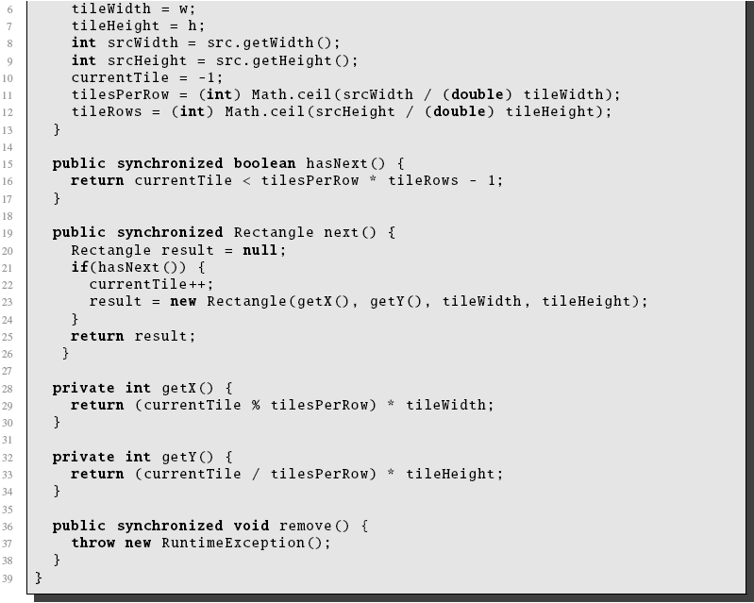

Slide 6
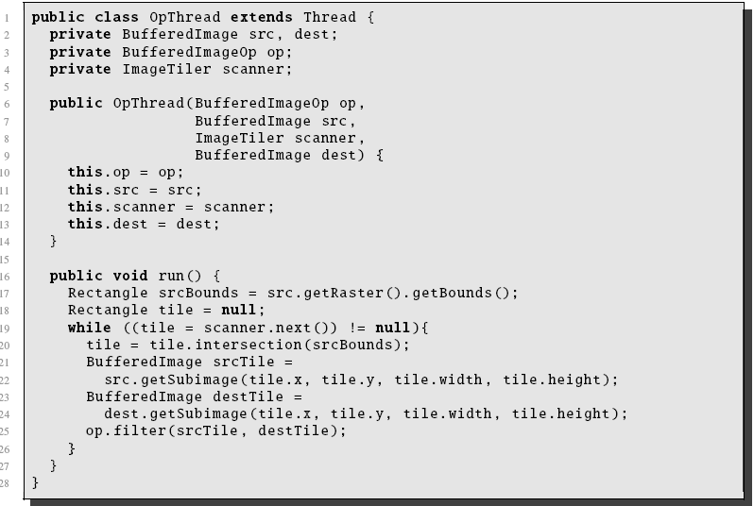
Construct a Thread
Must author a thread that applies a BufferedImageOp to tiles of an image.

Slide 7
Notes
The ‘getSubimage’ method returns a BufferedImage that shares the same databuffer as the source. Modification of the subimage is a modification of the source
The OpThread applies the same operation to each tile
The OpThread gets tiles from the tiler. It doesn’t matter which tiles are being operated on.

Slide 8
Can even write a ConcurrentOp
How about writing a BufferedImageOp that applies another BufferedImageOp in a concurrent fashion!
The ConcurrentOp accepts a BufferedImageOp and
Creates a single image tiler
Creates an OpThread for each available processor in the system. Each OpThread uses the same tiler
Starts the OpThreads and then waits for them to finish via the join.

Slide 9
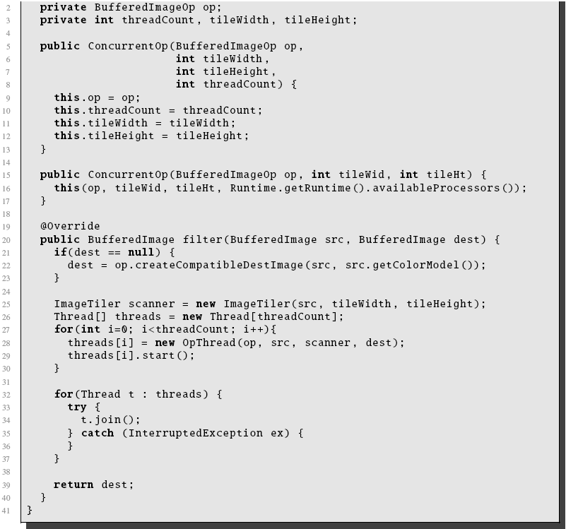

Slide 10
Using the ConcurrentOp
Here is some client code that makes use of the concurrent filter class.
BufferedImage source = ImageIO.read(new File(“file.jpg”));
BufferedImageOp invertor = new InvertOp();
ConcurrentOp op2 = new ConcurrentOp(invertor, 100, 100);
BufferedImage dest = op2.filter(source, null);
Not all ops are threadable. Any thread that relies on the location of a sample or the order of sample processing will not work properly.

Slide 11
JAI
Java Advanced Imaging (JAI) is a sophisticated image processing library.
Provides full support for floating point images
Larger range of image encoders/decoders
Larger range of color models
Multiple source filters
Deferred execution
Direct support for distributed and threaded applications
Can be executed in either
Accelerated mode by using optimized native libraries (DLL’s)
Native mode by using straight Java (slower).

Slide 12
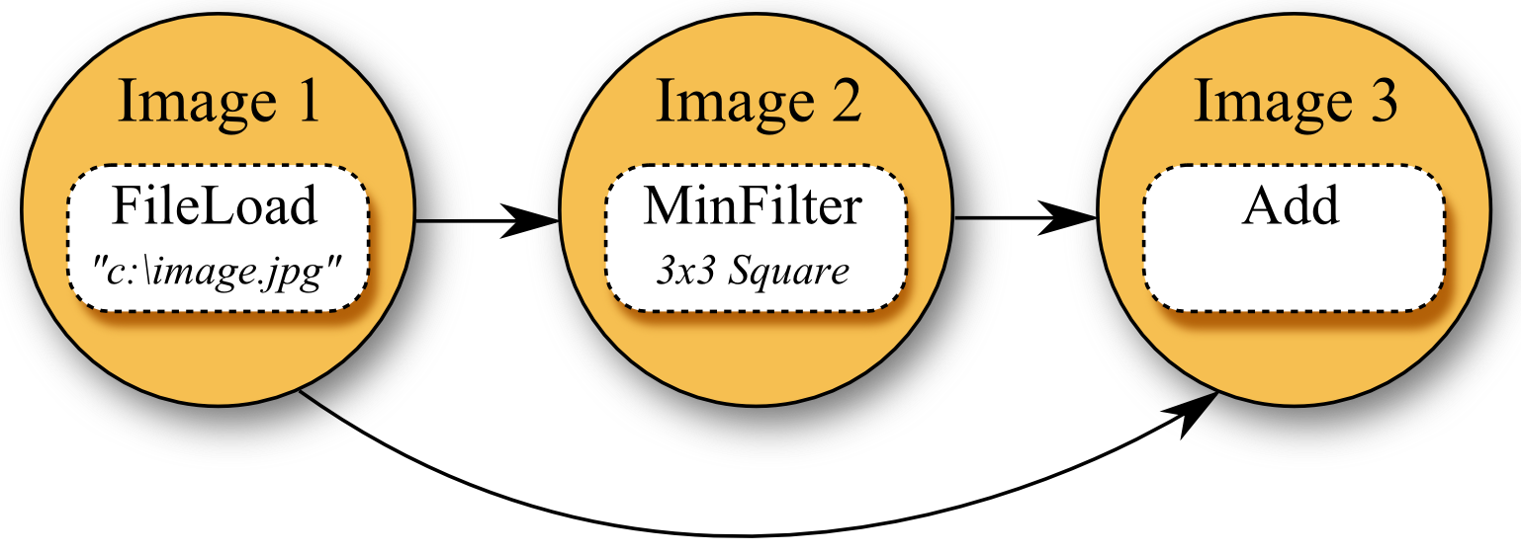
JAI
A JAI filter is viewed as a directed graph
Each node is an operation
Each edge shows the input/output
Each node is also the ‘result of the operation’

Slide 13
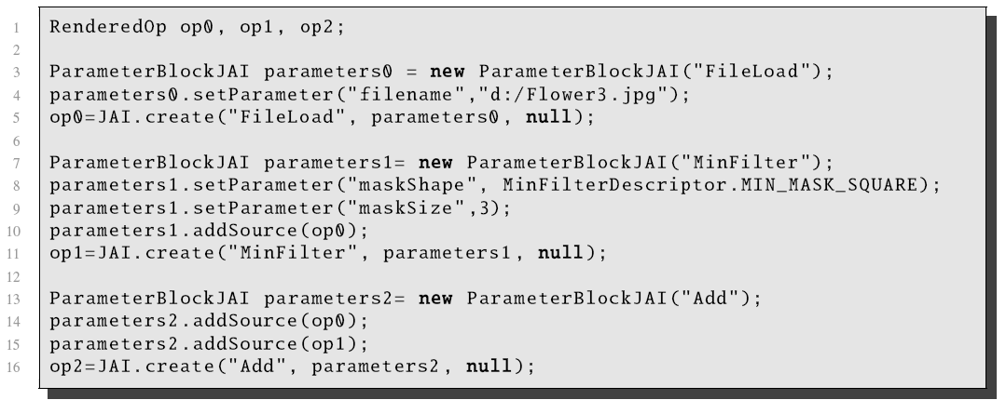
JAI Classes
Three main classes
RenderedOp – a node in a JAI chain
ParameterBlockJAI – a set of parameters for an operation
JAI – a set of static methods for creating chains.

