Slide 1
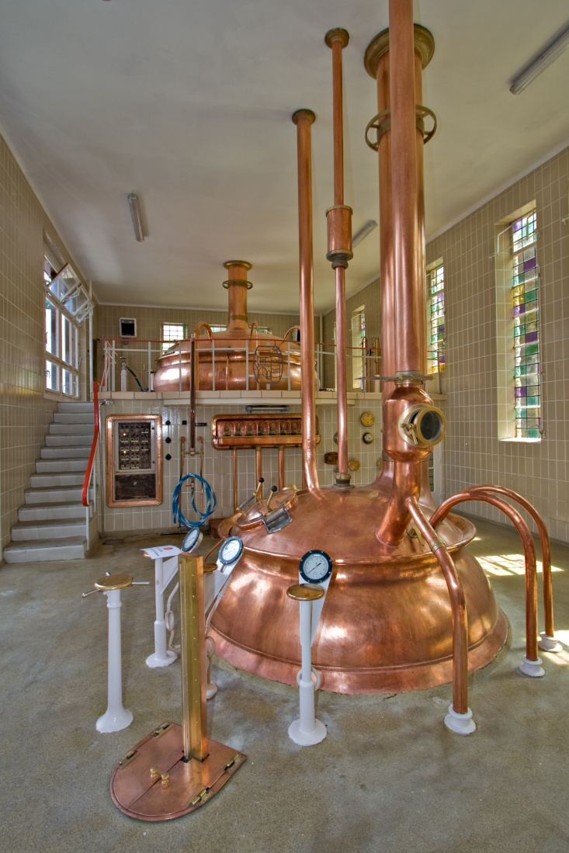
Morphology
The shape of things to come
Courtesy Luca Galuzzi (Lucag) http://commons.wikimedia.org/wiki/File:8210_Brewery_in_Abbaye_Notre-Dame_de_Saint-Remy_Rochefort_2007_Luca_Galuzzi.jpg
Distributed under CC license as found at http://creativecommons.org/licenses/by-sa/2.5/

Slide 2
Morphology
Used in different ways
Linguistics : the study of the structure and form of words
Biology : the shape of an organism
Astronomy : the shape of astronomical objects
Geography : the shape of land masses and rivers
Image Processing:
How to identify, represent and process the shapes of objects within a digital image
This is a step toward computer vision since the output of a morphological process may be geometric information

Slide 3
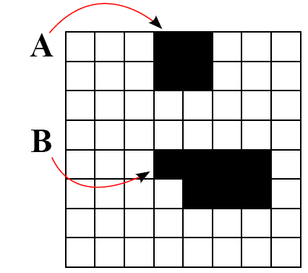
Components
A component is an object (or shape) within a digital image
The binary image below has two components
One task is to identify and label all image components

Slide 4
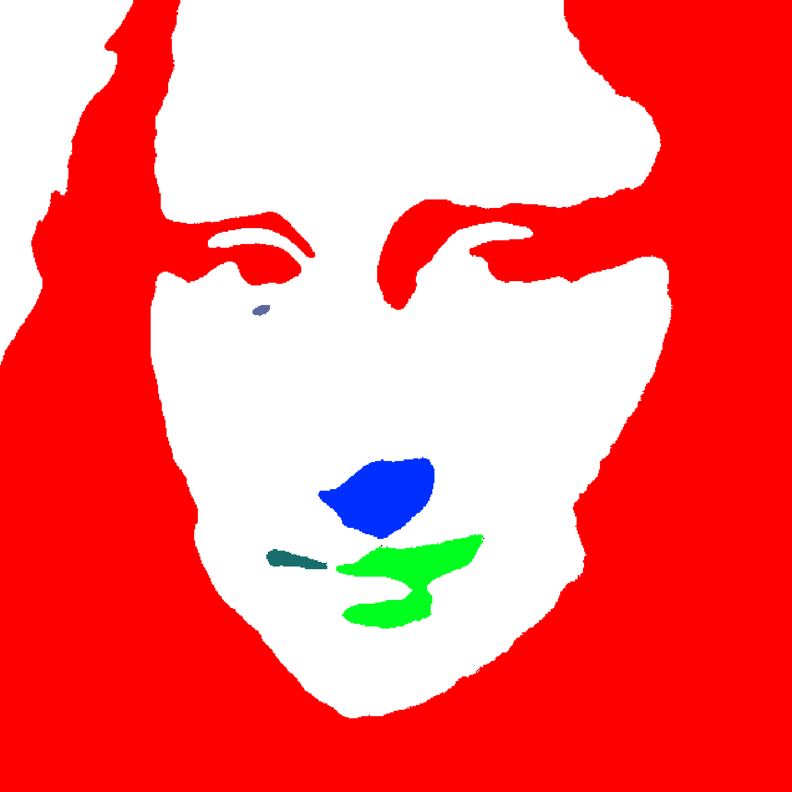
Components

Slide 5
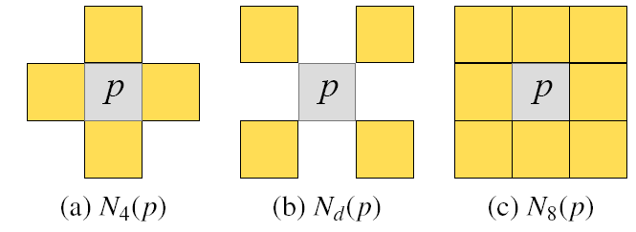
Connectedness
The pixels that comprise a component are joined by proximity and color likeness
Need to formally define when two pixels are in proximity.
A pixel has neighbors. The 4-adjacent, adjacent and adjacent neighbors are shown below.

Slide 6
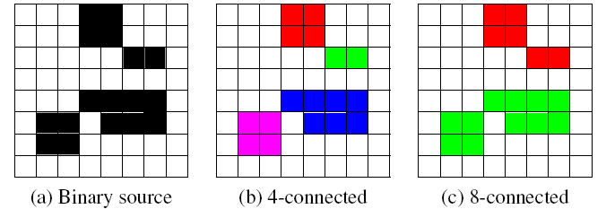
Connectedness
A pixel p is 4-adjacent to pixel q if q is one of the adjacent neighbors of p.
Non adjacent pixels p and q are 4-connected if there is a path of 4-adjacent pixels extending from p to q.
A 4-connected component is defined as a set of pixels such that each pixel is 4-connected to every other pixel in the component and no other pixels in the image are 4-connected to any pixel in the component.

Slide 7
Labeling connected components
Problem: generate a color destination image such that each pixel of the each component of the binary source image is uniquely colored (or labeled).
Begin by discussion ‘floodFill’

Slide 8
Labeling connected components
Problem: generate a color destination image such that each pixel of the each component of the binary source image is uniquely colored (or labeled).

Slide 9
Union-find labeling
Flood fill-based labeling suffers from two limitations:
Each pixel may be probed many times
Deep recursion may yield stack overflow – have to unroll the loop
Union-find addresses both these limitations
A component labeling algorithm
Uses a disjoint-set data structure.
Restates component labeling in terms of disjoint-set operations
Near-linear-time performance without deep recursion

Slide 10
Disjoint Set
A disjoint-set represents a collection of non-intersecting sets. No member is in more than one set.
A disjoint set supports two operations:
find(e) : for any element ‘e’ this method returns the set that contains ‘e’.
union(s1,s2) : for any two sets ‘s1’ and ‘s2’ this method merges them into a single set
A disjoint set can be understood as a forest of trees where each tree is a set and the label of the set is given by the root node of the tree
Find then becomes ‘follow the path from an element to it’s root’
Union becomes ‘make the root of one set a child of the other’

Slide 11
Union-find
For component labeling
The disjoint-set elements are pixels
The disjoint-set sets are components
The disjoint-set contains a collection of labeled components
The disjoint-set is initialized by placing each foreground pixel in it’s own set. A set of size 1
Each pixel is scanned and the set that contains it is merged with the set containing it’s neighbors as required
DisjointSet components = new DisjointSet(I)
for every pixel P in a raster scan of image I
if(P is a foreground pixel)
for every pixel Q in N₈(P) that has already been scanned
if(Q is a foreground pixel)
Set S1 = components.find(P)
Set S2 = components.find(Q)
components.union(S1,S2)

Slide 12
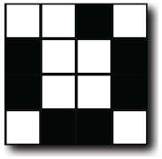
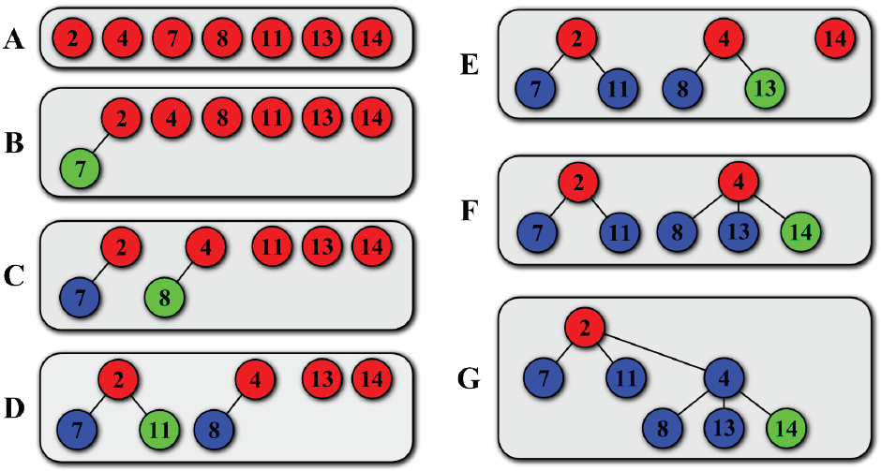
Example

Slide 13
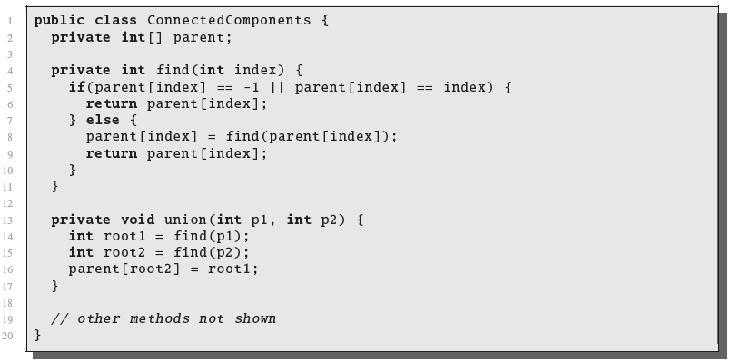
Java Implementation (partial)
Use a linear array named ‘parent’. Set it up such that
A pixel is given by an index. A label is an integer. Set -1 is the background.
If parent[i] == -1 then i is a root node with label -1
If parent[i] == i then i is a root node with label -i
Otherwise parent[i] is the parent node of i

Slide 14
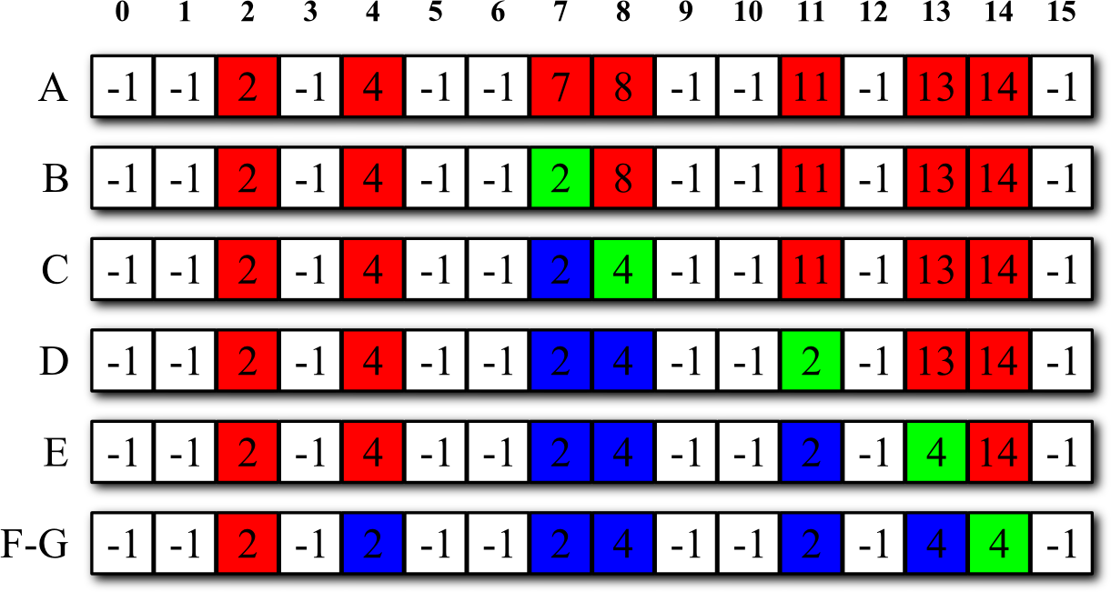
Example

Slide 15
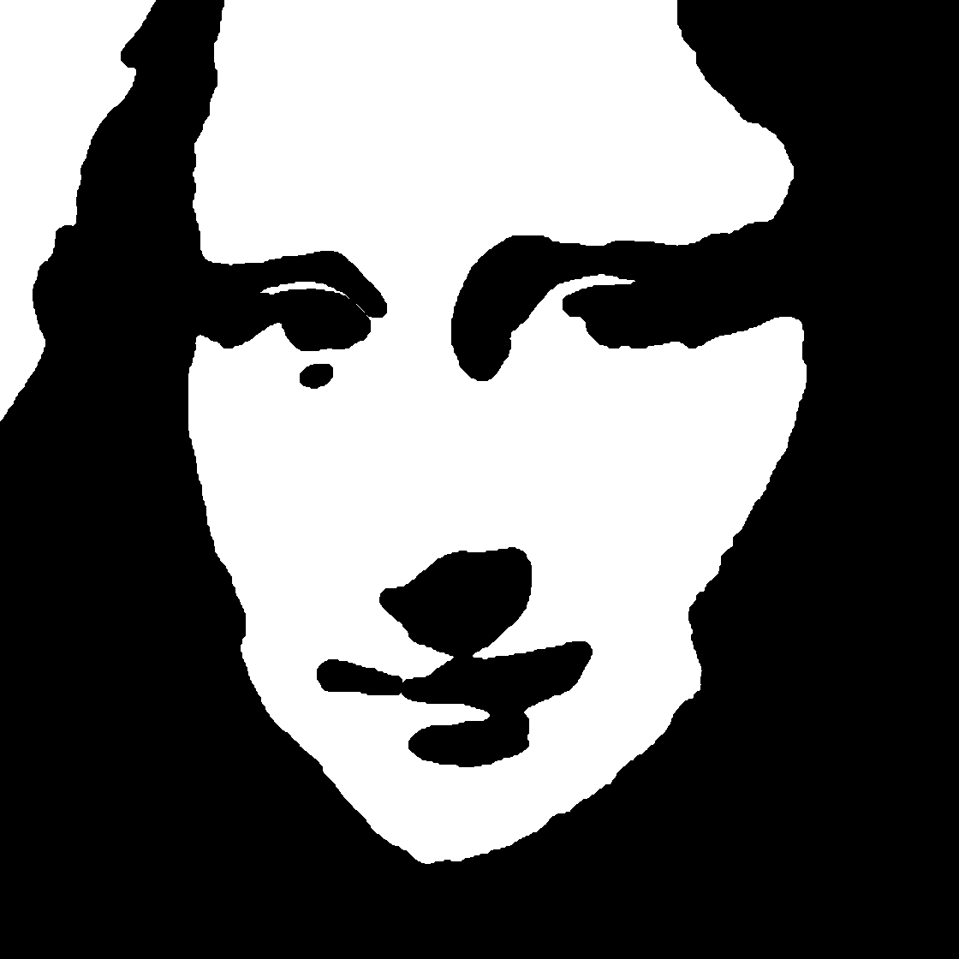
Dilation and Erosion
Dilation – causes a component to grow larger
Erosion – causes a component to grow smaller

Slide 16
Structuring Element
A structuring element is passed over each sample of a source.
The structuring element is a binary image
The source is a binary image.
Dilation
The output is black if at least one black pixel of the structuring element is positioned over a black source pixel
If the structuring element hangs over the edge of a component, the component will grow.
Erosion
The output is black if every black pixel of the structuring element is positioned over a black source pixel.
If the structuring element hangs over the edge of a component the component will shrink.

Slide 17
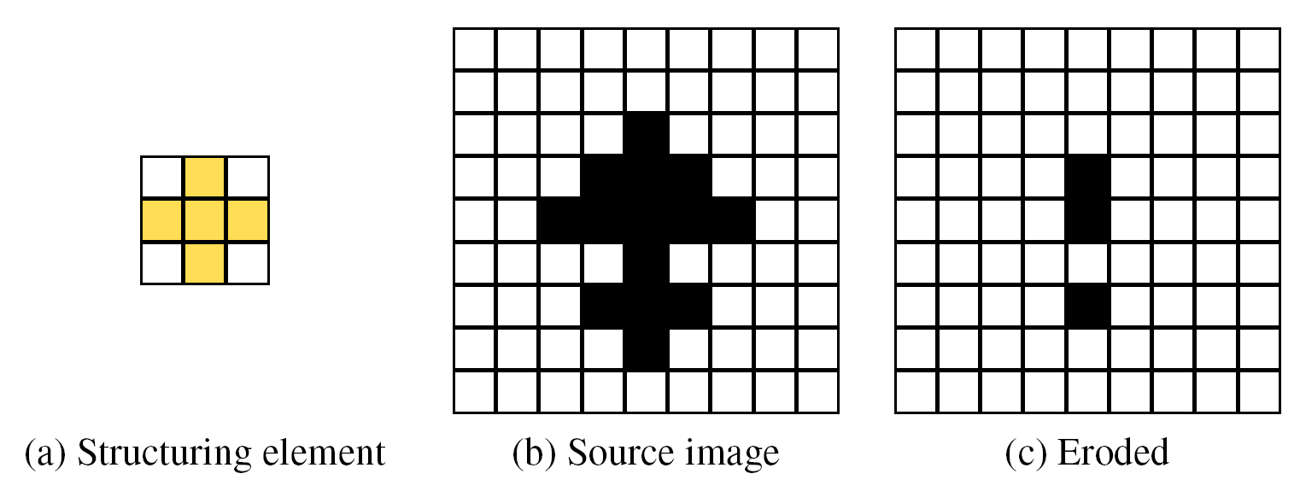
Erosion example

Slide 18
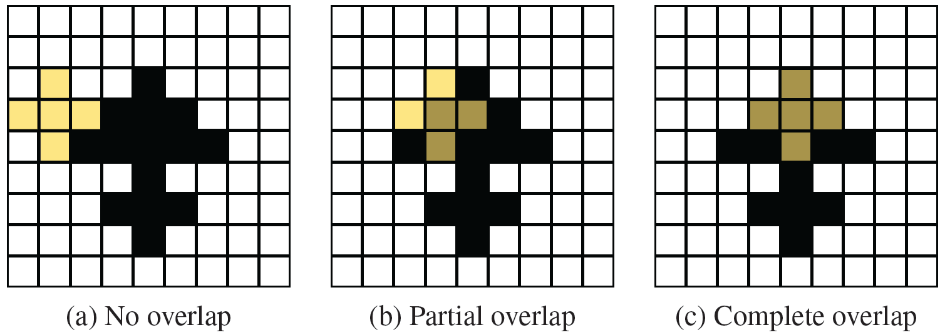
Structuring element

Slide 19
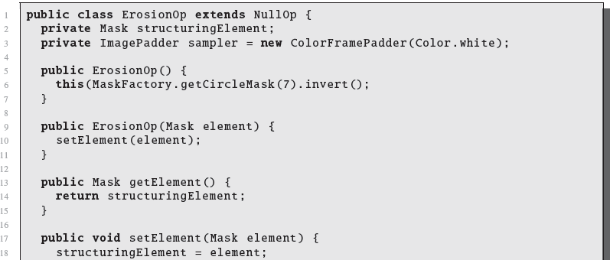
Implementation

Slide 20
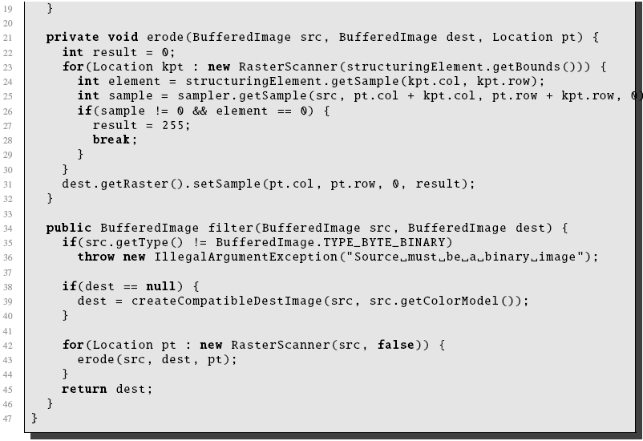
Implementation

Slide 21
Opening and Closing
Opening and closing are operations that are based on dilation and ersion.
Opening will divide components that have narrow connections.
Closing will join two components that are in close proximity.
Opening image A by structuring element B is the erosion of A with B followed by the dilation of A with B.
Closing image A by structuring element B is the dilation of A with B followed by the erosion of A with B.

Slide 22
Opening and Closing

Slide 23
Segmentation
Partitioning an image into regions such that each region is a component.
Typically done on color images (rather than binary)
Need to expand the notion of ‘similar color’
Two pixels are 4-connected if they are 4-adjacent and of sufficiently similar color.
Segmentation is a difficult and active area of research.

Slide 24
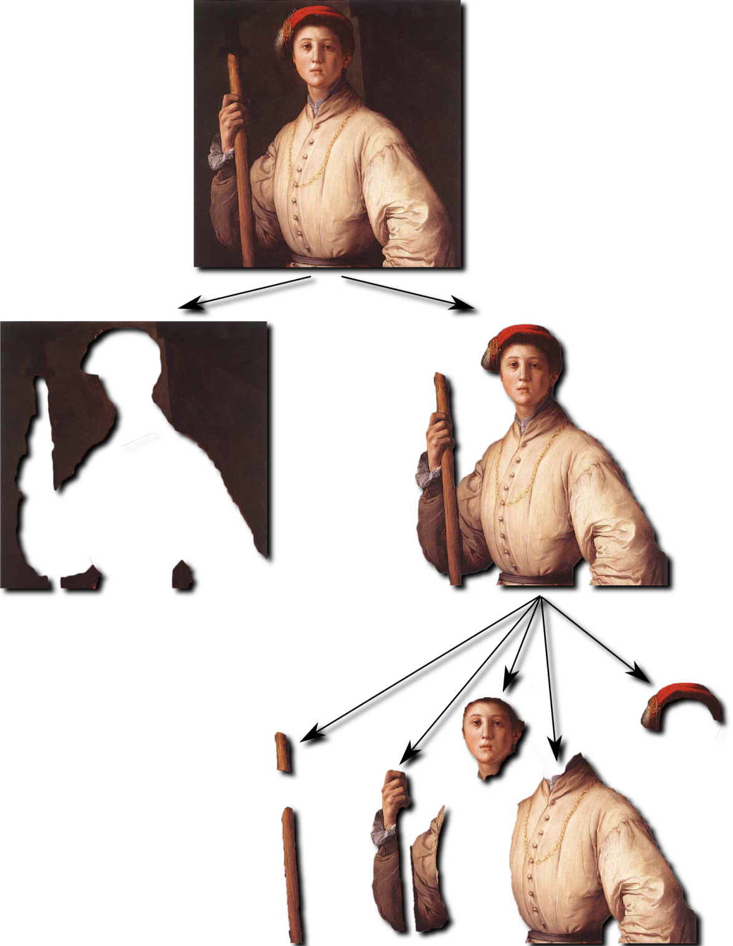
Example

