Slide 1
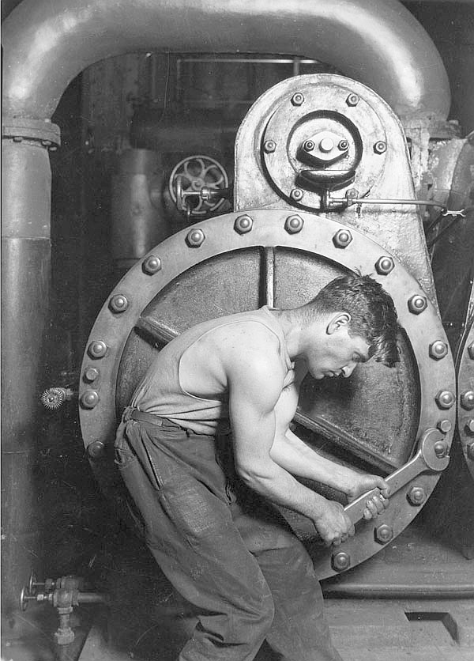
Compression
Smash the information to bits

Slide 2
Overview
The primary goal of image compression is to minimize the memory footprint of image data so that storage and transmission times are minimized.
Storage capacity can be limited, as is the case with digital cameras
Storage can be costly, as is the case when creating large warehouses of image data.
Transmission of image data is also a central concern in many image processing systems. Recent studies of web use, for example, have estimated that images and video account for approximately 85% of all Internet traffic. Reducing the memory footprint of image data will correspondingly reduce Internet bandwidth consumption.
More importantly, however, since most web documents contain image data it is vital that the image data be transferred over the network within a reasonable time frame.

Slide 3
Overview
Image compression works by identifying and eliminating redundant, or duplicated, data from a source image.
There are three main sources of redundancy in image compression.
Interpixel redundancy: pixels that are in close proximity within an image are generally related to each other.
Psycho-visual redundancy: Since the human visual system does not perceive all visible information with equal sensitivity we understand that some visual information is less important than others. Image compression systems may simply eliminate information that is deemed to be unimportant in terms of human perception.
Coding redundancy: If image samples are stored in such a way that more bits are required than necessary, then there is redundancy in the encoding scheme.

Slide 4
Overview
An image encoder compresses image data. An image decoder decompresses image data.
An image encoder generally consists of three primary components, each of which seeks to address one of the three source of redundancy.
The mapper transforms an image into a form, or representation, such that interpixel redundancy is either eliminated or reduced. Some compression techniques convert spatial domain information into the frequency domain, for example, and this transformation is considered to be part of the mapper.
The quantizer changes the information produced by the mapper into a discrete set of values and may even truncate data such that some information is lost in the process. The quantizer typically eliminates or reduces psycho-visual redundancy.
Symbol encoding is then performed on the resulting data stream in order to reduce coding redundancy..

Slide 5
Overview
Common compression formats (and their corresponding techniques) includes PNG, JPEG and GIF.
A compression technique can be characterized by
The computational complexity of the encoder
The computational complexity of the decoder
The compression ratio
The visual quality of the compressed image
Computational complexity will not be considered in this text. We will focus on the compression ratio and fidelity.

Slide 6
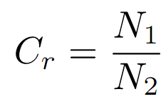
Compression Ratio
Compression ratio serves as the primary measure of a compression technique’s effectiveness. It is a measure of the number of bits that can be eliminated from an uncompressed representation of a source image.
Let N1 be the total number of bits required to store an uncompressed (raw) source image and let N2 be the total number of bits required to store the compressed data. The compression ratio Cr is then defined as the ratio of N1 to N2
Larger compression ratios indicate more effective compression
Smaller compression ratios indicate less effective compression
Compression ratios less than one indicate that the compressed representation is actually larger than the uncompressed representation.

Slide 7
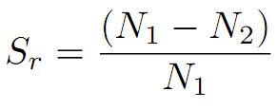
Savings Ratio
The savings ratio is related to the compression ratio and is a measure of the amount of redundancy between two representations.
The savings ratio is a percentage of how much data in the original image was eliminated to obtain the compressed image.
If, for example, a 5 Megabyte image is compressed into a 1 Megabyte image, the savings ratio is defined as (5-1)/5 or 4/5 or 80%.
This ratio indicates that 80% of the uncompressed data has been eliminated in the compressed encoding.
Higher ratios indicate more effective compression while negative ratios are possible and indicate that the compressed image exceeds the memory footprint of the original.

Slide 8
Fidelity
Root mean squared (RMS) error is a generally accepted way of measuring the quality of a compressed image as compared with the uncompressed original.
RMS error is a measure of the difference between two same-sized images and is not related to the memory footprint of an image.
Assume that a WxH image I having B bands is compressed into image I’. The root mean square error is then given by

Slide 9
Fidelity
The RMS error is a measure of the average sample error between two images.
This can be seen by recognizing that the total number of samples in the image, WxHxB, occurs in the denominator and that the numerator sums the squares of the errors between every pair of corresponding samples in the two images.
Since RMS is a measure of error
small RMS measures indicate high fidelity
Large RMS values indicate low fidelity

Slide 10
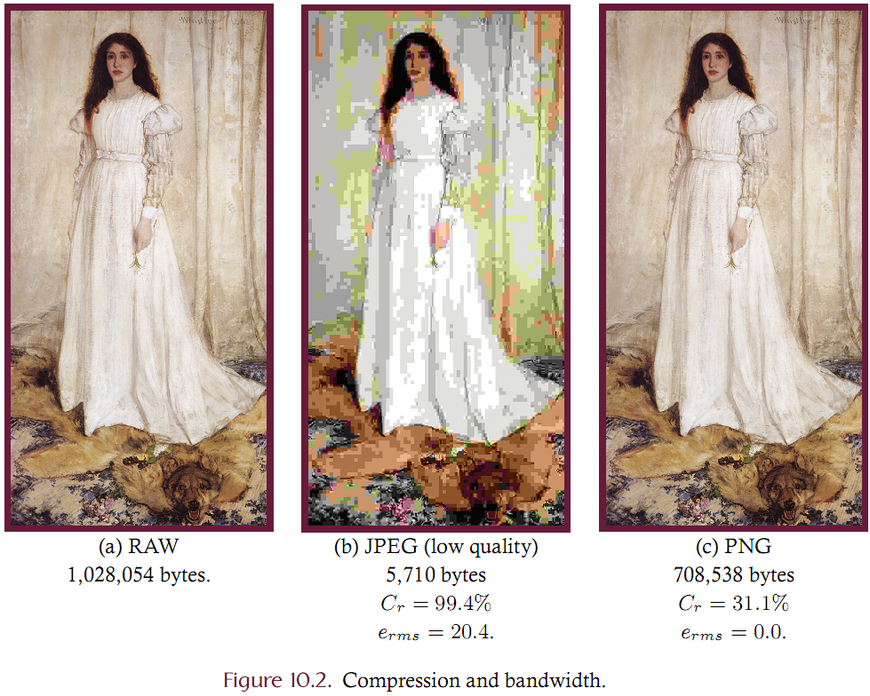

Slide 11
Lossy vs. Lossless
An image compression technique can be broadly classified as either lossy or lossless.
A lossless technique is one which always produces a compressed image with an RMS error of 0 relative to the source.
A lossy technique generates a compressed image that is not identical to the source. Lossy techniques are typically able to achieve greater compression ratios by sacrificing the quality of the result.
Figure 10.2 gives an illustration of the typical tradeoffs between compression ratio and fidelity.
In this example a 24-bit per pixel 513x668 image consumes 24x513x668 = 1,028, 054 bytes without any compression.
JPEG compression reduces the memory footprint to 6,923 bytes but significantly reduces the image quality while
PNG compression reduces the memory footprint to 708,538 bytes without any reduction in quality.
The JPEG technique achieved a compression ratio of 99.4% while the PNG approach delivered a 33.1% compression ratio. It should be noted that JPEG can be controlled so as to provide much higher quality results but with a corresponding loss of compression.

Slide 12
Run Length Coding
Run length encoding is a lossless encoding scheme in which a sequence of same-colored pixels is stored as a single value.
Consider a binary image in which each pixel is represented by a single bit that is either 0 (black) or 1 (white). One row of the image may contain the 32-pixel sequence:
11111111110001111111111111111111
This row contains three runs: 10 whites followed by 3 blacks followed by 19 whites.
This can be encoded by the three byte sequence {10, 3, 19} by assuming that the data begins with white runs.
The original representation consumes 32 bits of memory while the run length-encoded representation consumes 24 bits of memory if we assume that 8-bit bytes are used for each run.
What are the compression and the saving ratios?
Compression ratio of 4:3
Savings ratio of 25%.

Slide 13
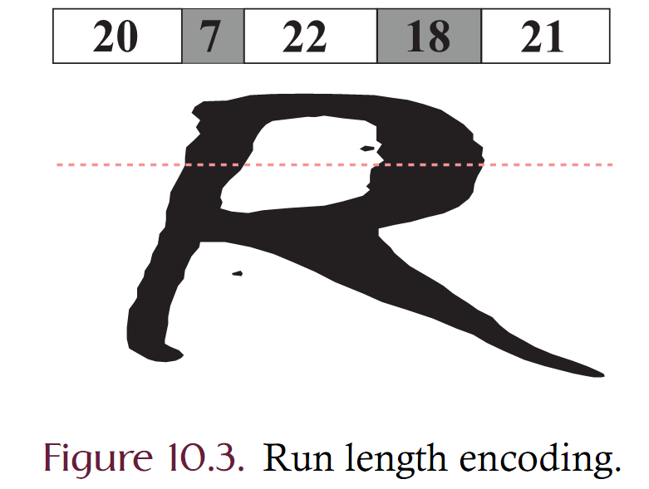

Slide 14
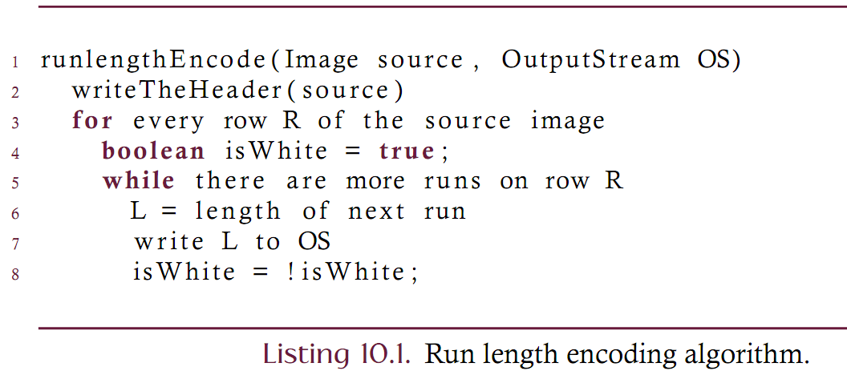
Run Length Encoding Implementation
Listing 10.1 gives an algorithm for run length encoding binary images. The encoder assumes that the first run encoded on each row is composed of white pixels.
Most monochrome images are of black foreground objects on white background and the first run will almost always be comprised of white pixels.
If the first pixel on any row is black, the length of the first white run is zero.
Most types of monochrome images (e.g., line drawings and scanned text), or palette-based iconic images are amenable to run length encoding while continuous tone images can not generally be effectively compressed with this technique.

Slide 15
RLE Implementation Issues
Consider using 8 bit integers for storing a single run
Each run is 8 bits.
Is it possible to represent runs over 255 long such that they can be decoded?
Can encode a single run length as a multi-byte sequence.
Reserve the value 255 to mean “this run is 255 pixels longer and the run is not over yet”
All other values B indicate that the run is B pixels longer and the run is over.
Can the following run length encoded row be decoded under this scheme?
{255, 255, 255,18, 32, 255,12, 65}
Under this encoding scheme, how is a run of length 255 encoded?

Slide 16
RLE Implementation Issues
Consider the problem of encoding a grayscale or color image.
For an 8-bit grayscale image there are more than two possible sample values
A run must be encoded as a two-element pair where the first element is the value of the run and the second is the length of the run.
When encoding a row profile containing the samples {100, 100, 103, 104, 110, 110, 110}, for example, the run length representation would be something like {(100,2), (103,1), (104,1), (110,3)}.
Since storage is required for the value of the run in addition to the length of the run, the effectiveness of run length encoding is reduced or negated.
Run length encoding of grayscale images is also problematic since it is extremely unlikely that a grayscale image contains runs of any significant length.

Slide 17
Run length encoding of Grayscales
Since run length encoding a binary image is generally effective we choose to view a grayscale image as a collection of binary images; each of which can be encoded using the technique of Listing 10.1.
Just as a single 24 bpp image can be split into three 8-bit grayscale images, an 8-bit grayscale sample can be split into eight 1-bit or binary bands.
All grayscale and color images can be decomposed into a set of binary images by viewing each sample as eight individual bits that form eight separate bands.

Slide 18
RLE and Bit Planes
Figure 10.4 illustrates how a 4-bit grayscale image can be decomposed into four separate monochrome images by bit plane slicing.
A1 bit is rendered as a white pixel while a 0 bit is rendered as black.
A 3x2 4-bit grayscale image is shown in part (b) where the samples are displayed in binary notation.
The least significant bit of each sample forms the 0th bit plane: P0
The most significant bit of each sample forms the 3rd bit plane: P3
The bit planes are shown as the four binary images of parts (b) through (e).

Slide 19
RLE and Bit Planes
Notes on bit planes
The 0th bit plane consists of the least significant bits of each sample. These bit planes contain little information and are sometimes considered to be ‘noise’.
The 7th bit plane consists of the most significant bits of each sample. These bits more accurately represent the structure of the grayscale source than the other planes.
The 7th bit plane of an 8 bit grayscale image is equivalent to thresholding the source against 128.

Slide 20
RLE and Bit Planes
Notes on representation:
Compression ratio improves if there are more long runs than short runs.
Consider two adjacent samples that have similar grayscale values of 127 and 128. In binary, these are given as 01111111 and 10000000. Each run on each bit plane is terminated by this small change in grayscale value.
Can usually lengthen runs by using gray coding rather than binary-coded-decimal encoding. Gray codes ensure that two adjacent values differ by a single binary bit.

Slide 21
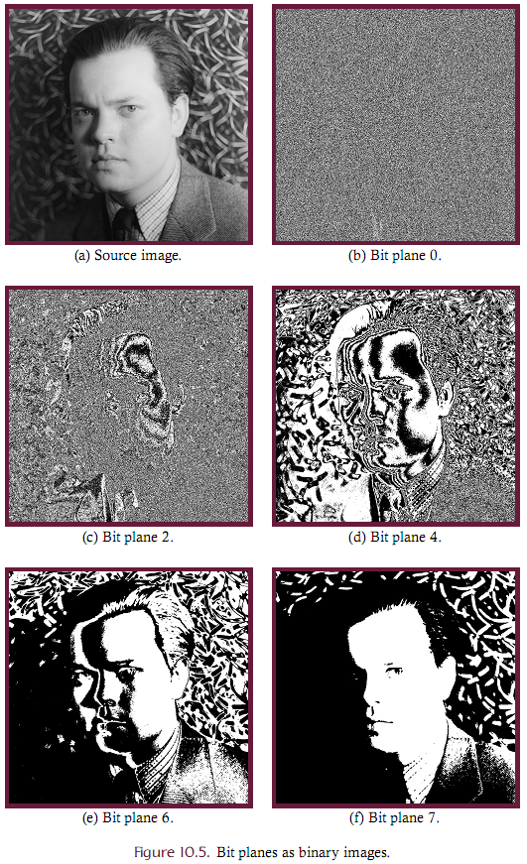
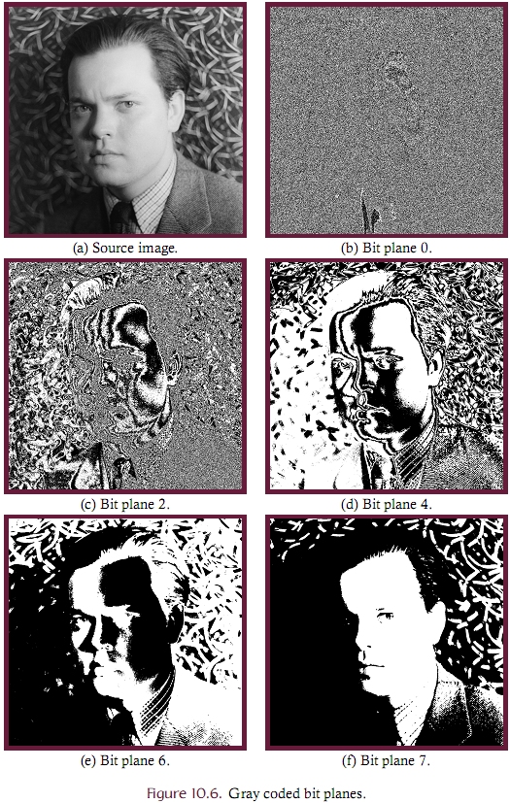

Slide 22
Implementation
All encoders/decoders must be a great deal of attention to low level issues involving good design and even bit-level representation.
Let’s design two abstract classes that serve to encode and decode an image.
This design will closely mirror the Java framework.

Slide 23
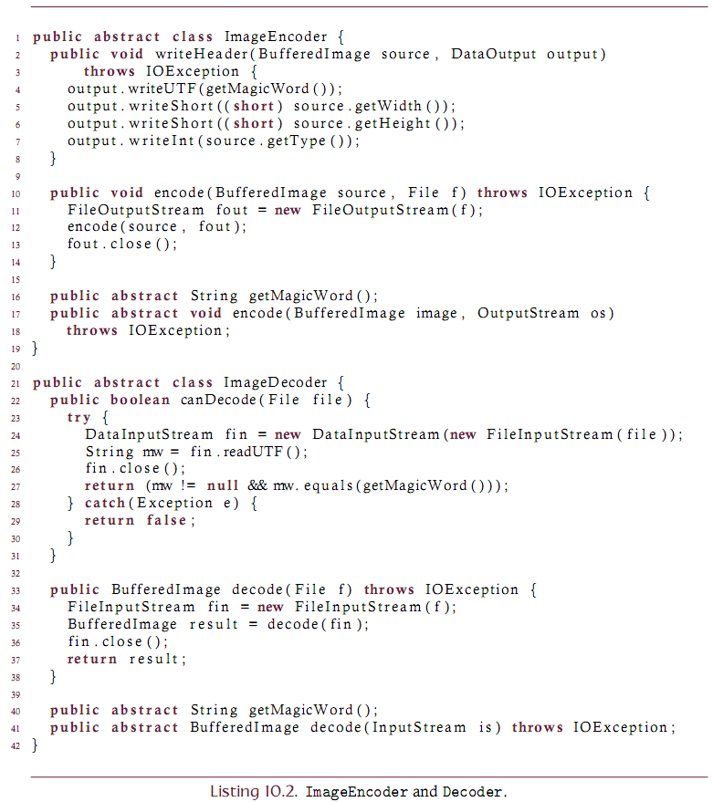

Slide 24
ImageEncoder Notes
The primary method is the abstract “encode” which takes an image and an output stream and write the image to the stream in some format.
Most encoders will first write a header. The header will usually contain
A magic word – a short byte sequence that serves to indicate the file format. The “getMagicWord” method obtains the magic word for particular encoder implementations.
Information about the encoded image. Perhaps the width, height, number of bands etc..
The “writeHeader” method saves this information in a simple format.

Slide 25
ImageDecoder Notes
The primary method is the abstract “decode” which takes an input stream and creates an image.
Most decoders will first read a header.
Read the magic word to ensure that they can decode the data. This is a fast process and is given by the “canDecode” method.

Slide 26
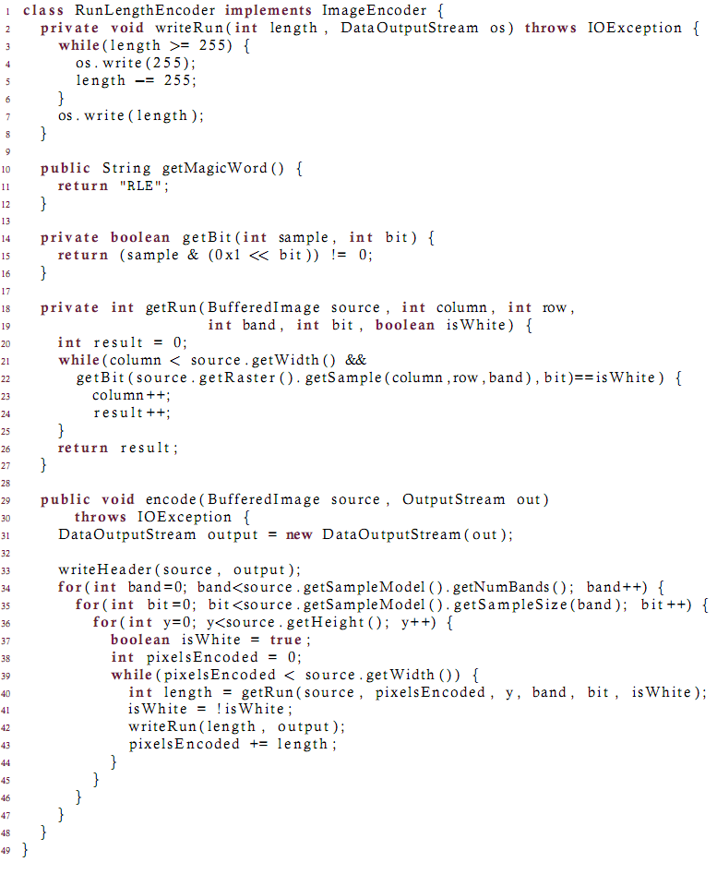

Slide 27
Hierarchical Coding
In run length encoding each datum represents a one-dimensional run of pixels. Constant area coding (CAC) is a two-dimensional extension where entire rectangular regions of pixels are stored as a single unit.
While run-length encoding is a lossless compression technique, constant area coding can be either lossy or lossless depending upon the specific implementation.
Consider encoding a WxH binary image using a CAC technique.
If the entire image is white we simply output white and are done with the encoding.
If the entire image is black we output black and are also done encoding.
If, however, the image is neither all white nor all black
The image is divided into four equally sized regions by splitting the image in half both vertically and horizontally
Each of these four regions is then recursively encoded following the same procedure.
The process recurses only for non-homogeneous regions and will always terminate since at some point the region will be no larger than a single pixel which will be either all white or all black.

Slide 28
Hierarchical Coding
The division of an image region into four equal-sized subregions is often represented through a region quadtree.
A region quadtree is a data structure that partitions two-dimensional rectangular regions into subregions as described in the preceding paragraph.
Each node of a quadtree contains either zero or four children and represents a rectangular region of two dimensional space.
Any node having no children is a leaf (or terminal) node
Any node having four children is an internal node.
Leaf nodes represent rectangular regions that are completely filled by a single color
Internal nodes represent regions containing variously colored quadrants as described by their four children.

Slide 29
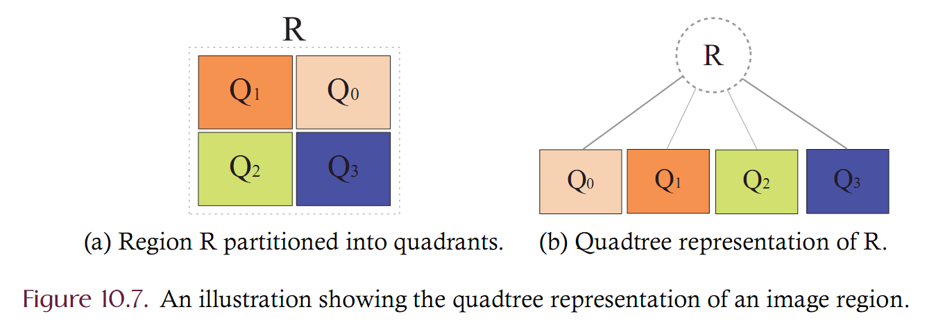
Quad Tree example

Slide 30
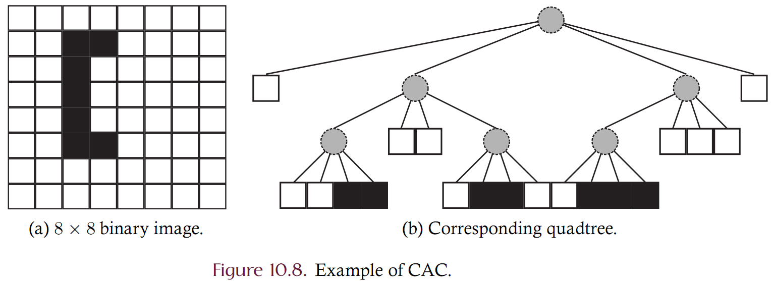
CAC Example

Slide 31
CAC Example
Consider encoding the quad tree from Figure 10.8
Must traverse each node and output some information
Use a pre-order traversal
Represent each node by a single bit:
0 denotes a region that contains at least 1 black pixel
1 denotes an all white region
This scheme generates: 0100110011010010010001111

Slide 32
CAC Implementation
When implementing a CAC encoder an image is first converted into its quadtree representation after which the tree is then serialized.
Our implementation will implicitly construct the quadtree through a sequence of recursive function calls and hence there is no need for an explicit tree data type.
Each function call represents a single tree node and the series of calls effectively traverses, in a pre-order fashion, the quadtree representation.
We will also use the MemoryCacheImageOutputStream which enables bit-level writing to some OutputStream. This is a standard class in the Java distribution.

Slide 33
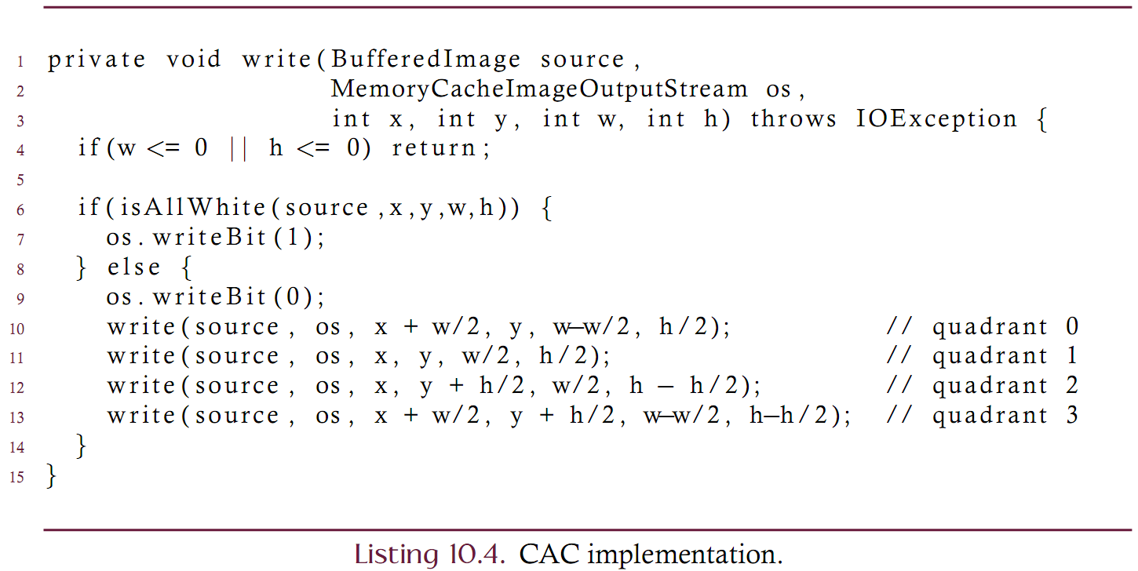
CAC Implementation

Slide 34
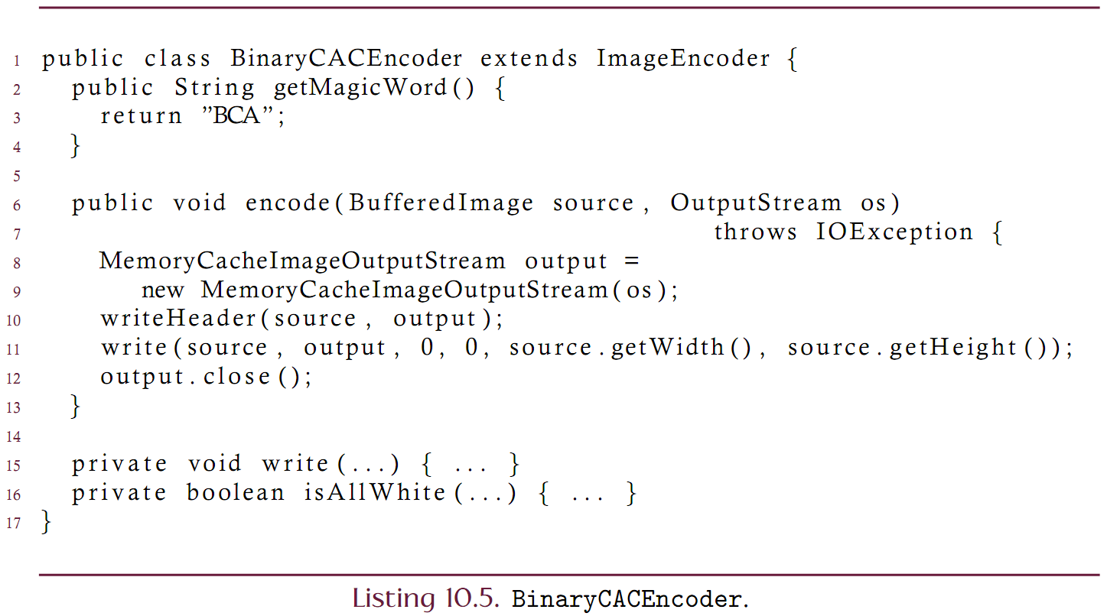
CAC Implementation

Slide 35
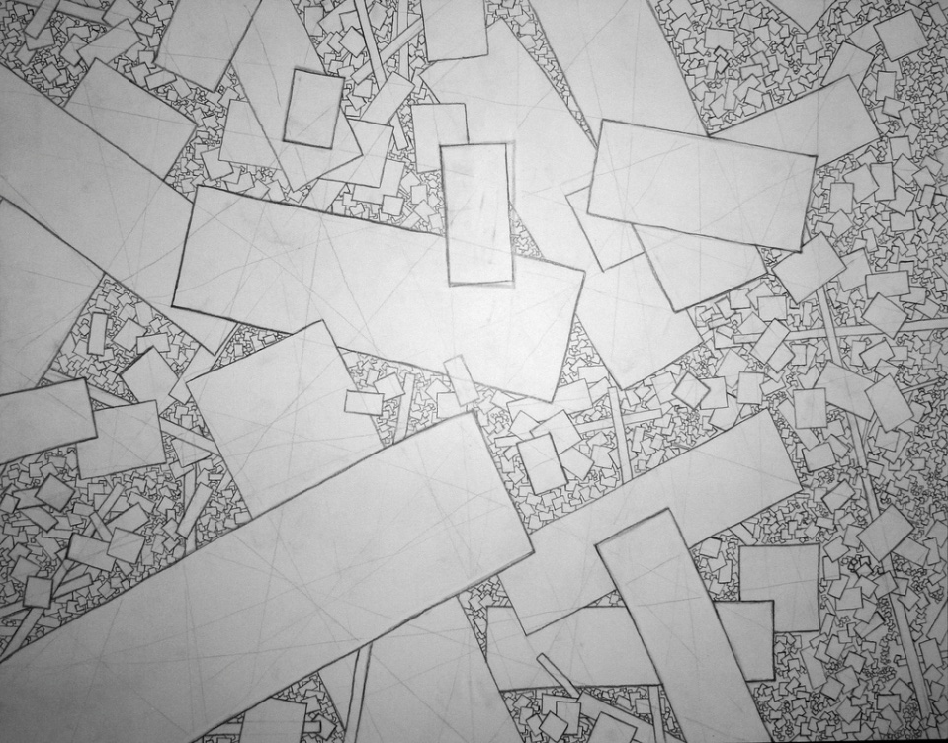
Hierarchical
Could CAC be used on
Gray-scale images?
Color photos?
What kind of images would CAC be most useful for?
Scanned Text (lots of white space)
Line/CAD drawings (lots of white space)
Image courtesy: http://www.flickr.com/photos/peterhess/2282904848/

Slide 36
Hierarchical(Revisited)
Can implement a lossy version of hierarchical coding to improve compression at the cost of image fidelity. Useful only for grayscale and color images.
Lossless:
If the region is all white, write a ‘1’ bit and done
Otherwise write a ‘0’ bit and then
The block is divided into 4 quadrants
Encode each quadrant [recursion will terminate if the region becomes 1x1]
Lossy:
If region samples are sufficiently similar, write the average sample value and done
Otherwise write a ‘0’ byte and then
The block is divided into 4 quadrants
Encode each quadrant [recursion will terminate if the region becomes 1x1]

Slide 37
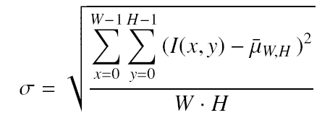
Lossy Hierarchical encoding
A regions ‘color’ is reduced to a single value which is the average of the original source samples.
Sufficiently similar usually means ‘the standard deviation is small enough”
Set a threshold and if the standard deviation falls below the threshold, the samples in the region are sufficiently similar.
The threshold becomes a ‘quality’ setting
higher thresholds correspond to lower quality
lower thresholds correspond to higher quality

Slide 38
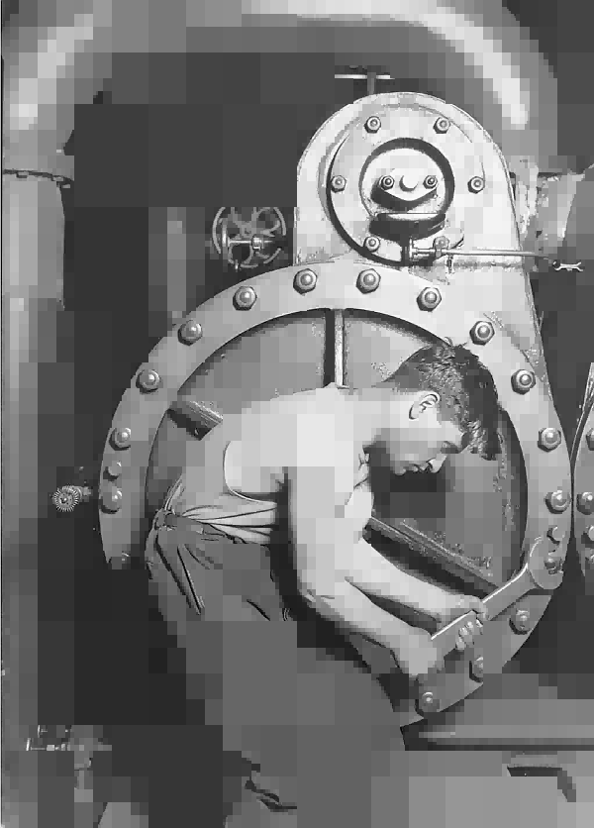
Compression Example
Source
threshold = 10
threshold = 20

Slide 39
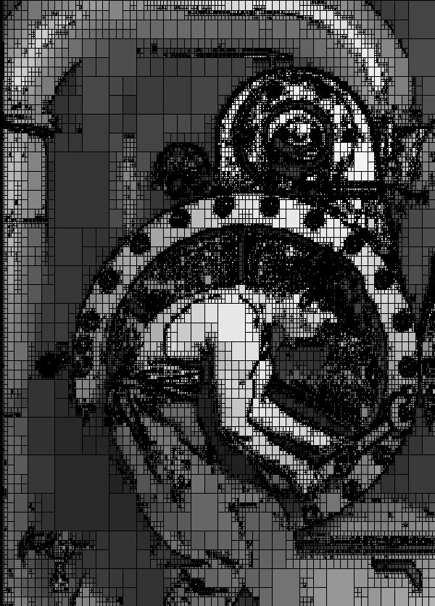
Compression Example

Slide 40
Numeric Example
Use a standard deviation threshold of 5.0.

Slide 41
Predictive Coding
Addresses interpixel redundancy
Neighboring samples are usually similar
Predicts the Nth sample of a scan by examining the previous K samples
Encodes the difference between the predicted value and the actual value

Slide 42
Lossless Predictive Coding
In the simplest case, the predicted value is the last value seen
Given a stream of N samples:
S0, S1, S2, …, Sn-1, Sn
Predict that the first sample S0 is 128
Predict that the Sk sample is Sk-1.

Slide 43
Lossless Predictive Encoding
Consider encoding the error (or difference) stream.
The error may range between -255 and 255
The bit depth has increased from 8 to 9 bits! An ‘un’ compression!
The key benefit is the distribution of data in the error stream

Slide 44
Lossy Predictive Coding
Reduce the accuracy of the saved image for increased compression
One of the simplest lossy predictive coding schemes is known as Delta Modulation. Record the approximate error between the predicted and actual samples values.
For a sequence of samples S that are indexed by k to generate an approximate sequence of samples S’ by using a fixed delta value, the approximate error is given by

Slide 45
Delta Modulation Example

Slide 46
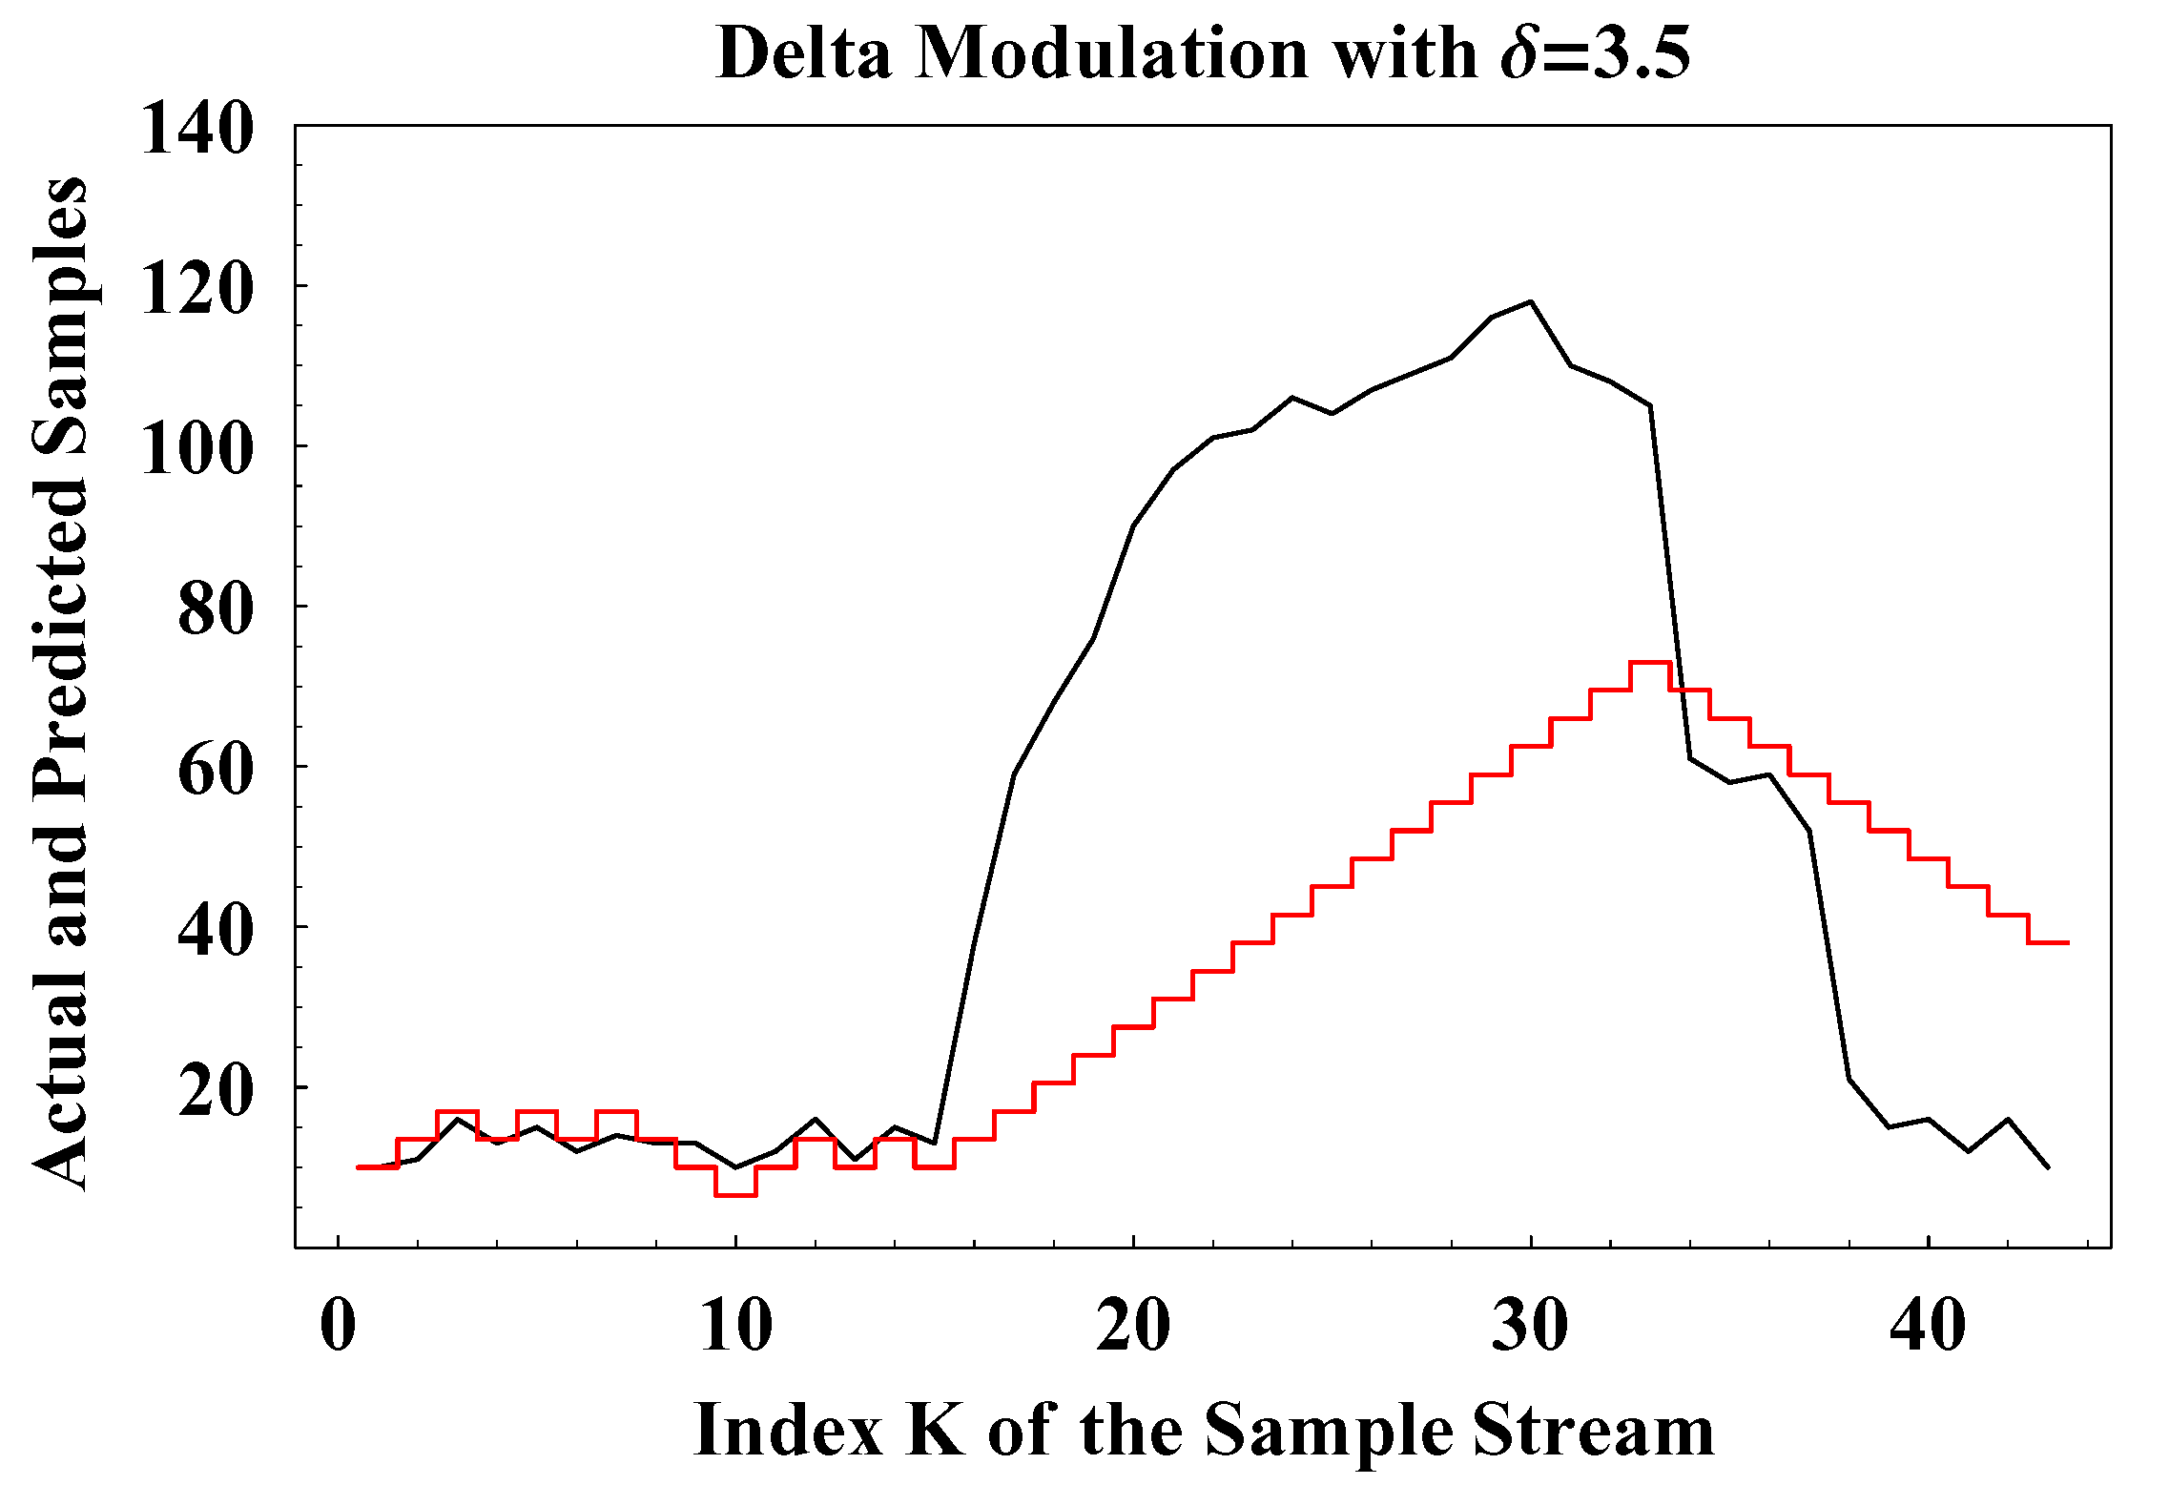
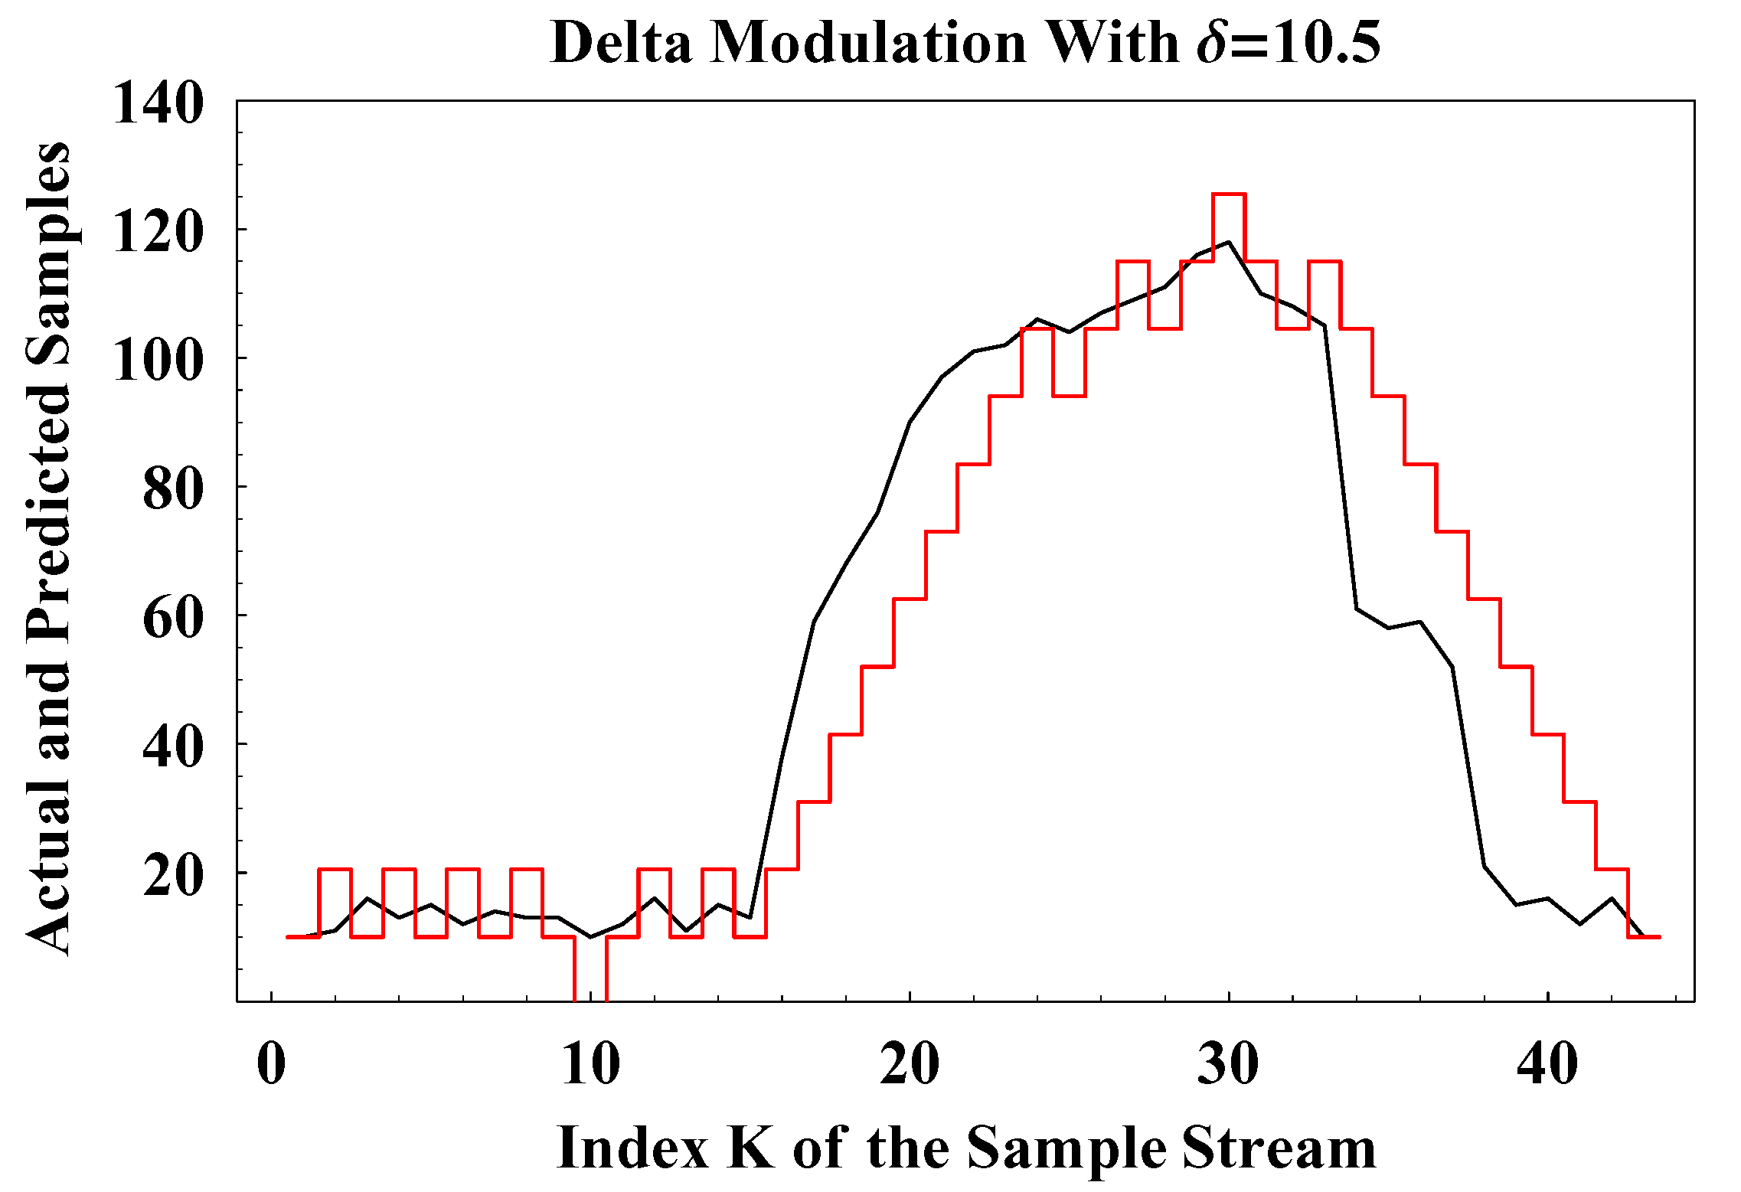
Effect of delta value

Slide 47
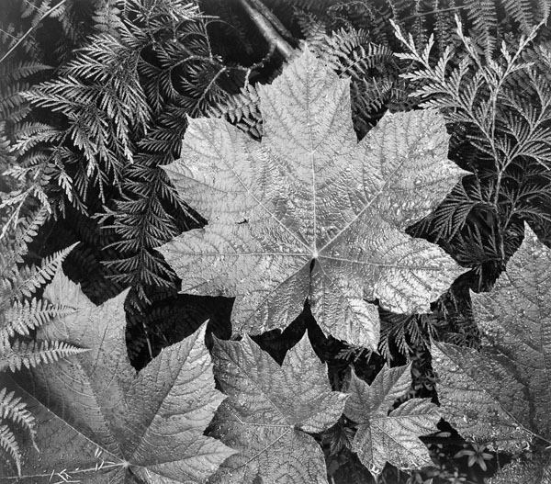
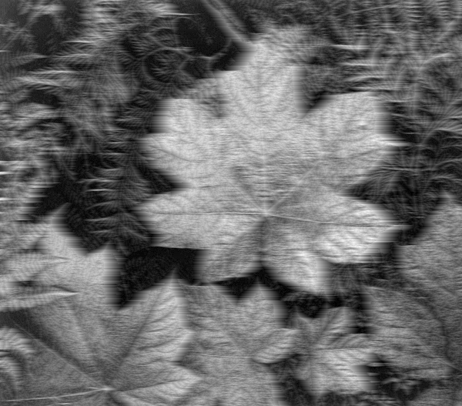
Delta Modulation Example

Slide 48
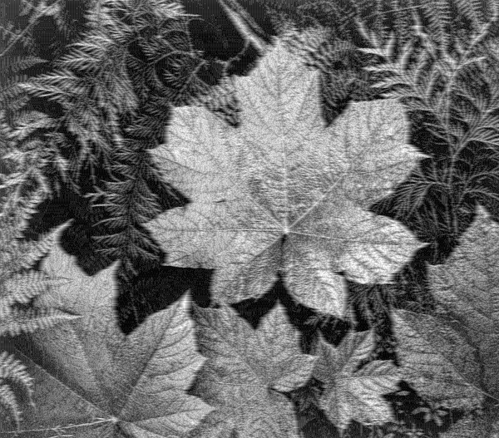
Delta Modulation Example

Slide 49
JPEG case study
JPEG is a file format developed by the Joint Photographic Experts Group.
JPEG is a broad standard
Supports both lossy and lossless compression
The most common implementation is JFIF. Most often people mean JFIF when the use the term JPEG.
JFIF is based on the DCT coefficients of an image
This presentation will describe JFIF
JPEG 2000 is a newer standard based on wavelets

Slide 50
JPEG/JFIF overview

Slide 51
JPEG/JFIF overview
Convert to YCbCr color space and subsample in chroma
Tile into 8x8 blocks, offset by -128 and take the DCT
Quantize the coefficients. Divide by small numbers in the upper-left of each tile and large numbers in the lower-right.
Encode the resulting quantized coefficients losslessly
Delta coding of DC components
RLE for the AC components
Huffman compress each band independently with (possibly different) huffman tables
The only ‘lossy’ portion of this process is sub-sampling and quantization.

Slide 52
JPEG example (quality increases to the right)

Slide 53
Definitions
Steganography
“the art of concealing the existence of information within seemingly innocuous carriers”
“an encrypted message may draw suspicion while a hidden message will not”
Neil Johnson
Image Processing and Steganography
“the art of concealing the existence of information within seemingly innocuous digital images”

Slide 54
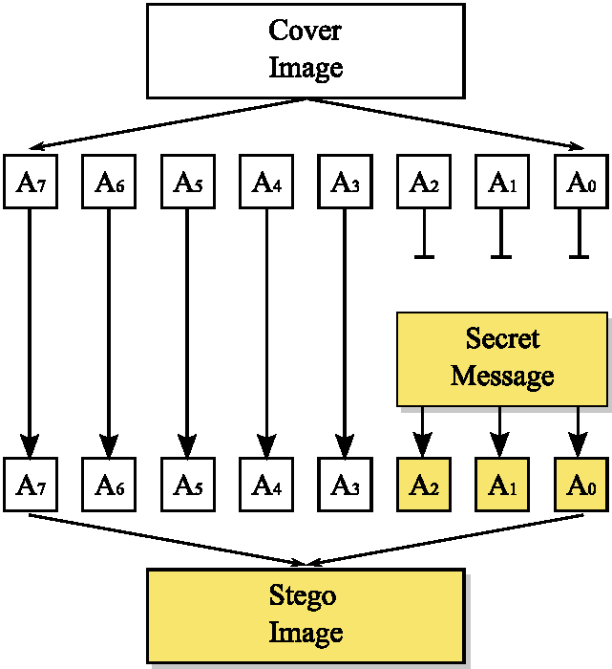
The Big Idea (LSB embedding)
An image contains more information than can be perceived.
Replace the “imperceptible bits” of a cover image with the bits of a “secret message”.
The Challenge:
Write Java code to LSB embed a secret message in an image. The secret message can be “any object”.

Slide 55
Java Framework
Design a set of classes to perform LSB embedding
Isolate the task of embedding/extracting
<<interface>> Steganographer
+embed(cover:BufferedImage, msg:Object):BufferedImage +extract(stego:BufferedImage):Object
LSBSteganographer
+embed(cover:BufferedImage, msg:Object):BufferedImage +extract(stego:BufferedImage):Object +getChannelCapacity():int +setChannelCapacity(channels:int)

Slide 56
Steganography
algorithm embedData(Image image, int[] DATA)
Input: A gray-scale image and array of integer-valued data (text or image or whatever)
Output: A gray-scale image with DATA contained in the least significant bit plane
// NOTE that the DATA probably has some HEADER information
// Actual implementation would not have the interface designed this way
for every pixel P_{k} in the image
replace the LSB of pixel P_{k} with the Kth bit of DATA

Slide 57
Numeric Example
Consider the following image (shown in decimal and binary notation)
Embed the text “HI”
Two one-byte characters which in ASCII are 72 (H) and 73 (I)
These number in binary are {01001000,01001001}.

Slide 58
Numeric Example
Before and after embedding {01001000,01001001}.
Consider
How many bits have actually been changed?
Are these changes perceptible changes?

Slide 59
Class design
Isolate the task of writing/reading bits.
The key is to integrate into Java’s existing IO framework
ImageOutputStream extends OutputStream
+ImageOutputStream(destination:BufferedImage, numChannels:int) +hasMoreBits():boolean +writeBit(int b) +writeByte(int b) +write(int b)
ImageInputStream extends InputStream
+ImageInputStream(source:BufferedImage, numChannels:int) +hasMoreBits():boolean +getNextBit():int +getNextByte():int +read():int

Slide 60
Implement the ImageOutputStream
Similar to scanner but is an output stream
class ImageOutpuStream extends OutputStream {
private BufferedImage buffer;
private int row, col, band, channel, numChannels;
// The least significant bit of b is written to the buffer
public void writeBit(int b) throws IOException {
if(!hasMoreBits()) throw new IOException(“Out of capacity”);
int newPixel = buffer.getRaster().getSample(col,row,band);
newPixel = setBit(newPixel, b, channel);
buffer.getRaster().setSample(col,row,band,newPixel);
advanceIndices();
}
}
}
The writeByte and write methods are then built on the writeBit.

Slide 61
Embedding
Now that we can write data to an image, we must use that to embed data.
Humor me. Assume that we are only writing an image within an image.
class LSBSteganographer implements Steganographer {
private int numberOfChannels;
public Image embed(BufferedImage cover, Object message) {
Image result = cover.copy();
int k = getNumberOfChannels();
OutputStream rOut = new ImageOutputStream(result, k);
writeHeaderInformation(message, rout);
for every pixel P in message
rOut.writeByte(P);
return result;
}
}

Slide 62
Embedding
We already know how to write an image to an output stream. Use the ImageIO class!
class LSBSteganographer implements Steganographer {
private int numberOfChannels;
public Image embed(BufferedImage cover, Object message) {
Image result = cover.copy();
int k = getNumberOfChannels();
OutputStream rOut = new ImageOutputStream(result, k);
ImageIO.write((BufferedImage)message, “PNG”, rOut);
return result;
}
}
What if the message is not an image? Can we embed it in the cover?

Slide 63
Embedding
Assume that the message is not an image. Can we embed it?
class LSBSteganographer implements Steganographer {
private int numberOfChannels;
public Image embed(BufferedImage cover, Object message) {
Image result = cover.copy();
int k = getNumberOfChannels();
OutputStream rOut = new ImageOutputStream(result, k);
DataOutputStream fout = new DataOutputStream(rOut);
fout.writeObject(message);
return result;
}
}
The DataOutputStream will encode any Serializable object. Unfortunately, BufferedImage is not Serializable.

Slide 64
Embedding
Assume that the message is not an image. Can we embed it?
class LSBSteganographer implements Steganographer {
private int numberOfChannels;
public Image embed(BufferedImage cover, Object message) {
Image result = cover.copy();
int k = getNumberOfChannels();
OutputStream rOut = new ImageOutputStream(result, k);
if(message instanceof Serializable) {
DataOutputStream fout = new DataOutputStream(rOut);
fout.writeObject(message);
} else if(message instanceof BufferedImage) {
ImageIO.write(message, “PNG”, rout);
} else throw new IllegalArgumentException();
return result;
}
}
Will now encode anything if it is either Serializable or an image.

Slide 65
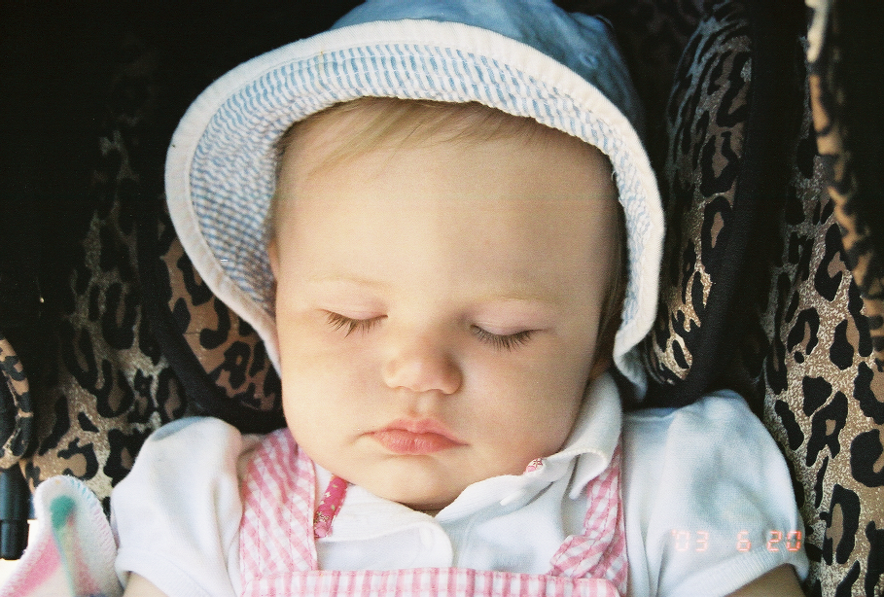
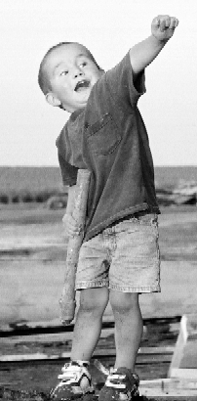
Example of Multiple Embeddings
Children's children are a crown to the aged,
and parents are the pride of their children.
Author: Solomon, King of Israel as recorded in the book of Proverbs chapter 17 verse 6.

Slide 66
Other embedding techniques and uses
Embedding data can be done in the frequency domain.
Consider JPEG encoding – based on the DCT coefficients.
Manipulation of the DCT coefficients would
Spread the embedded data across the entire image (or block).
Would be difficult to detect and difficult to thwart
Could embed ‘patterns’ that are detectible but hard to identify and hence erase
Could be used for copyright protection
Identify and protect copyrighted work
Techniques could apply to audio, video, and image data

