Slide 1
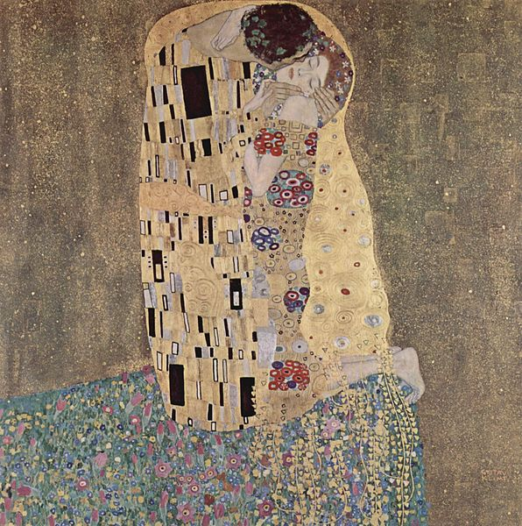
The Fourier Domain
A complex study of complexity

Slide 2
Fourier Domain
Expresses an image as the sum of weighted sinusoids
Wavelengths are determined by image dimensions
Amplitudes are determined by sample values
Fourier coefficients are complex rather than real values
Given a one-dimensional sequence f of N samples, the one dimensional discrete Fourier transform is given as
N is the length of a row and hence u is in [0, N-1]

Slide 3
Complex complexities
The symbol j denotes the imaginary unit
j satisfies the relation j² = 1
Usually written more compactly by using Euler’s formula

Slide 4
Forward and Inverse

Slide 5
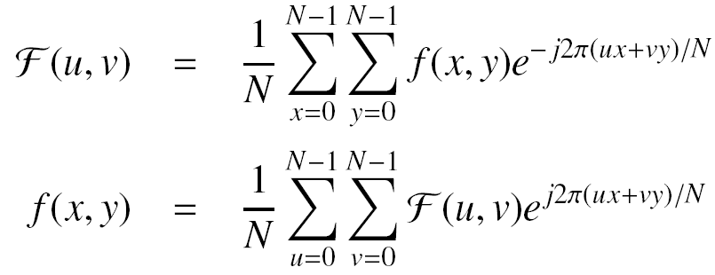
2D DFT

Slide 6
2D DFT
Each DFT coefficient is a complex value
There is a single DFT coefficient for each spatial sample
A complex value is expressed by two real values in either Cartesian or polar coordinate space.
Cartesian: R(u,v) is the real and I(u, v) the imaginary component
Polar: |F(u,v)| is the magnitude and phi(u,v) the phase

Slide 7
2D DFT
Representing the DFT coefficients as magnitude and phase is a more useful for processing and reasoning.
The magnitude is a measure of strength or length
The phase is a direction and lies in [-pi, +pi]
The magnitude and phase are easily obtained from the real and imaginary values

Slide 8
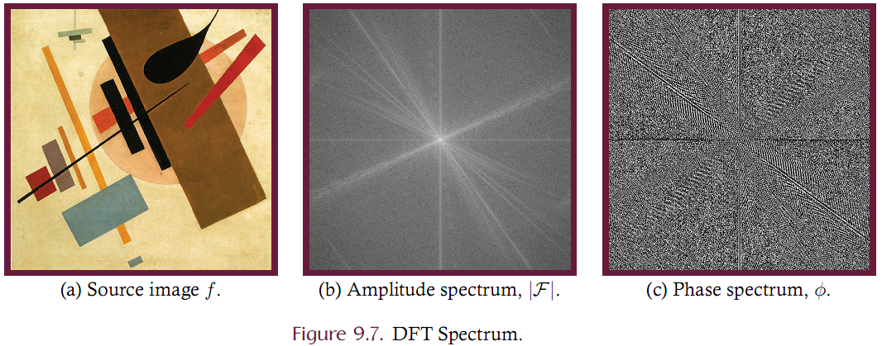
Magnitude Spectrum and Phase Spectrum

Slide 9
Magnitude Spectrum and Phase Spectrum
Notes on the magnitude spectrum:
Magnitudes are generally referred to as the “spectrum” but this should be understood as the magnitude spectrum.
Typically has an extremely large dynamic range and it is typical to log-compress those values for display (as in the previous slide)
For presentation, the DC component, F(0,0), is placed at the center. Low frequency components are shown near the center and frequency increases with distance from center.

Slide 10
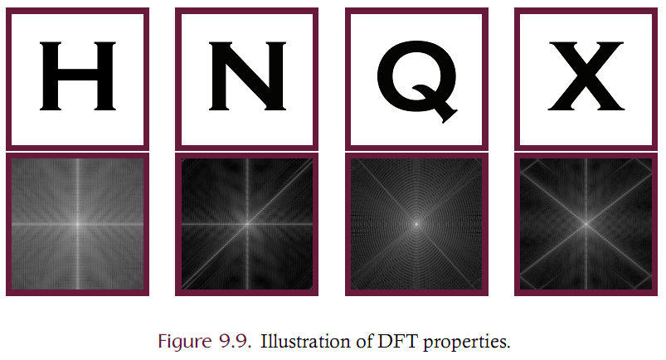
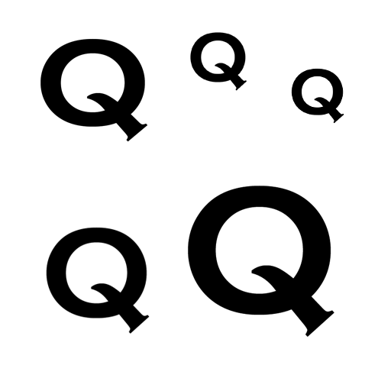
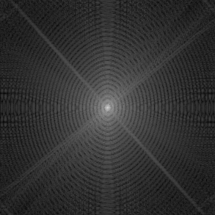
Magnitude Spectrum and Phase Spectrum
The magnitude spectrum contains information about the shape of objects. A strong edge in the source will generate a strong edge in the magnitude spectrum (rotated 90 degrees)
The phase spectrum contains information about their actual location in the source. An image of lots of ‘Q’s will have the same magnitude specta but not the same phase spectra.

Slide 11
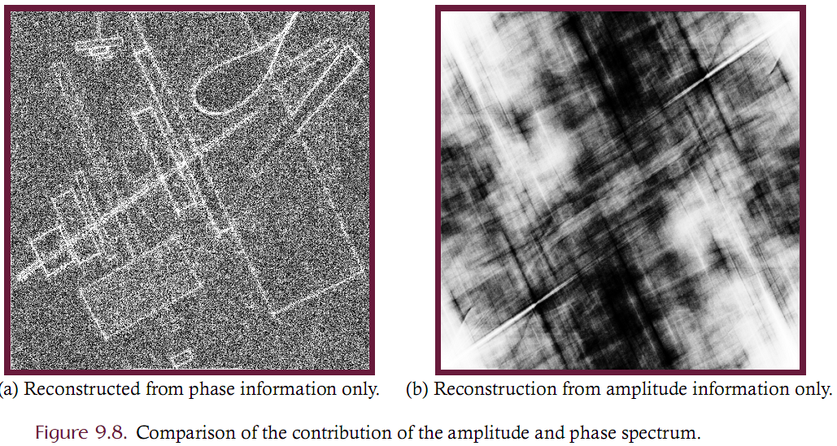
Magnitude Spectrum and Phase Spectrum

Slide 12
DFT Example
Given a row profile, compute the Fourier coefficients
Index | 0 | 1 | 2 | 3 | 4 | 5 | 6 | 7
Value | 20 | 12 | 18 | 56 | 83 | 10 | 104 | 114

Slide 13
Translation, Rotation, Distributivity
Translation of the source will cause the phase spectrum to change but leave the magnitude spectrum unchanged since the phase spectrum encodes location information while the magnitude spectrum encodes shape information.
Rotation of the source corresponds to an identical rotation of the magnitude and phase spectra.
Distributivity. The Fourier transform is distributive over addition (not multiplication):

Slide 14
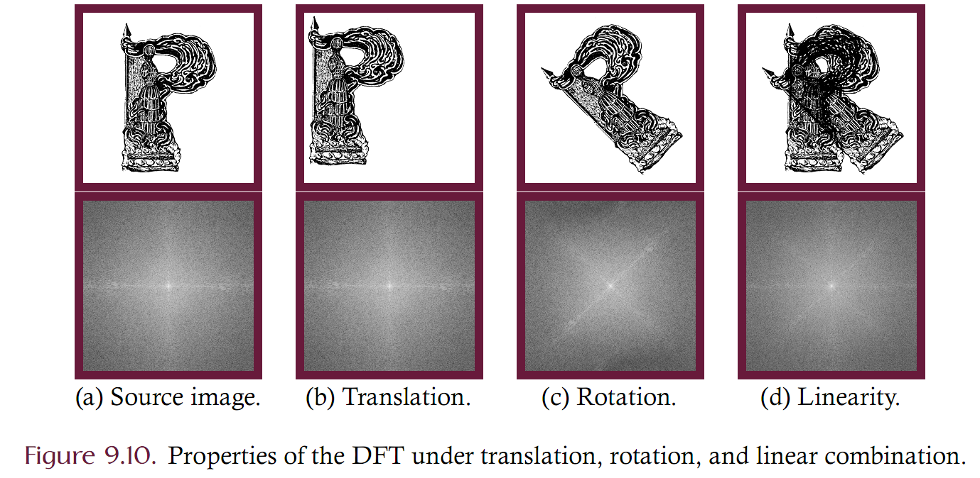
Translation, Rotation, Distributivity

Slide 15
Periodicity
The DFT is periodic
Sinusoids have infinite, repeating extent and so the DFT ‘image’ is infinite and repeated (tiled)
While this property of the DFT may initially seem to be of little consequence, it carries important implications.
Since the source image wraps around itself, the source image will appear to have edges where no edges actually exist.
For example, the left side of an image is bright and the right side is dark, there will be a false edge created when the image is tiled since the brightness of the left side is placed adjacent to the darkness of the right side.
These artiﬁcial edges will then be reflected in the amplitude spectrum and give a false characterization of the power spectrum of the source image.

Slide 16
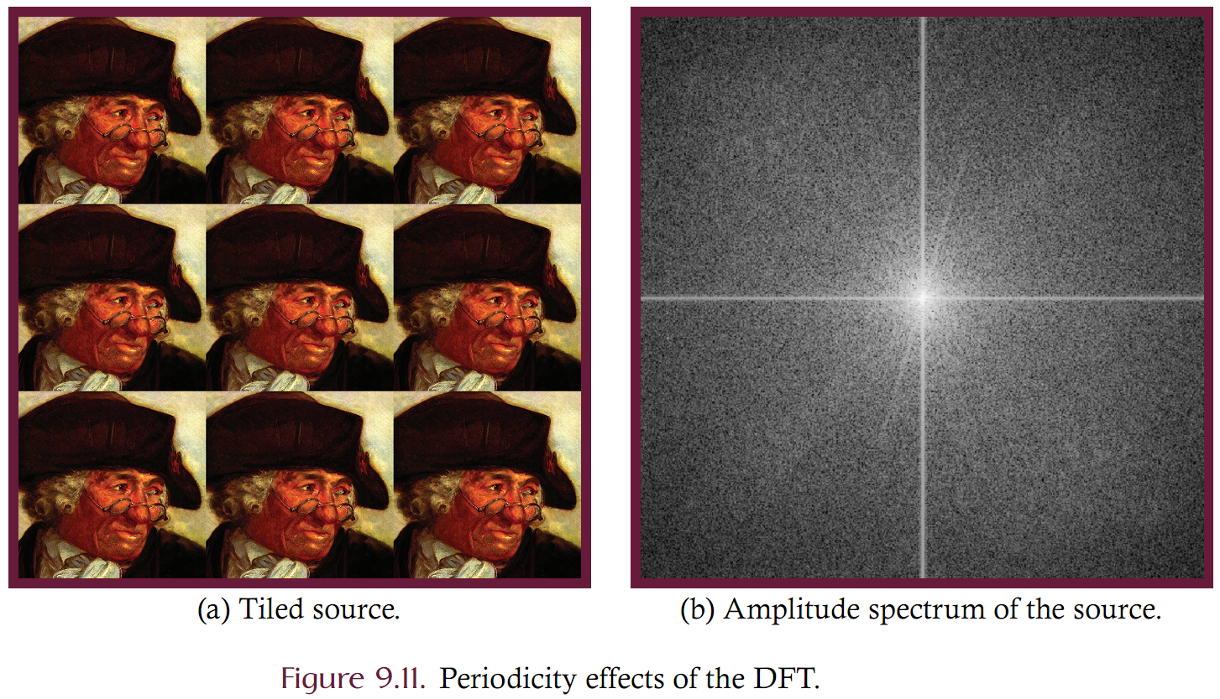
Example

Slide 17
Windowing
Windowing is a technique to minimize the artificial distortions injected into the spectrum of an image due to tiling discontinuities.
Windowing is an image processing filter that is applied prior to conversion into the Fourier domain and an inverse windowing filter must be applied when recovery of the source image is desired from the DFT coefficients.
Windowing forces continuity (or near continuity) at tile edges. Smoothly force the samples to be zero (or near zero) at the image edges by scaling image samples.

Slide 18
Windowing
Windowing is multiplication
Each sample is multiplied by a windowing function
Windowing function is parameterized on distance from center
Windowing function is unity at the center and falls to zero at image borders
Choose a windowing function
Bartlett
Hanning
Blackman
Hamming

Slide 19
Windowing Functions
The Bartlett window is a cone
Discontinuous at edges and center
Computationally simple
Hanning window
Continuous

Slide 20
Bartlett
Blackman window
Continuous
Steeper dropoff than Hanning
Hamming (not Hanning) window
Discontinuous at edges
Steeper dropoff than Hanning

Slide 21
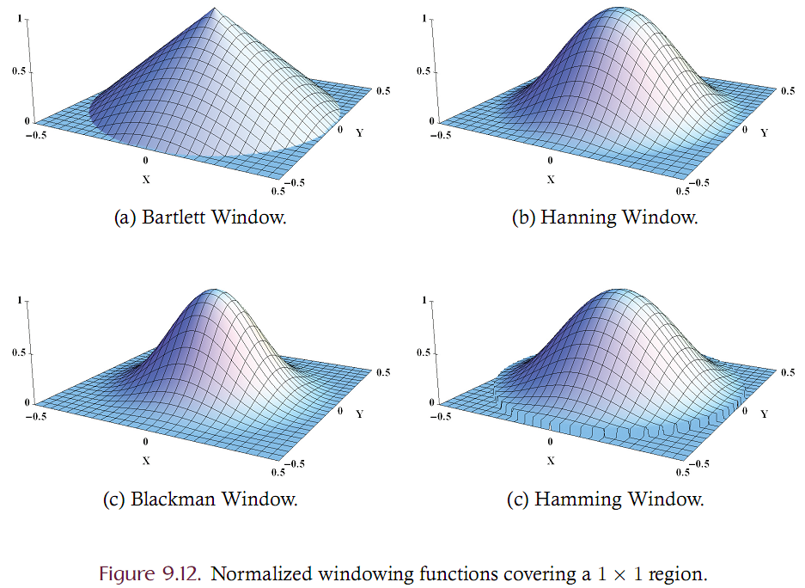
Common Windowing Functions

Slide 22
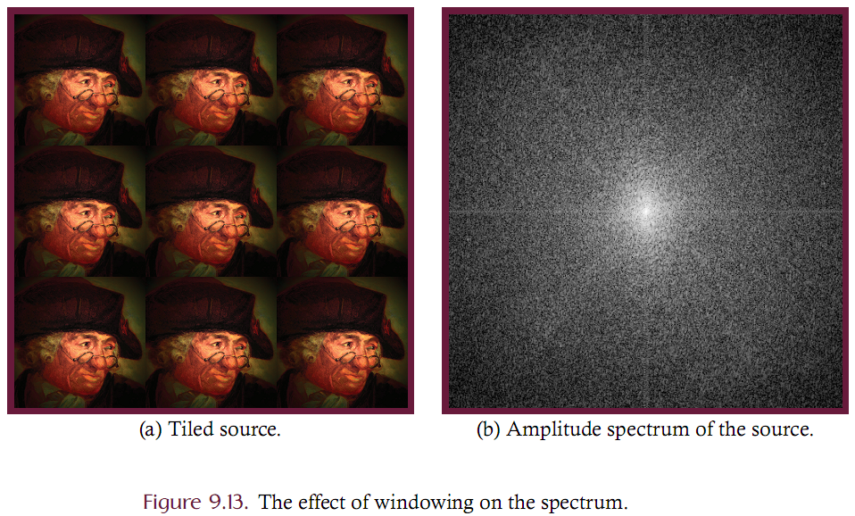
Effect of Windowing on Amplitude Spectrum

Slide 23
Frequency Domain Filtering
Images can be processed in either the spatial or frequency domain
Spatial domain filters have already been discussed
Frequency domain filters can achieve the same results by altering the DFT coefficients directly
Frequency domain filtering can be generalized as the multiplication of the spectrum F of an image by a transfer function H.

Slide 24
Frequency Domain Filtering
Recall that the DFT coefficients are complex-valued.
Multiplication of F with H will possibly change both the amplitude and phase spectrum
In practice, however, most frequency domain filters are zero-phase. This means that the phase spectrum is not changed; only the amplitude spectrum is changed.

Slide 25
Convolution
Convolution in the spatial domain corresponds to multiplication in the Fourier domain.
This has strong computational implications
Recall that convolution of an NxN image with MxM kernel is O(M²N²) in the spatial domain.
What is the performance in the Fourier domain?
O(N²)

Slide 26
Convolution
Convolution of an image f with kernel h can be performed using point-by-point multiplication
This may seem inefficient since the DFT must be computed twice (forward and inverse).
The brute-force technique is O(n^4)
The FFT technique (presented later) is O(NLogN)

Slide 27
Low Pass Filtering
Low pass filtering is convolution. It attenuates high frequency components of an image while leaving low frequency components intact.
Low pass filtering can be naturally accomplished in the frequency domain since the frequency components are explicitly isolated in the spectrum.
The DFT coefficients correspond to frequency components of the source and that their frequency increases with increasing distance from the center of the shifted spectrum.
Low pass filtering is then accomplished by zeroing the amplitude of the high frequency DFT coefficients. Determining which DFT coefficients should be zeroed amounts to determining how far the coefficients is from the center of the shifted spectrum.
Typically, a threshold radius is chosen such that all DFT coefficients outside of this threshold radius have their magnitude set to zero while all DFT coefficients falling inside of the threshold are unchanged (passed through).

Slide 28
Low Pass Filtering
Representing low pass filtering as multiplication of DFT coefficients, we must identify a transfer function (H) that corresponds to setting high-frequency components to zero.
An “ideal” low pass filter is given in 9.23 where rc is the cutoff frequency.
The term ideal as it is used of an ideal low pass filter should not be taken to mean that this filter is optimal for low pass filtering.
An ideal low pass filter is ideal in the sense that it has an exact cutoff above which all terms are exactly zero and below which all terms are set to unity.

Slide 29
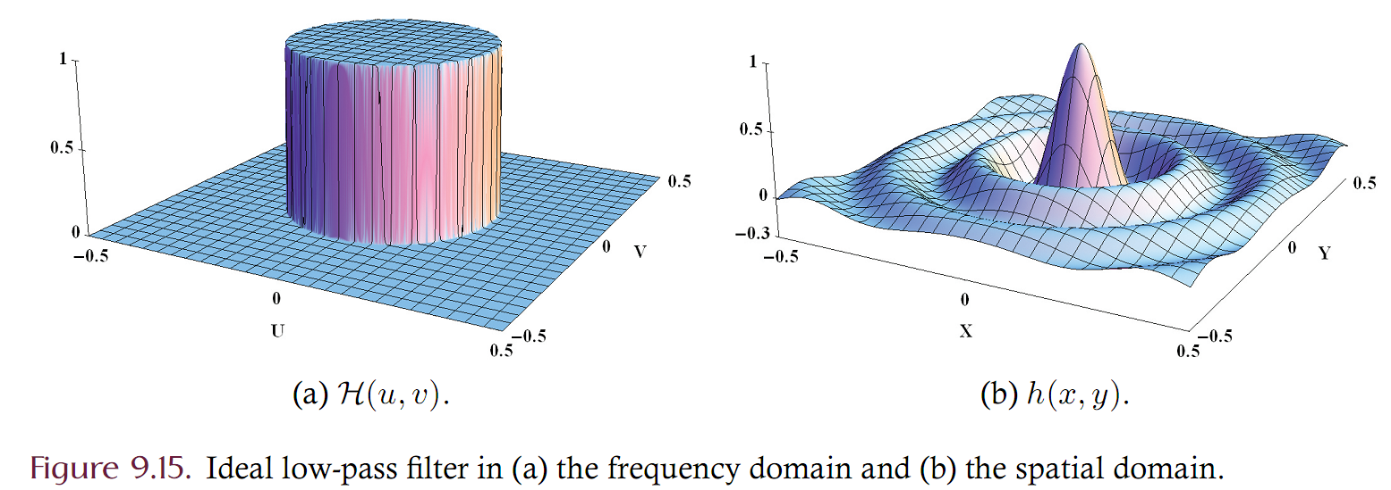
Ideal low pass filter

Slide 30
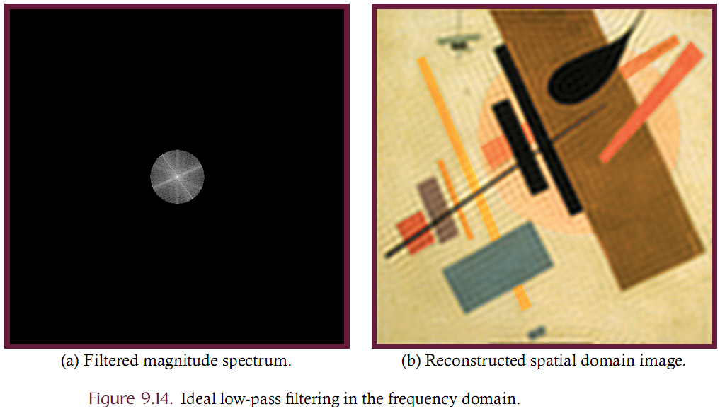
Ideal Low-Pass filtering example

Slide 31
Low Pass Filtering
Butterworth filter is a low-pass filter with smooth edges such that there is no (or minimal) ringing in the spatial domain
Parameterized on “order” – defines the sharpness of the filter
N is the order of the filter. Larger N represent stronger cutoffs
Rc is the cutoff frequency. Smaller Rc is stronger blur

Slide 32
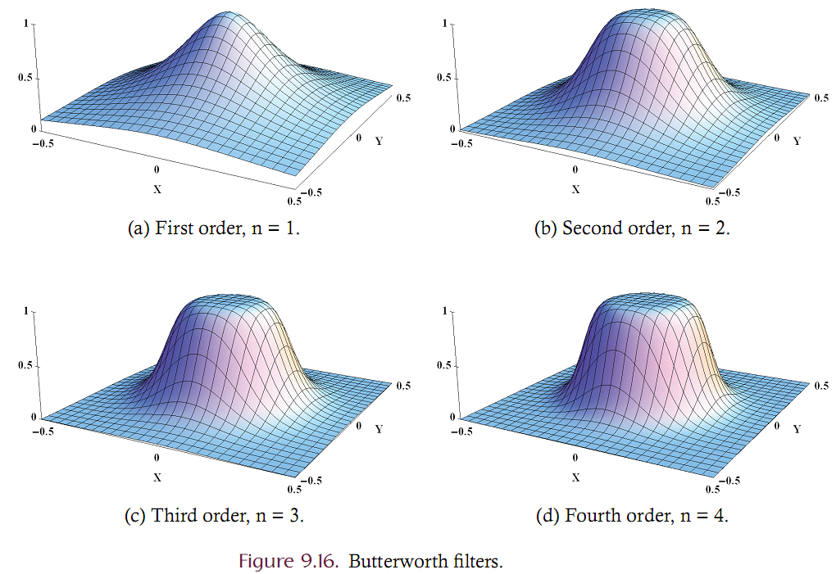
Butterworth Filters

Slide 33
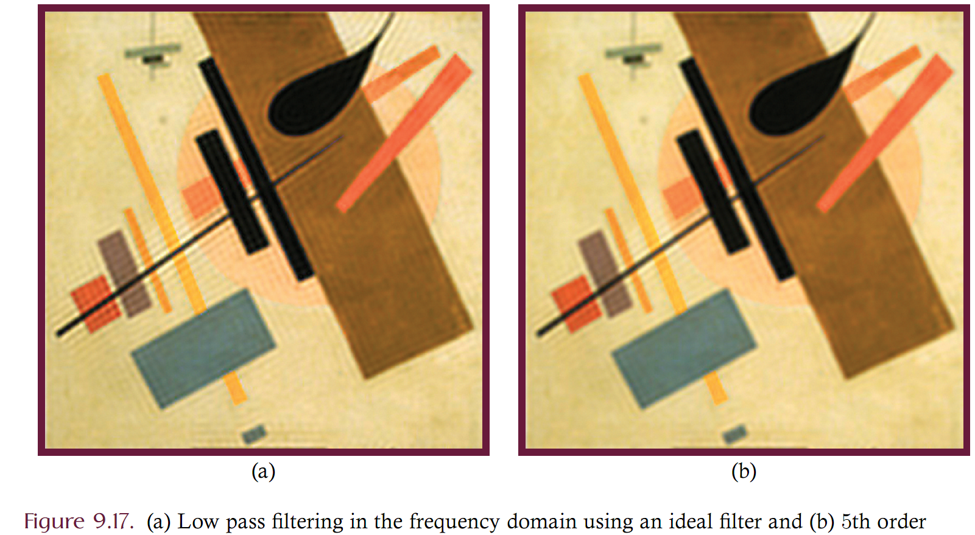
Ideal vs. Butterworth (5th order)

Slide 34
Gaussian low pass filter
Other well-known frequency domain low pass ﬁlters include the Chebyshev and the Gaussian transfer functions.
The Gaussian low pass ﬁlter has the very interesting property of having the same form in both the Fourier and spatial domains. In other words, the DFT of a Gaussian function is itself a Gaussian function.
A Gaussian low pass filter introduces no ringing when applied either in the spatial or frequency domains. The Gaussian transfer function is given as

Slide 35
High-pass and band-pass filtering
High pass attenuates low frequency components while leaving high frequency components intact.
The technique for performing high pass filtering is identical to that of low-pass filtering; however, the transfer functions are inverses to the low pass functions.

Slide 36
High Pass
Ideal – Butterworth - Gaussian

Slide 37
Band Filters
Low pass filtering is useful for reducing noise but may produce an image that is overly blurry.
High pass filtering is useful for sharpening edges but also accentuates image noise.
Band filtering seeks to retain the benefits of these techniques while reducing their undesirable properties.
Band filtering isolates the mid-range frequencies from both the low-range and high-range frequencies.
A band stop (or notch) filter attenuates mid-level frequencies while leaving the high and low frequencies unaltered.
A band pass filter is the inverse of a band stop; leaving the mid-level frequencies unaltered while attenuating the low and high frequencies in the image.
A band of frequencies may be specified by giving the center frequency and the width of the band. The band width determines the range of frequencies that are included in the band.

Slide 38
Band filters
A band stop filter is essentially a combination of a low and high pass filter, which implies that ideal, Butterworth, and Gaussian band stop filters can be defined.
Equation 9.29 is the Butterworth band pass while Equation 9.30 is the Butterworth band stop.

Slide 39
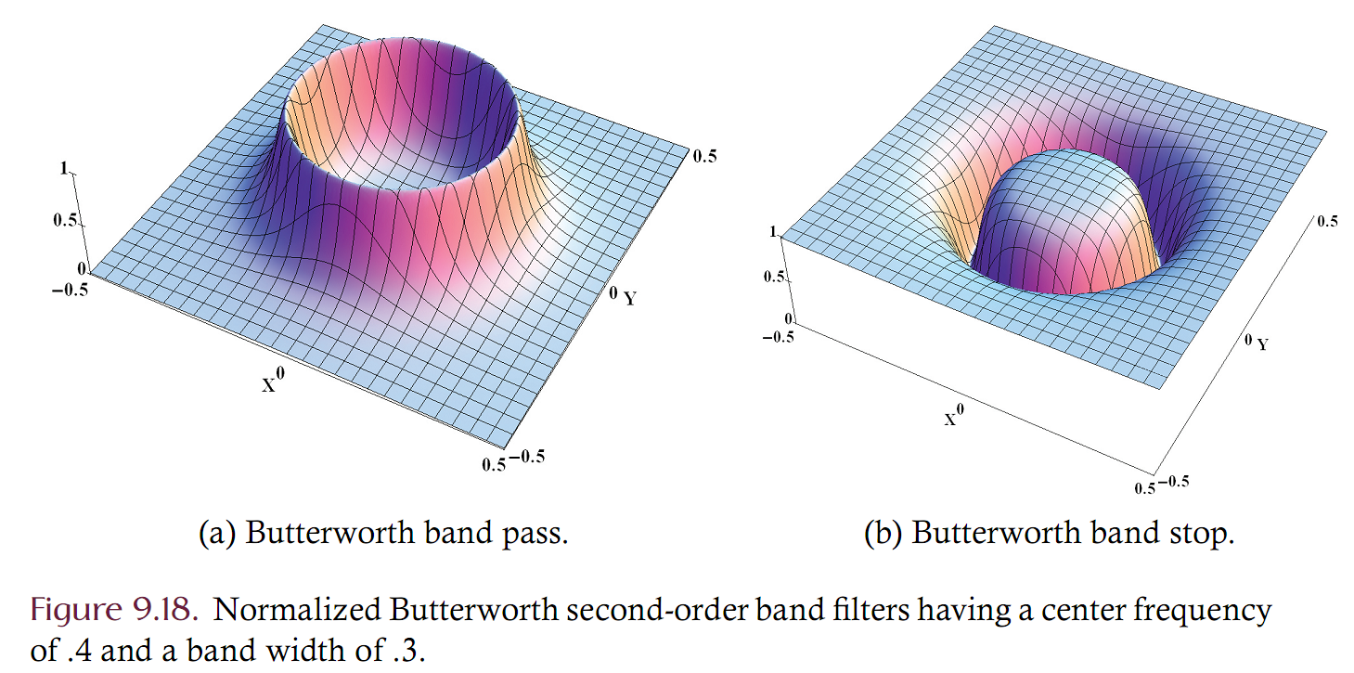
Band pass and band stop

Slide 40
Periodic Noise Removal
Direct frequency domain filtering can be used to identify and eliminate periodic noise from a digital image.
Periodic noise can penetrate a digital image if the acquisition system is in close proximity to electromechanical machinery, electric motors, power lines, and the like.
Periodic noise manifests as sharp localized spikes in the spectrum, and hence specialized filters or interactive systems can be used to identify and eliminate this type of noise.

Slide 41
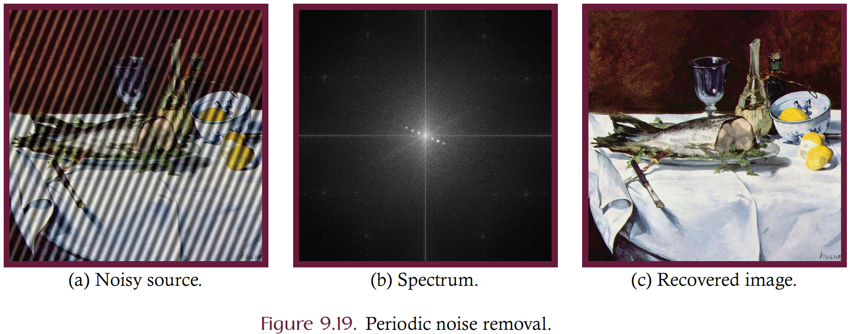
Periodic Noise Example

Slide 42
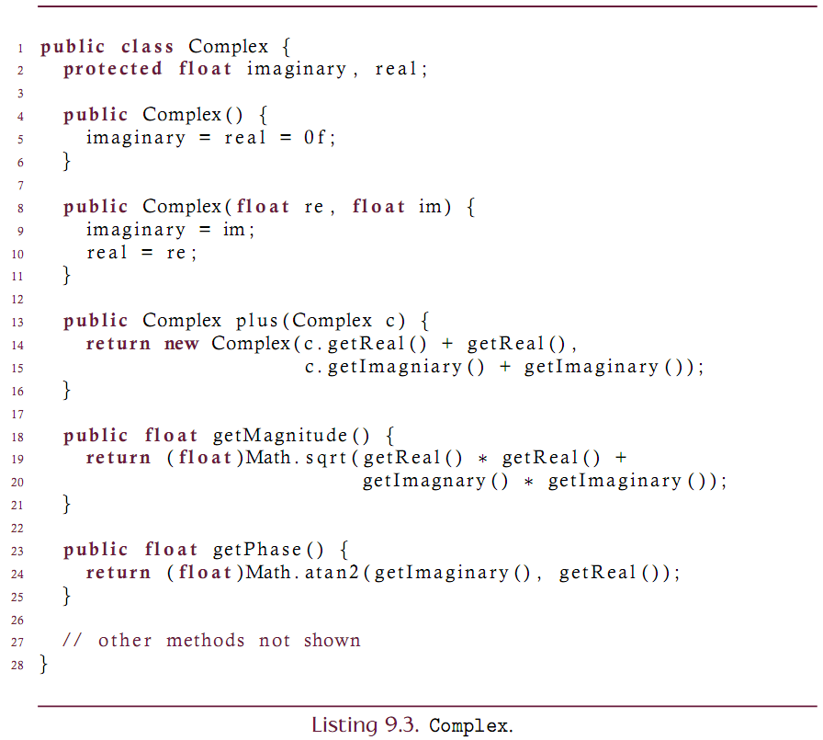
Implementation

Slide 43
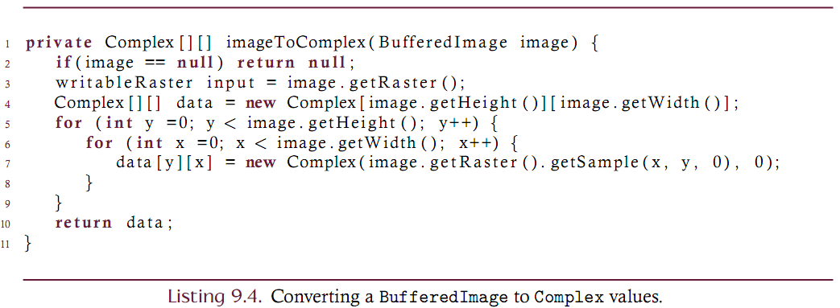
Implementation

Slide 44
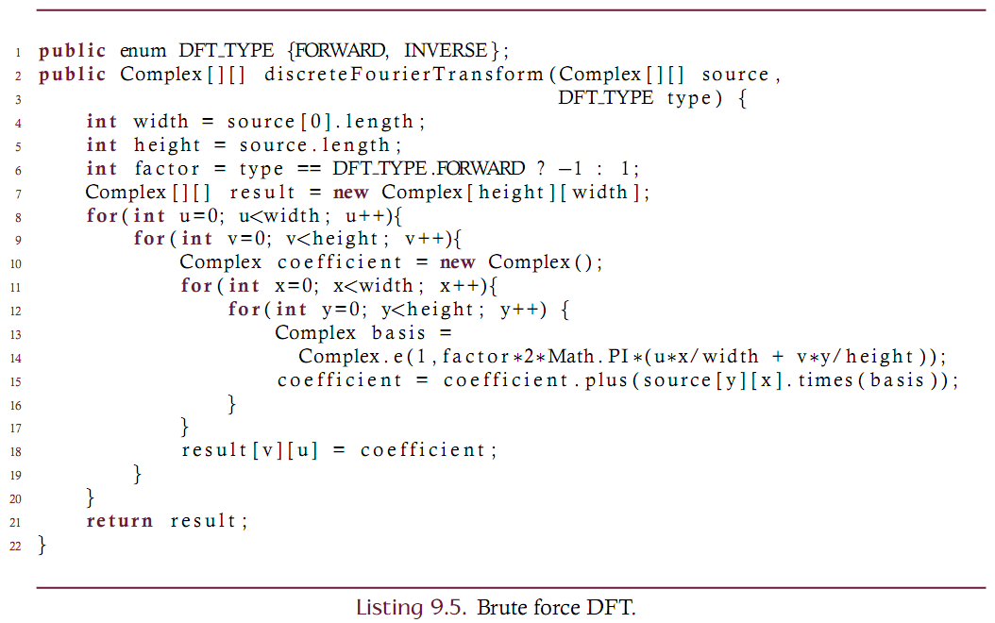
DFT

Slide 45
Separability
Spatial
Image
(2D Ints)
1 Dimensional
Row by Row
Partially
Transformed
(2D Complex)
1 Dimensional
Col by Col
Fully
Transformed
(2D Complex)
Partially
Transformed
(2D Complex)
1 Dimensional Inverse Col by Col
1 Dimensional
Inverse Row by Row
The Fourier Transform is separble. We can compute the 2d DFT (and inverse) by repeated applications of the 1D DFT

Slide 46
FFT
The Fast Fourier Transform (FFT) is an efficient technique to compute the DFT by clever elimination of redundant computations.
The FFT is used in a plethora of domains to solve problems in spectral analysis, audio signal processing, computational chemistry, error correcting codes, and of course image processing.
The FFT is so important that it is often implemented in hardware.
While various FFT techniques have been discovered, the term FFT typically refers to the Cooley-Tukey algorithm. This technique was discovered and rediscovered by a variety of mathematicians but was popularized by J. W. Cooley and J. W. Tukey in their 1965 publication entitled An Algorithm for the Machine Calculation of Complex Fourier Series

Slide 47
FFT Overview
A typical divide and conquer strategy forms the basic premise of the FFT. For the one-dimensional case, an input of length N is divided into two subsections of equal length.
The first subsection contains all of the even-indexed samples of the input
The second subsection contains all of the odd-indexed samples.
The FFT of each of the components is then computed and the resulting DFT coefficients are then combined by multiplication with complex roots of unity.
Since the input must be divided into two equally sized subsections at every step, the algorithm is limited to handling those inputs where N is a power of 2.
Variants on the Cooley-Tukey algorithm have been developed that are able to compute the DFT of a sequence of any length. Implementations that require the input to be a power of 2 are known as radix-2.

Slide 48
FFT
Let f(x) be a sequence of N samples and let e(x) be the even-indexed values while o(x) are the odd-indexed samples (using zero indexing). Let E(u) and O(u) be the Fourier coefficients of e(x) and o(x) and let M = N/2. The Fourier coefficients of f are then given by

Slide 49
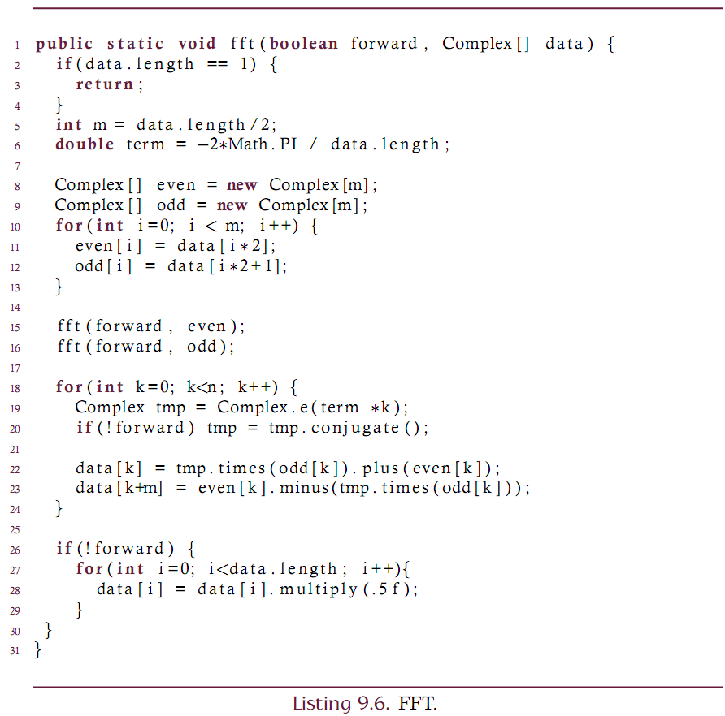

Slide 50
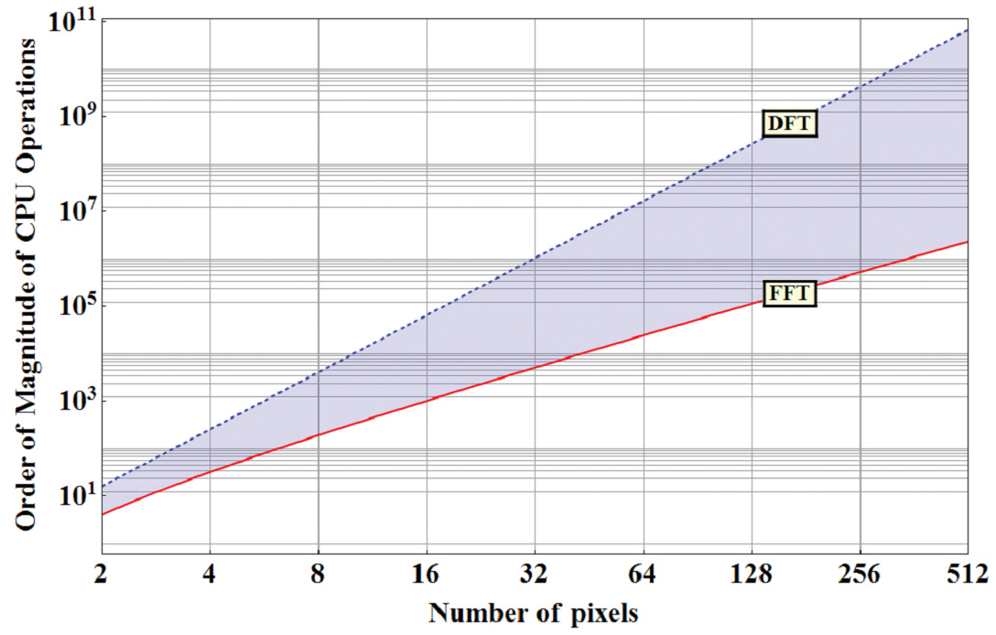

Slide 51
Wavelets
Similar to the Fourier series, wavelets are a class of functions that decompose a signal into a set of basis functions and that have properties superior to the DFT for some applications.
In wavelet transformations, the basis functions are all scaled and translated copies of a waveform known as the mother wavelet.
The discrete wavelet transform (DWT) is used to convert a finite length discrete sequence into a sequence of wavelet coefficients based on the mother wavelet.
The DWT is a recursive process where at each stage of the transform the input is scaled and a set of average (or low frequency) coefficients and detail (or high frequency) coefficients is generated.
Each subsequent stage operates only on the low frequency terms; thus generating a pyramid of increasingly coarse approximations of original sequence in addition to the high frequency content that can be used to reconstruct the original.

Slide 52
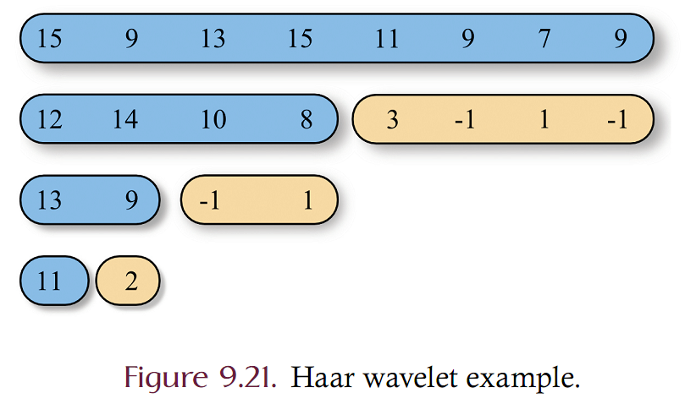
Haar wavelet example
The Haar wavelet is a unit-length “square wave”
Consider a sequence of 8 samples given as {15, 9, 13, 15, 11, 9, 7, 9}.
First: average to obtain .5 * {15+9, 13+15, 11+9, 7+9} = {12, 14, 10, 8}
Second: compute the details: {15-12, 13-14, 11-10, 7-8} = {3, -1, 1, -1}
Third: Repeat the first two steps on the averages
The original sequence is fully recoverable.
The low-frequency components represent a scaled version of the original

Slide 53
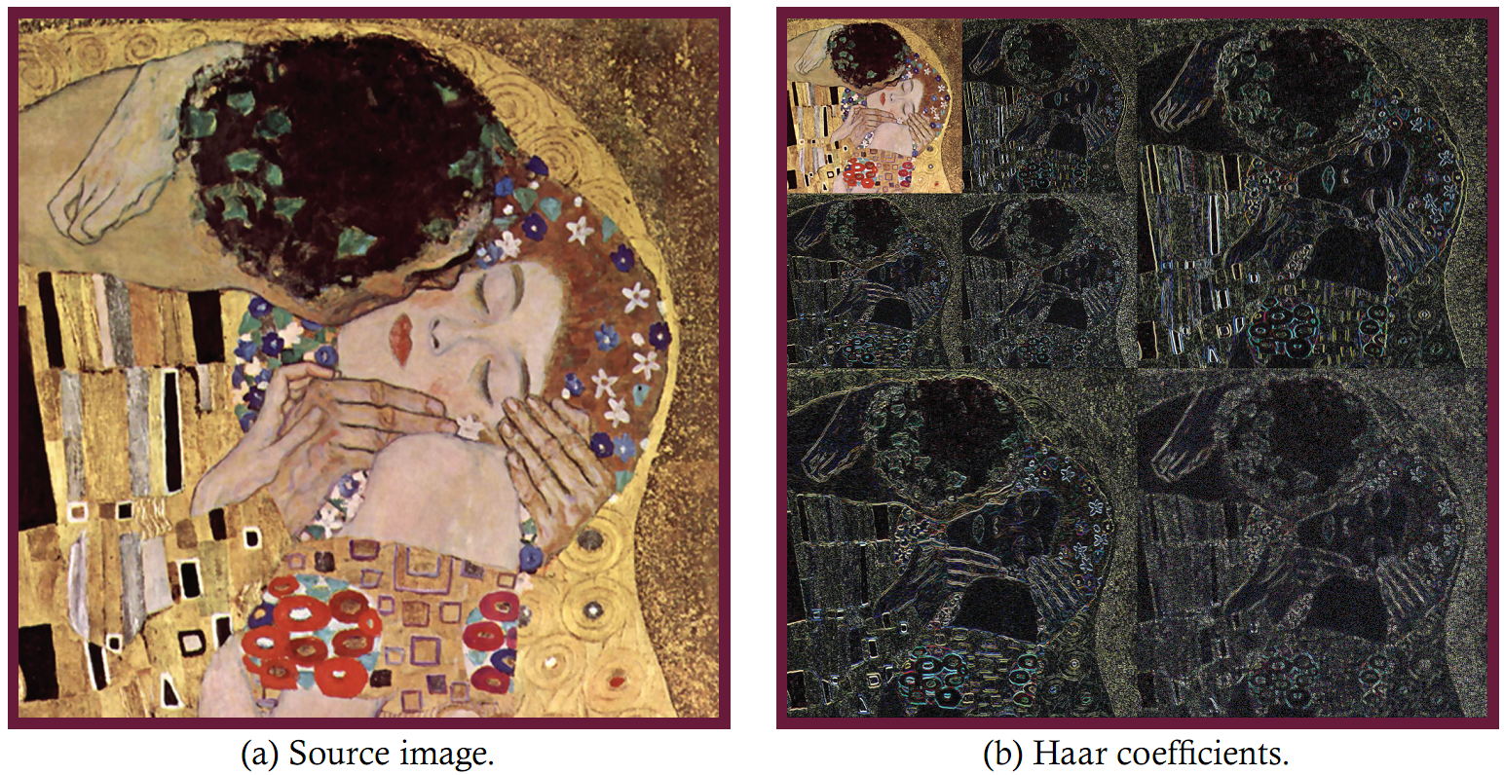
Visual example of Haar

