Slide 1
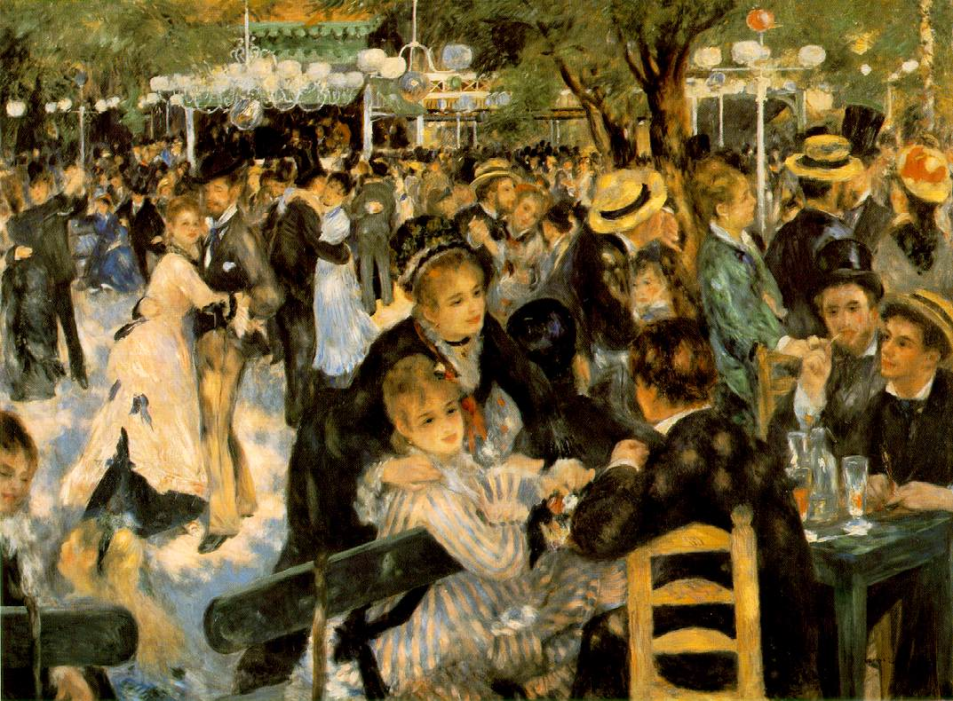
The Frequency Domain
Light and the DCT
Pierre-Auguste Renoir: La Moulin de la Galette from http://en.wikipedia.org/wiki/File:Renoir21.jpg

Slide 2
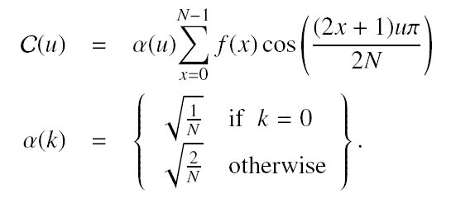
DCT (1D)
Discrete cosine transform
The strength of the ‘u’ sinusoid is given by C(u)
Project f onto the basis function
All samples of f contribute the coefficient
C(0) is the zero-frequency component – the average value!

Slide 3
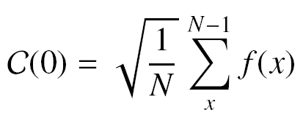
DCT (1D)
Consider a digital image such that one row has the following samples
There are 8 samples so N=8
u is in [0, N-1] or [0, 7]
Must compute 8 DCT coefficients: C(0), C(1), …, C(7)
Start with C(0)
Index | 0 | 1 | 2 | 3 | 4 | 5 | 6 | 7
Value | 20 | 12 | 18 | 56 | 83 | 10 | 104 | 114

Slide 4
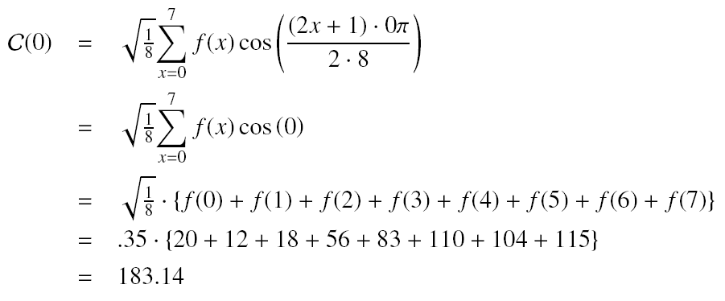
DCT (1D)

Slide 5
DCT (1D)
Repeating the computation for all u we obtain the following coefficients
Spatial
domain
Frequency domain

Slide 6
DCT (1D) implementation
Since the DCT coefficients are reals, use array of floats
This approach is O(?)
public static float[] forwardDCT(float[] data) {
final float alpha0 = (float) Math.sqrt(1.0 / data.length);
final float alphaN = (float) Math.sqrt(2.0 / data.length);
float[] result = new float[data.length];
for (int u = 0; u < result.length; u++) {
for (int x = 0; x < data.length; x++) {
result[u] += data[x]*(float)Math.cos((2*x+1)*u*Math.PI/(2*data.length));
}
result[u] *= (u == 0 ? alpha0 : alphaN);
}
return result;
}

Slide 7
DCT (2D)
The 2D DCT is given below where the definition for alpha is the same as before
For an MxN image there are MxN coefficients
Each image sample contributes to each coefficient
Each (u,v) pair corresponds to a ‘pattern’ or ‘basis function’

Slide 8
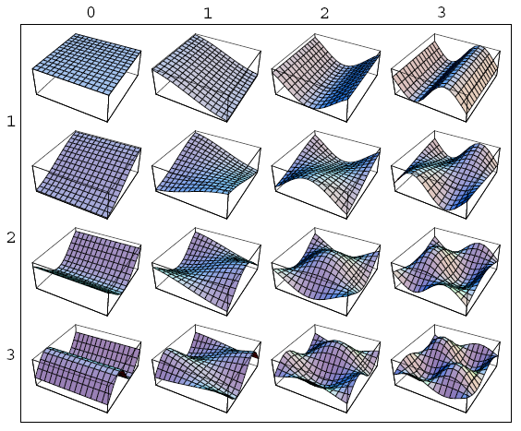
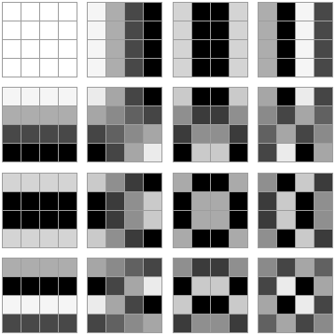
DCT basis functions (patterns)
Basis functions
Basis patterns (imaged functions)

Slide 9
Separability
The DCT is separable
The coefficients can be obtained by computing the 1D coefficients for each row
Using the row-coefficients to compute the coefficients of each column (using the 1D forward transform)

Slide 10
Invertability
The DCT is invertible
Spatial samples can be recovered from the DCT coefficients

Slide 11
Summary of DCT
The DCT provides energy compaction
Low frequency coefficients have larger magnitude (typically)
High frequency coefficients have smaller magnitude (typically)
Most information is compacted into the lower frequency coefficients (those coefficients at the ‘upper-left’)
Compaction can be leveraged for compression
Use the DCT coefficients to store image data but discard a certain percentage of the high-frequency coefficients!
JPEG does this

Slide 12
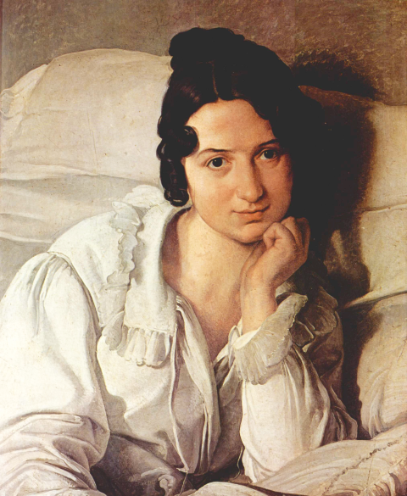
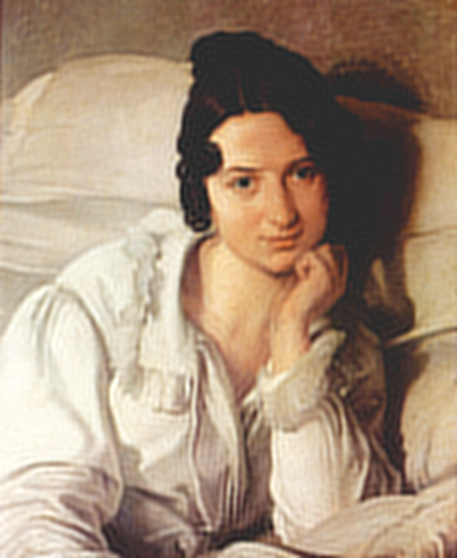
DCT Compaction and Compression
source
discarding 95% of dct
discarding 99% of dct

Slide 13
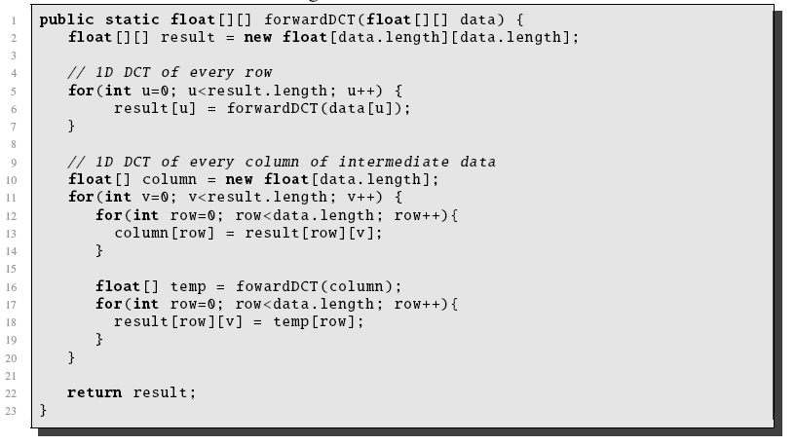
Implementation

