Slide 1
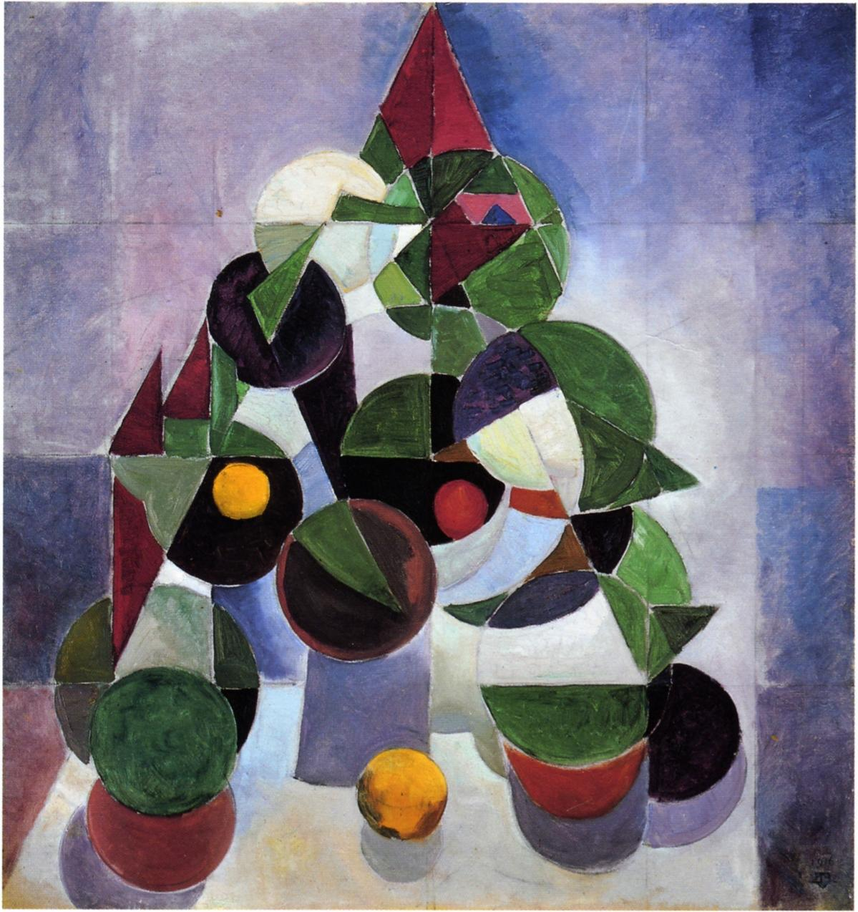
Geometric Operations
Move over rover

Slide 2
Geometric Operations
Previous operations have taken a sample at some location and changed the sample value (the light intensity) but left the location unchanged.
Geometric operations take a sample and change it’s location in the destination while leaving the sample value unchanged.
In general, geometric operations take a source pixel at some location (x,y) and map it to location (x’, y’) in the destination.

Slide 3
Affine Transformations
The mapping between (x,y) and (x’, y’) can be generalized as given in Equation (7.1), where both Tx and Ty are transformation functions that produce output coordinates based on the x and y coordinates of the input pixel.
Both functions produce real values as opposed to integer coordinates and are assumed to be well defined at all locations in the image plane.
Function Tx outputs the horizontal coordinate of the output pixel while function Ty outputs the vertical coordinate:

Slide 4
Affine Transformations
The simplest kind of transformations are linear
x’ and y’ are linearly related to (x, y)
All linear transformations are known as affine transformations
Properties of affine transformations
A straight line in the source is straight in the destination
Parallel lines in the source are parallel in the destination
The class of affine transformation functions is given by (7.2) where the six m coefficients determine the exact effect of the transform.
Note that T_{x} is a linear combination of weighted x, y and offset m02
Note that T_{y} is a linear combination of weighted x, y and offset m12
The values of the six coefficients determine the specific effect
Four of the coefficients are sufficient for rotation/scaling/shearing
Two of the coefficients are necessary for translation

Slide 5
Affine Transformations
These two equations are often augmented by a third equation that may initially seem frivolous but allows for convenient representation and efficient computation.
The validity of the equation 1=0x+0y+1 is obvious but including it as a third constraint within our system allows us to write the affine system in the matrix form of Equation (7.3).
The 3x3 matrix of coefficients in Equation (7.3) is known as the homogeneous transformation matrix.
Using this augmented system, a two-dimensional point is represented as a 3x1 column vector where the first two elements correspond to the column and row while the third coordinate is constant at 1.
When a two-dimensional point is represented in this form it is referred to as a homogenous coordinate.
When using homogenous coordinates, the transformation of a point V with a transformation matrix A is given by the matrix product AV and is itself a point. In other words, there is closure under transformation.

Slide 6
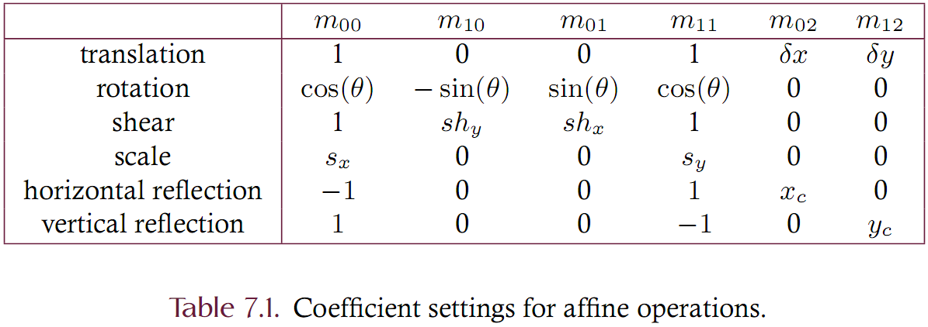
Affine Transformations
An affine transformation matrix is a six parameter entity controlling the coordinate mapping between source and destination image.
The following table shows the correspondence between coefficient settings and effect.

Slide 7
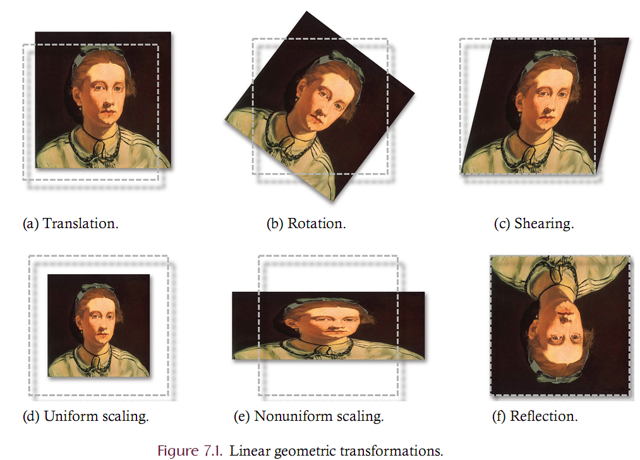

Slide 8
Affine Transformations
A single homogeneous matrix can also represent a sequence of individual affine operations.
Let A and B represent affine transformation matrices
the affine matrix corresponding to the application of A followed by B is given as BA
BA is itself a homogeneous transformation matrix.
Matrix multiplication, also termed concatenation, therefore corresponds to the sequential composition of individual affine transformations.
Note that the order of multiplication is both important and opposite to the way the operations are mentally envisioned.
While we speak of transform A followed by transform B, these operations are actually composed as matrix B multiplied by (or concatenated with) matrix A.
Assume, for example, that matrix A represents a rotation of 30 degrees about the origin and matrix B represents a horizontal shear by a factor of .5. The affine matrix corresponding to the rotation followed by shear is given as BA.

Slide 9
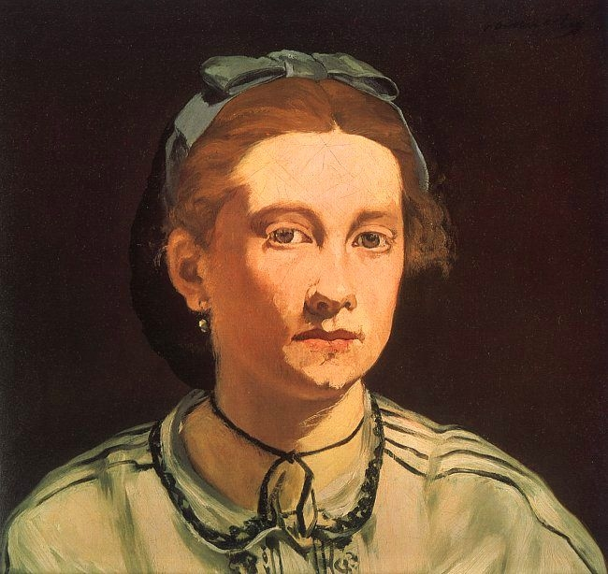
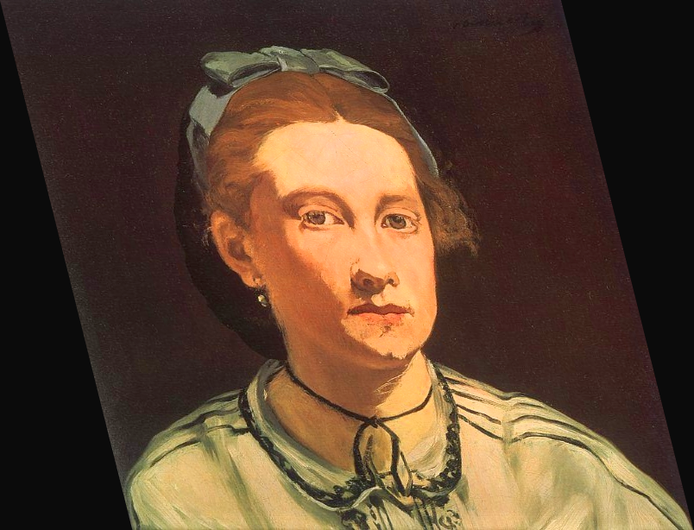
Affine Transformations
Explain what the following transformation matrices accomplishes
1.0 | 0.25 | 0.0
0.0 | 1.0 | 0.0
0.0 | 0.0 | 1.0

Slide 10
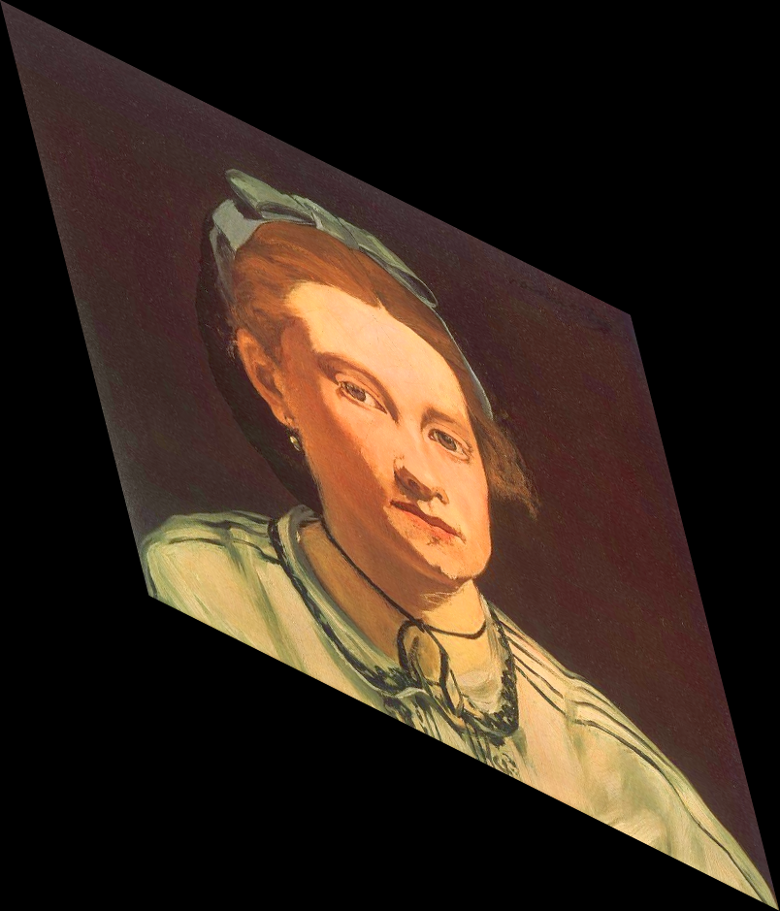
Affine Transformations
Explain what the following transformation matrices accomplishes
1.0 | 0.25 | 0.0
0.5 | 1.0 | 0.0
0.0 | 0.0 | 1.0

Slide 11
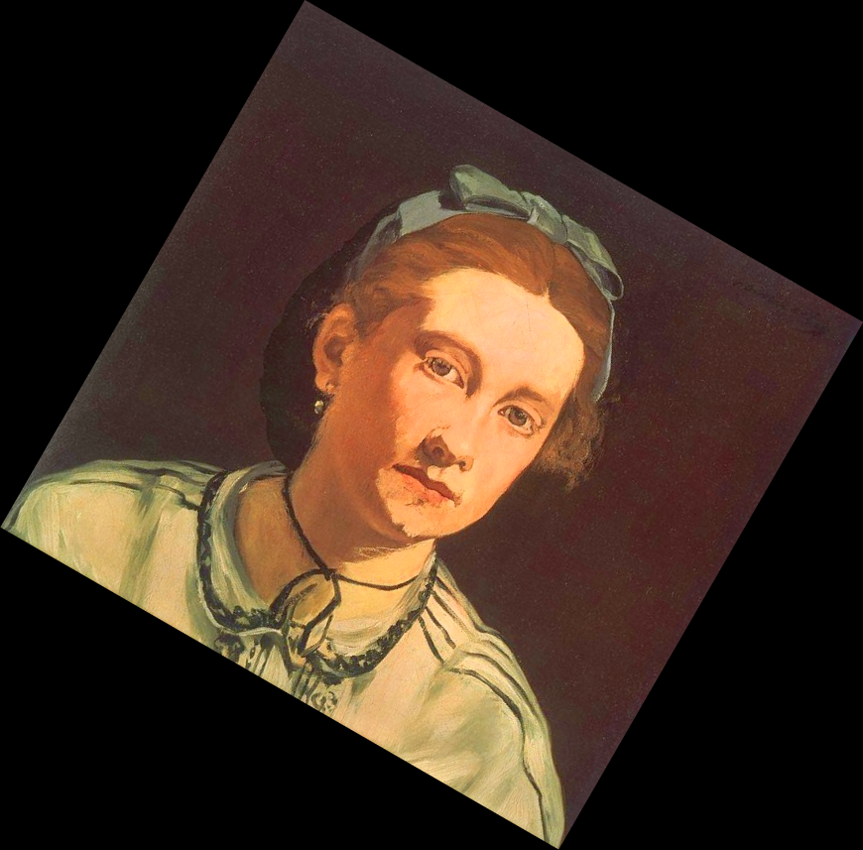
Affine Transformations
Explain what the following transformation matrices accomplishes
.87 | -0.5 | 0.0
0.5 | .87 | 0.0
0.0 | 0.0 | 1.0

Slide 12
Affine Transformations
Explain what the following transformation matrix accomplishes
0.5 | 0.0 | 0.0
0.0 | 2.0 | 0.0
0.0 | 0.0 | 1.0

Slide 13
Issues with geometric ops
Under point and regional processing
Source and destination images were the same size
Color depth was occasionally different
Under geometric processing
Source and destination images may not be the same size
Output locations may not be integer values!
‘Gaps’ may occur when mapping inputs to outputs

Slide 14
Point Transformation
Example. Consider rotating an image by 30 degrees clockwise. Note that cos(30) is .866 and sin(30) is -.5.
The transformation is given by
Consider relocating the sample at (10, 20)
10
20
1

Slide 15
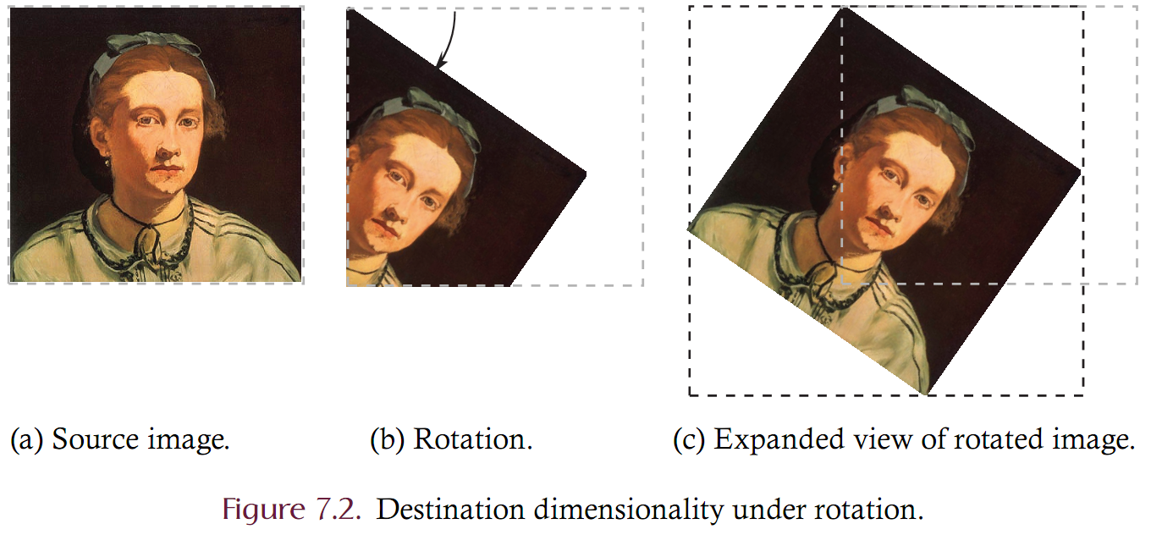
Two Issues
Two issues:
Dimensionality: The destination image may not be large enough to contain all of the processed samples
Transformed locations are not integers: How can we place a source sample at a non-integer location in the destination?

Slide 16
Two Issues: Dimensionality
Consider a source image that is rotated about the origin such that some pixels are mapped outside of the bounds of the source. Implementations must decide whether to
Size the destination image in such a way as to truncate the result
Allow the destination to contain the entire rotated image.
Both the width and height of the destination image must be increased beyond that of the source.
Can compute the destination dimensions by transforming the bounds and using the width and height of the bounds as the destination dimensions.

Slide 17
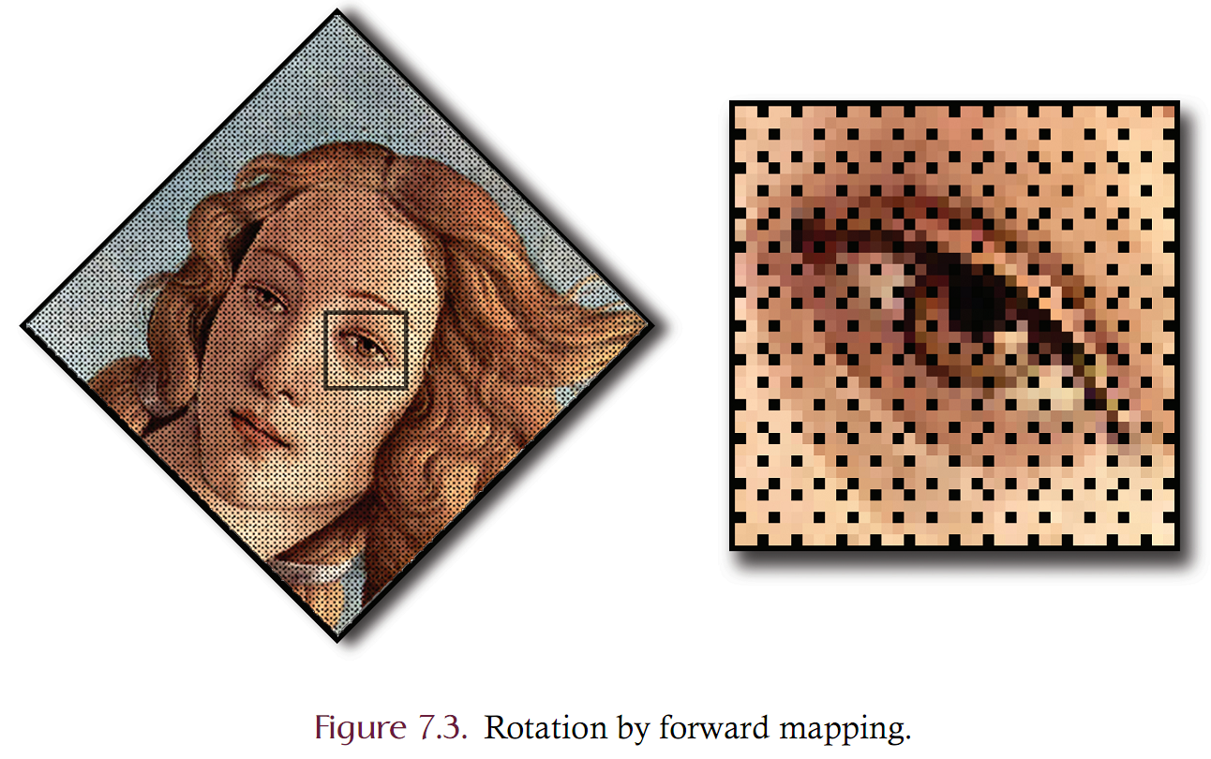
Two Issues: Mapping
The issue of how integer-valued source coordinates are mapped onto integer-valued destination coordinates must also be addressed.
Forward mapping takes each pixel of the source image and copies it to a location in the destination by rounding the destination coordinates so that they are integer values.
Forward mapping yields generally poor results since certain pixels of the destination image may remain unfilled. Example: a source image is rotated by 45 degrees using a forward mapping strategy. Example: scaling an image to make it larger!

Slide 18
Image Rotation Example
Use forward mapping algorithm to rotate the image below by 30 degrees clockwise
algorithm rotate(Image, theta)
INPUT: an MxN image and angle theta
OUTPUT: the original image rotated by theta
Let rotatedImage be an MxN “empty” image
for every pixel P at location X,Y in the image
compute rotated X,Y coordinates X’,Y’
place P at X’,Y’ in rotatedImage
return rotatedImage
X Y X Y Round(x, y)
-----------------------------------------
0 0 0.000 0.000 0 0
0 0.866 0.500 1 1
0 1.732 1.000 2 1
0 1 -0.500 0.866 0 1
1 0.366 1.366 0 1
1 1.232 1.866 1 2
0 2 -1.000 1.732 -1 2
2 -0.134 2.232 0 2
2 0.732 2.732 1 3
0 3 -1.500 2.598 -1 3
3 -0.636 3.098 -1 3
2 3 0.232 3.598 0 4
 | 0 | 1 | 2
0 | 0 | 10 | 15
1 | 20 | 25 | 30
2 | 35 | 40 | 45
3 | 50 | 55 | 60
 | -1 | 0 | 1 | 2
0 |  | 0
1 |  | 20/25 | 10 | 15
2 | 35 | 40 | 30
3 | 50/55 |  | 45
4 |  | 60

Slide 19
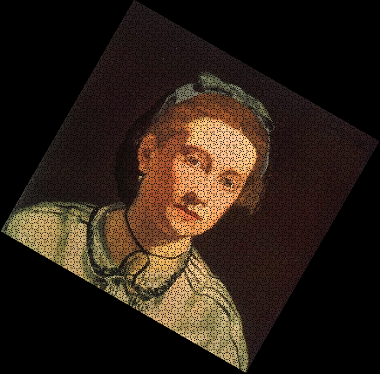
Forward Mapping

Slide 20
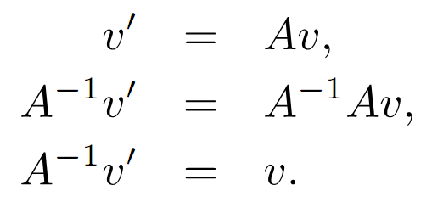
Backward mapping
Backward mapping solves the gap problem caused by forward mapping.
An empty destination image is created and each location in the destination is mapped backwards onto the source.
The source location may not be integer-valued coordinates; hence a sample value is obtained via interpolation.
Let A be an affine transform matrix and let v be a location in the destination image such that v = [x,y,1]^{T}

Slide 21
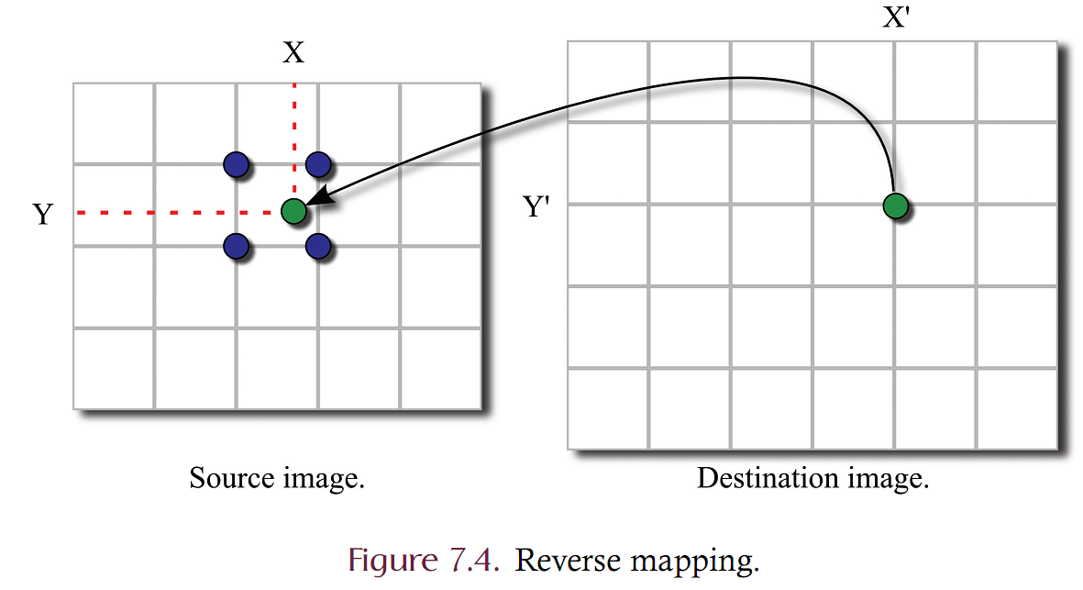
Backward (Reverse) Mapping
When using inverse mapping, the source location (X,Y) corresponding to destination (X’,Y’) may not be integer values.
Must ‘interpolate’ the sample value

Slide 22
Interpolation
Interpolation refers to the creation of new samples from existing image samples. Interpolation seeks to increase the resolution of an image by adding virtual samples at all points within the image boundary.
Recall that a sample represents the intensity of light at a single point in space and that the sample is displayed in such a way as to spread the point out across some spatial area.
Using interpolation it is possible to define a new sample at any point in space and hence the use of real-valued coordinates poses no difficulty.
Common interpolation techniques:
zero order – nearest neighbor
first order – (bilinear)
second order – (bicubic)

Slide 23
Nearest Neighbor
Nearest neighbor interpolation.
Assume that a destination location (x’ y’) maps backward to source location (x, y).
The source pixel nearest location (x, y) is located at (round(x), round(y)) and the source pixel at that image is then carried over as the value of the destination.
In other words, I’(x’, y’) = I(round(x), round(y))
Nearest neighbor interpolation is computationally efficient but of generally poor quality, producing images with jagged edges and high graininess.

Slide 24
Bilinear Interpolation
Bilinear interpolation assumes that the continuous image is a linear function of spatial location.
Linear, or first order, interpolation combines the four points surrounding location (x,y) according to Equation (7.8), where (x, y) is the backward mapped coordinate that is surrounded by the four samples at (j,k) (j, k+1), (j+1, k), and (j+1, k+1)

Slide 25
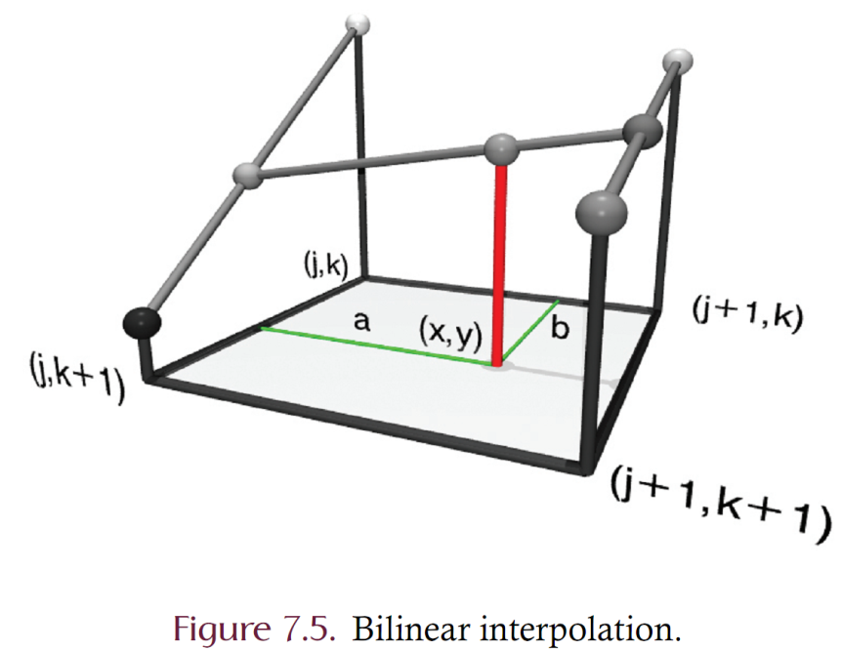
Bilinear Interpolation
Bilinear interpolation is a weighted average where pixels closer to the backward mapped coordinate are weighted proportionally heavier than those pixels further away.
Bilinear interpolation acts like something of a rigid mechanical system
Two rods vertically connect the four samples surrounding the backward mapped coordinate.
A third rod is connected horizontally which is allowed to slide vertically up and down the fixture.
A ball is attached to this horizontal rod and is allowed to slide freely back and forth across the central rod.
The height of the ball determines the interpolated sample value wherever the ball is located.
In this way it should be clear that all points within the rectangular area bounded by the four corner posts have implicit, or interpolated, sample values.

Slide 26
Bicubic Interpolation
In bi-cubic interpolation, the destination sample is a non-linear weighted sum of the 16 samples nearest to the reverse mapped location.
Properties of second order interpolation
everywhere continuous
more computational effort required

Slide 27
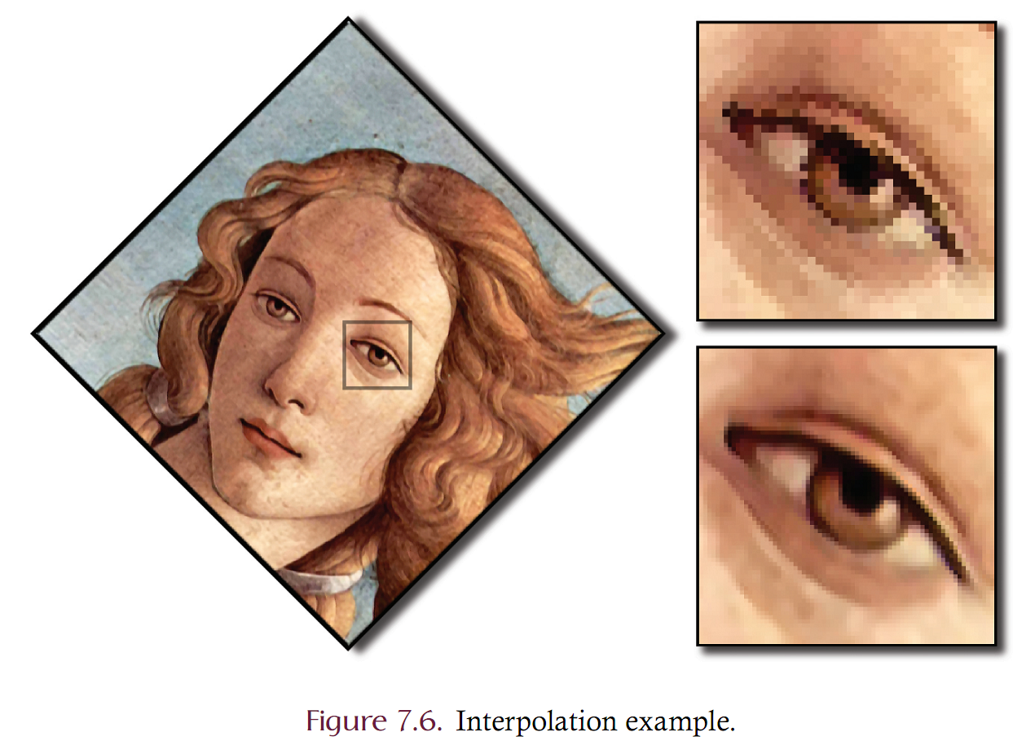

Slide 28
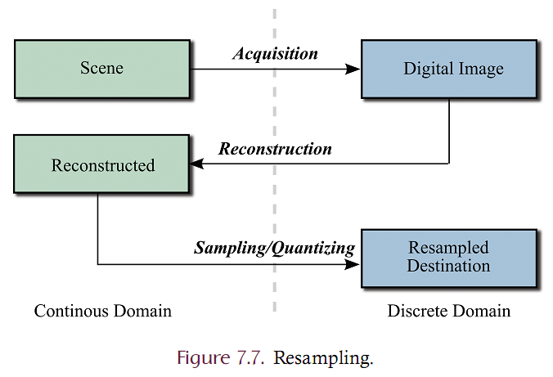
Resampling
An image is either in the
continuous domain: where light intensity is defined at every point in some projection
discrete domain, where intensity is defined only at a discretely sampled set of points.
Resampling changes the dimensions of an image by either increasing or decreasing the width and/or height of an image.
When an image is acquired, an image is taken from the continuous into the discrete domain.
Reconstruction takes the image from the discrete domain into the continuous domain using interpolation.
The reconstructed image can then be resampled to any desired resolution through the typical process of sampling and quantization.

Slide 29
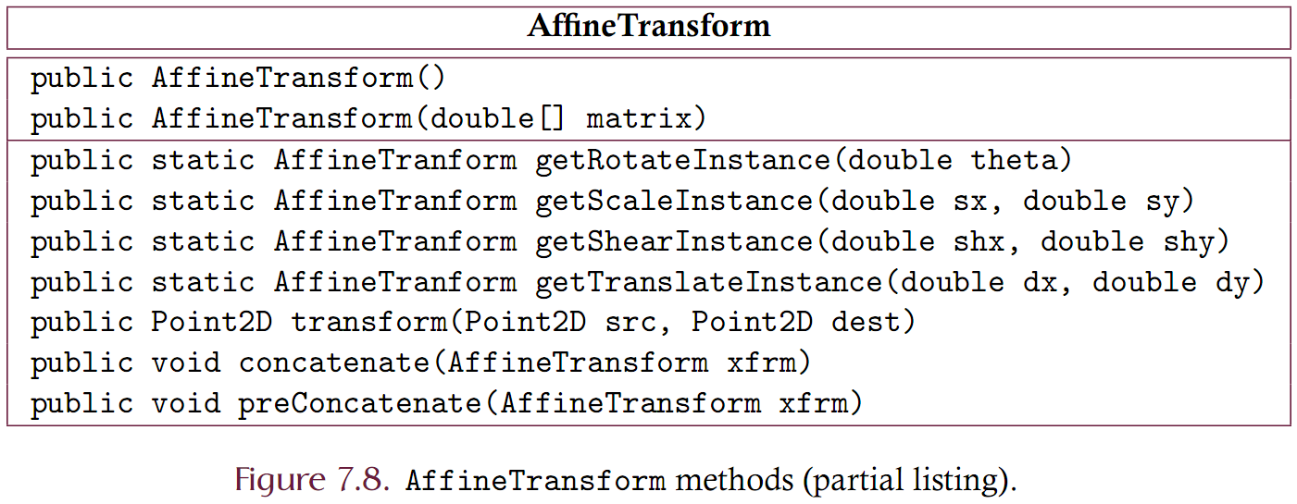
Implementation: AffineTransform
The standard Java distribution provides an AffineTransform class for representing homogeneous afﬁne transformation matrices. AffineTransform contains several convenient methods for creating homogeneous matrices of which a partial listing is given in Figure 7.8.

Slide 30
Implementation: AffineTransform
The Point2D class is deﬁned in the java.awt.geom package and represents, a two-dimensional point.
The transform method accepts a Point2D object and maps it in accord with the transformation matrix to obtain an output coordinate.
If the destination point is non-null then the X and Y coordinates of the destination are properly set and the destination point is returned.
If the destination point is null, a new Point2D object is constructed with the appropriate coordinate values and that object is returned.
The AffineTransform class contains a createInverse method that creates and returns the inverse AffineTransform of the caller. This method throws an exception if the matrix is not invertible..
The concatenate and preConcatenate perform matrix multiplication.
Let A be the calling AffineTransform object and B the AffineTransform that is passed as the single required parameter. The concatenate method modiﬁes A so that A becomes AB while preconcatenation modiﬁes A such that A becomes BA.

Slide 31
Implementation: AffineTransformOp
The AffineTransformOp is a BufferedImageOp that applies an afﬁne transformation to a source image.
The AffineTransformOp contains an AffineTransform, which is used to map source to destination coordinates.
Clients must construct an AffineTransform which is passed as a parameter to the constructor.
The transformation matrix must be invertible since backwards mapping will be used to map destination locations into the source.
Clients must also specify an interpolation technique by providing an integer valued constant that is either TYPE NEAREST NEIGHBOR, TYPE BILINEAR, or TYPE BICUBIC.

Slide 32
Implementation: AffineTransformOp
List 7.1 shows how to rotate an image clockwise 45 degrees using the AffineTransformOp
The AffineTransformOp is implemented in such a way as to extend the bounds of the destination in only the positive x and y directions while all pixels mapping to negative coordinates are ignored.
It is possible to rotate all pixels onto negative coordinate values and hence to produce an empty destination. Example: If an image is rotated by 180 degrees, all pixels except the origin fall outside of the bounds of the source. In this case the AffineTransformOp actually gives rise to an exception since it computes the width and height of the destination to be zero.

Slide 33
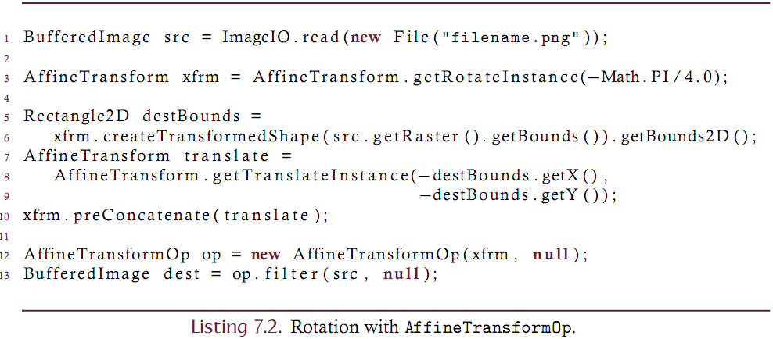
Implementation: AffineTransformOp
Transforming that ensures the entire source image is contained in the destination
Rescale the bounds
Translate the origin

Slide 34
Implementation: AffineTransformOp

Slide 35
Custom Implementation
Geometric operations depend on
The mapping function
Must be ‘reversible’
May be affine but may not be!
The interpolation technique
nearest neighbor / bilinear / bicubic
other? (Lanczos)
How edges are to be handled
Occurs if the destination location maps outside of the source bounds
Best to write separate classes that are responsible for
mapping (and inverse mapping)
interpolating
edge handling (already done through the ImagePadder class)

Slide 36
Custom Implementation: Interpolant
The Interpolant of Listing 7.4 is an interface containing a single method named interpolate.
This method takes a real-valued Point2D and produces the sample value (an int valued intensity) at that location in the source image.
An ImagePadder object must be supplied so that the source image is extended across all space in order to allow interpolation at all spatial coordinates.
Interpolation works on a single band and hence the band is also given as the ﬁnal argument.

Slide 37
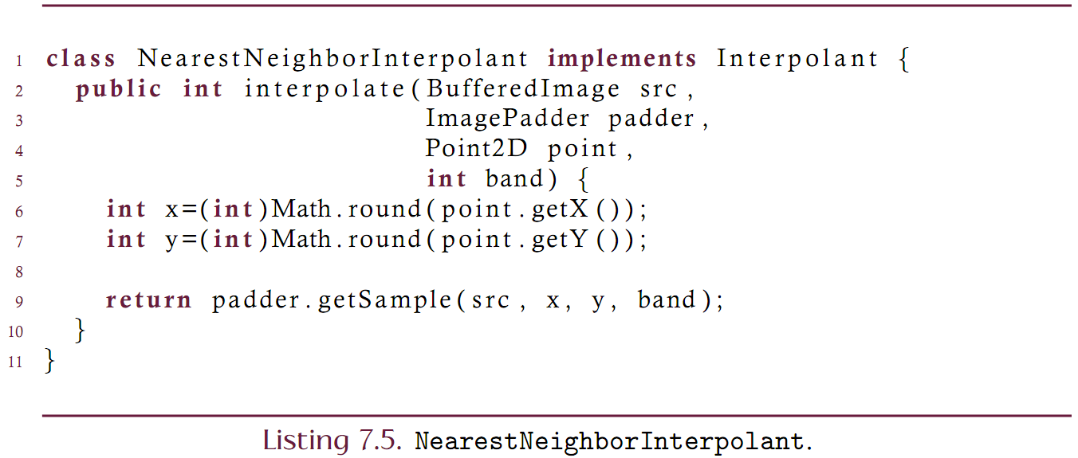
Custom Implementation: Interpolant
The Interpolant can be implemented for various interpolation strategies.

Slide 38
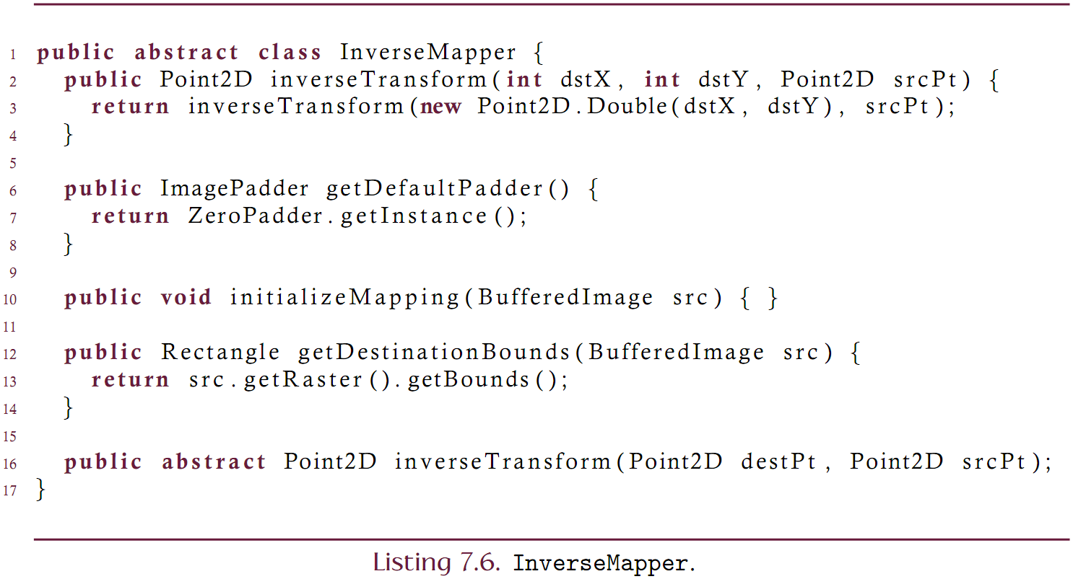
Custom Implementation: InverseMapper
Since geometric transformations key on a mapping between source and destination, the responsibility for mapping is abstracted into its own class.
Listing 7.6 describes the InverseMapper class.
Must be able to take a destination location and find the corresponding source location
Also supports computing the destination bounds of a source image when mapped through this mapper.
May need to ‘initialize’ the mapper for a specific source image

Slide 39
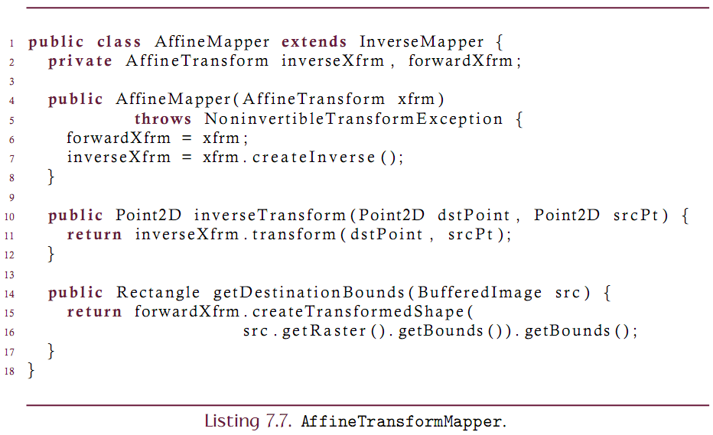
Custom Implementation: AffineMapper
Subclass the InverseMapper for Affine transformations

Slide 40
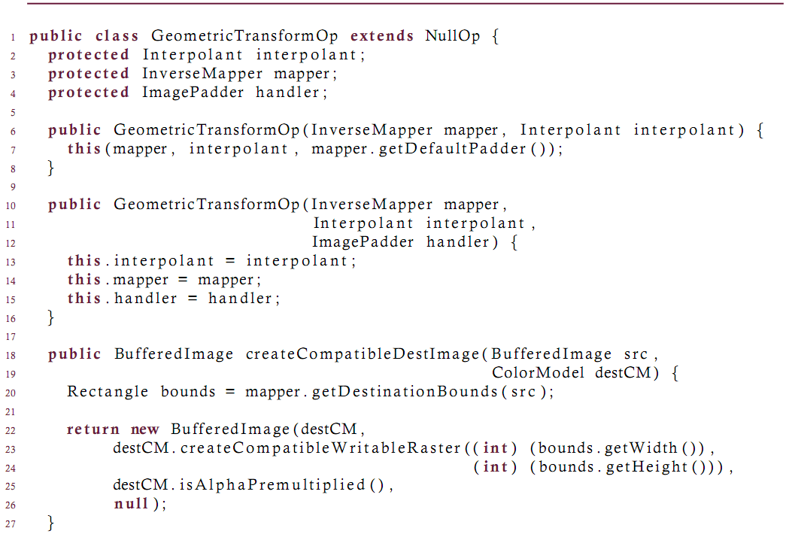
Custom Implementation: GeometricTransformOp
Create a GeometricTransformOp that is able to perform any type of geometric transformation (whether affine or not!)
This process is parameters on a mapper, an interpolant and a padder.

Slide 42
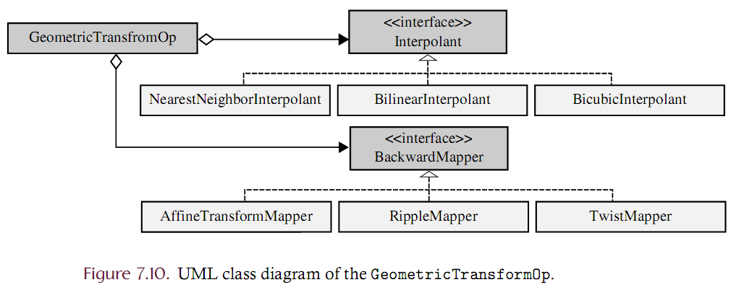
Class Design Overview
Support for GeometricTransforms involves a variety of cooperating classes as shown in the UML diagram of Figure 7.10.

Slide 43
Using the GeometricTransformOp

Slide 44
Non linear transformations
Non linear transformations can be achieved by implementing the InverseMapper
Consider a “TwirlMapper”
This mapper imposes a sin-wave displacement on a location in both the x and y dimensions
The strength of the displacement and the frequency of the displacement can be controlled
Where r is the distance between the point and the center coordinate
Theta is the angle of rotation between the point and the center coordinate

Slide 45
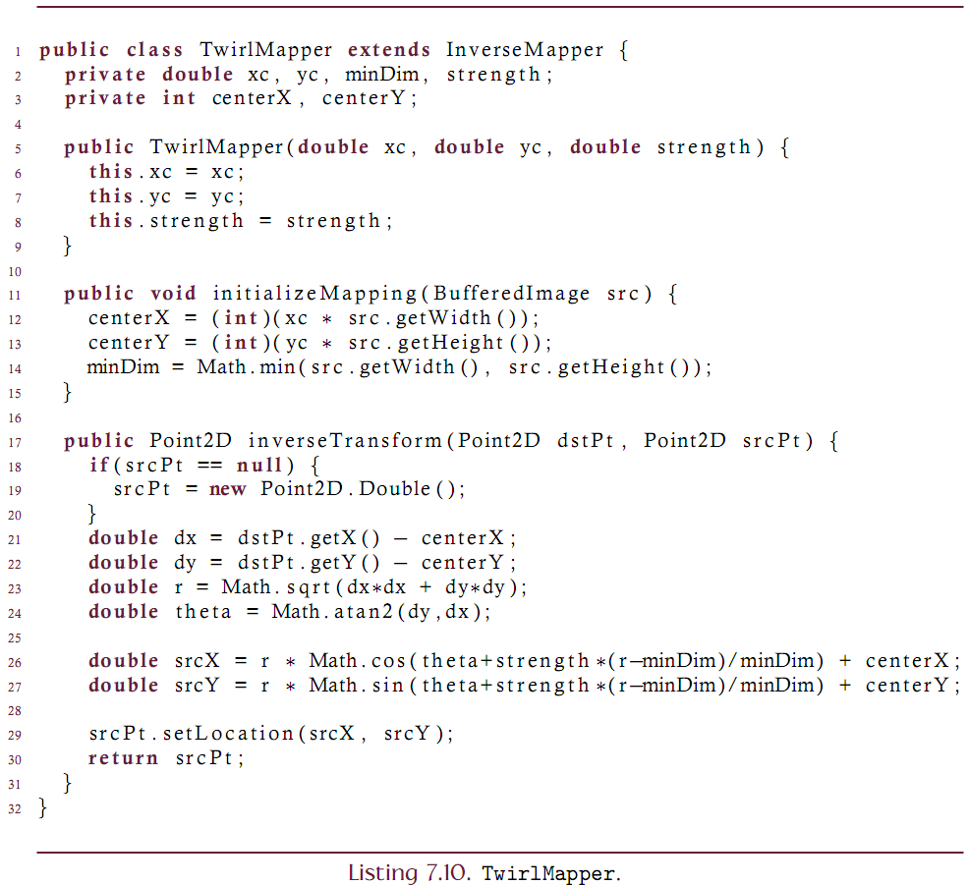
Non linear transformations

Slide 46
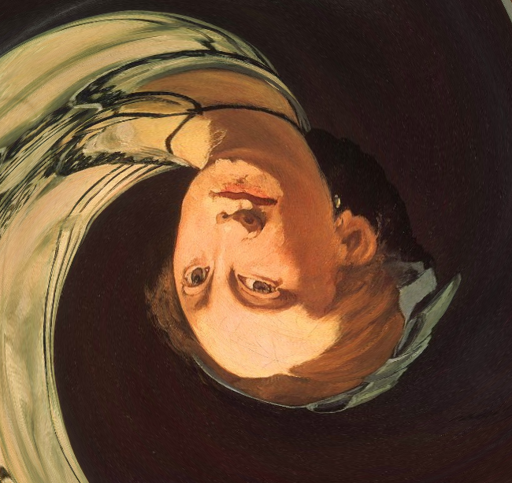
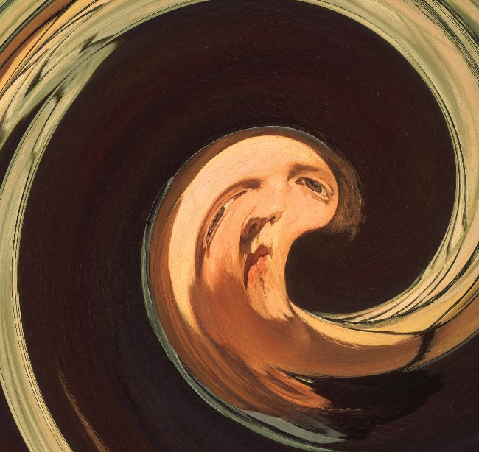
Twirl Mapper
xc = .5, yc = .5, strength = 3.75
xc = .65, yc = .5, strength = 7.5

Slide 47
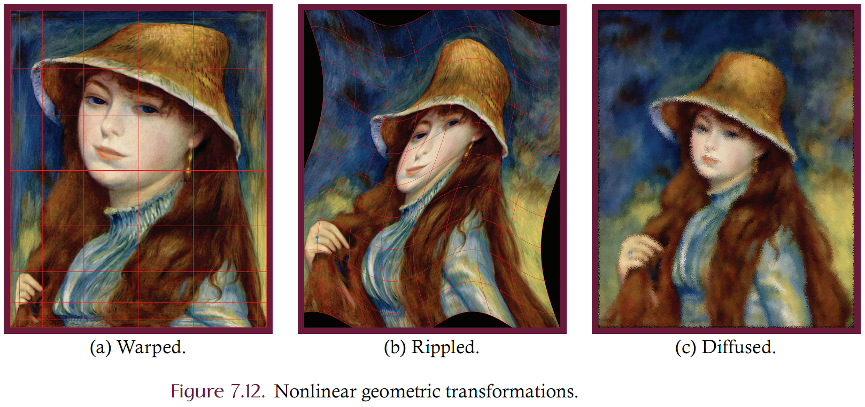
Other examples

