Slide 1
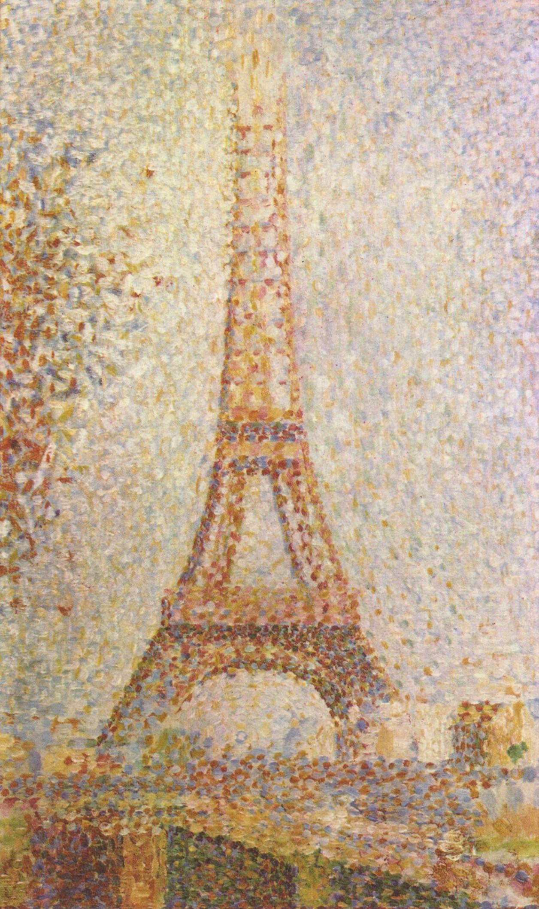
Point Processing
Histograms

Slide 2
Histogram Equalization
Histogram equalization is a powerful point processing enhancement technique that seeks to optimize the contrast of an image at all points.
As the name suggests, histogram equalization seeks to improve image contrast by flattening, or equalizing, the histogram of an image.
A histogram is a table that simply counts the number of times a value appears in some data set.
In image processing, a histogram is a histogram of sample values.
For an 8-bit image there will be 256 possible samples in the image and the histogram will simply count the number of times that each sample value actually occurs in the image.
In other words, the histogram gives the frequency distribution of sample values within the image.

Slide 3
Histogram Equalization
For an N-bit WxH grayscale image where the i^{th} sample is known to occur n_{i} times, the histogram is given as:
Histograms are typically normalized such that the histogram values sum to 1. In Equation (5.10) the histogram is not normalized since the sum of the histogram values is WH.
The normalized histogram is given in Equation (5.11), where hat-h(i) represents the probability that a randomly selected sample of the image that will have a value of i:

Slide 4
Histogram Equalization
A histogram is typically plotted as a bar chart where the horizontal axis corresponds to the dynamic range of the image and the height of each bar corresponds to the sample count or the probability.
Generally, the overall shape of a histogram doesn’t convey much useful information but there are several key insights that can be gained.
The spread of the histogram relates directly to image contrast where
narrow histogram distributions are representative of low contrast images
wide distributions are representative of higher contrast images.
Generally, the histogram of an underexposed image will have a relatively narrow distribution with a peak that is significantly shifted to the left
Generally, the histogram of an overexposed image will have a relatively narrow distribution with a peak that is significantly shifted to the right.

Slide 5
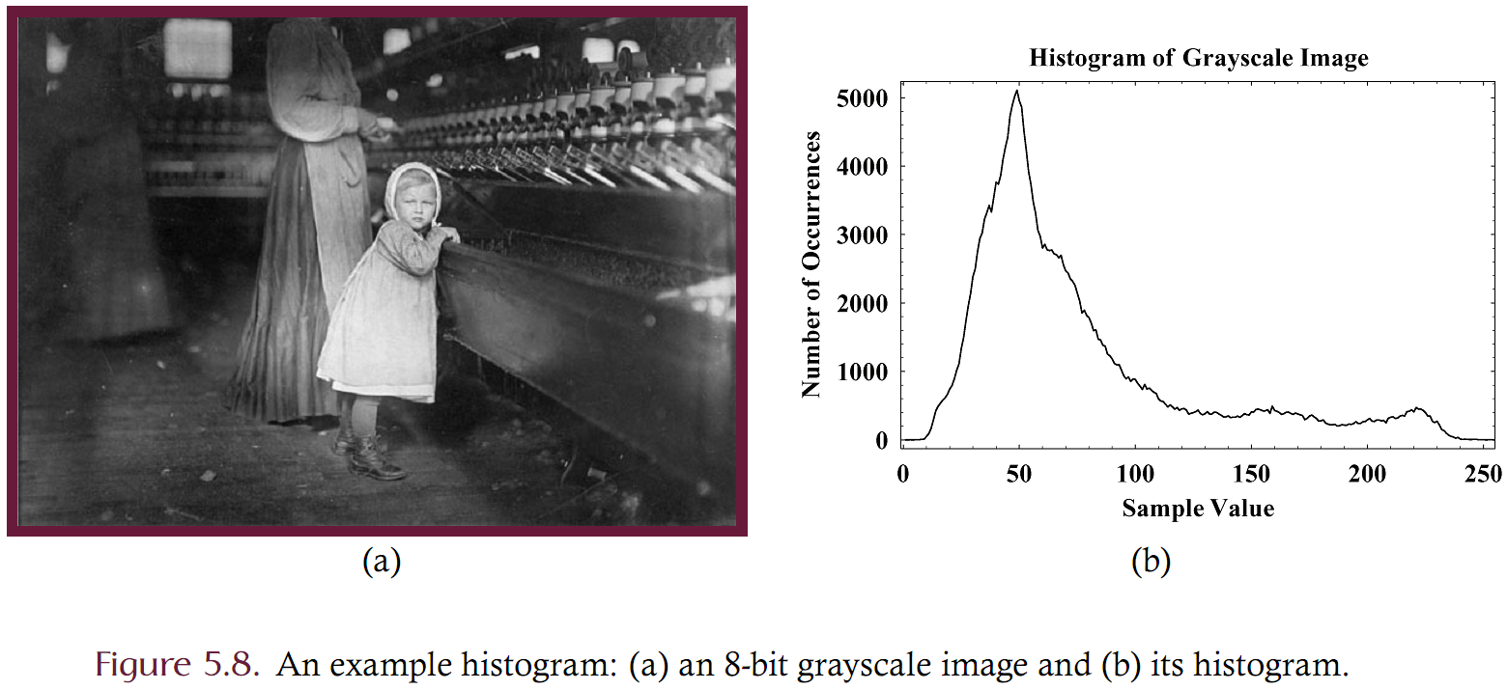
Histogram Example

Slide 6
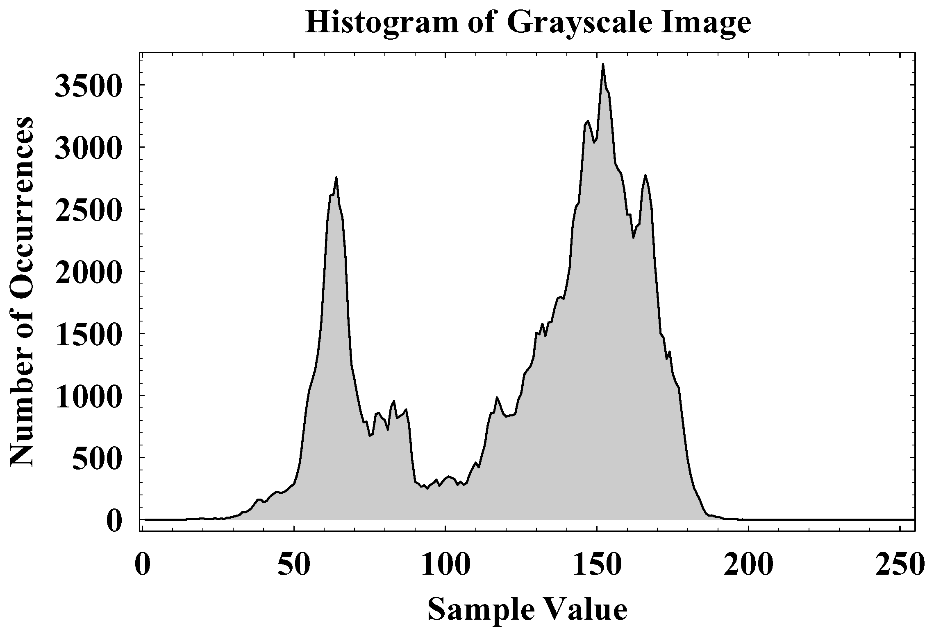
Histogram Example
The image is characterized by low contrast. This is reflected in the histogram which shows that most samples are in a narrow region of the dynamic range (little information below 40 or above 190).

Slide 7
Histogram Equalization
Histogram equalization is a way of improving the local contrast of an image without altering the global contrast to a significant degree.
This method is especially useful in images having large regions of similar tone such as an image with a very light background and dark foreground.
Histogram equalization can expose hidden details in an image by stretching out the contrast of local regions and hence making the differences in the region more pronounced and visible.
Non-linear point processing technique that attempts to flatten the histogram such that there are equal numbers of each sample value in the image.

Slide 8
Histogram Equalization
Uses the cumulative distribution function (CDF) as the lookup table.
Given an N-bit image having histogram h, the normalized CDF is given by:
The CDF essentially answer the question “what percentage of the samples in an image are equal-to-or-less-than value j?”
The normalized CDF must be rescaled to [0,255] and is then used as the lookup table.

Slide 9
CDF (Extra notes)
The CDF is monotonically increasing
The derivative (slope) of the CDF is steep where there is a lot of information in the source and is flat where there is little information in the source.
The CDF of a perfectly equalized image is a straight line with a slope of 1.

Slide 10
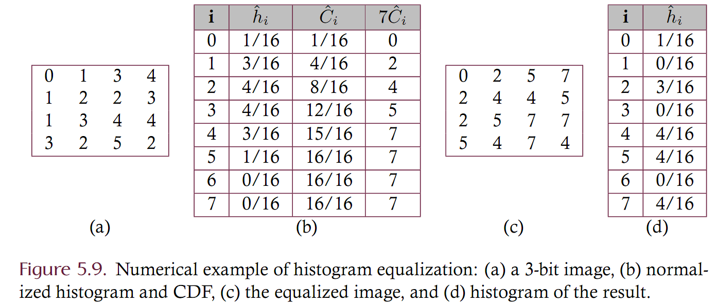
Numeric Example of Equalization

Slide 11
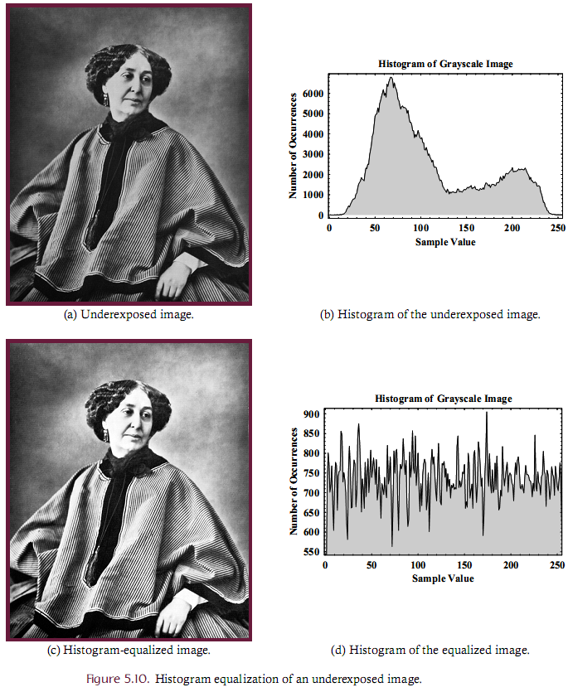
Example

Slide 12
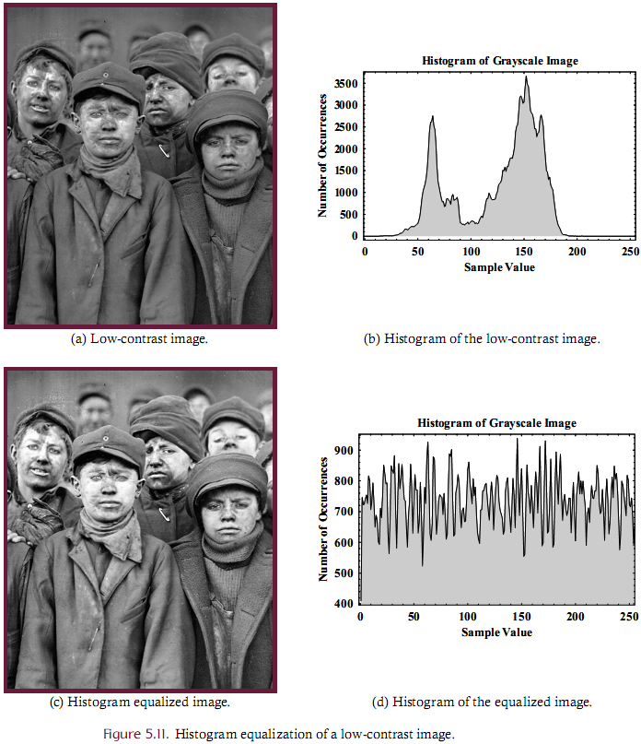
Example

Slide 13
Histogram Equalizing Color Images
Histogram equalization can also be done on color images by performing the grayscale technique on each separate band of the image.
Care should be taken when doing this, however, since the colors will likely be dramatically altered as a result.
If the tonal distributions are different among the red, green, and blue channels of an image, for example, the lookup tables for each channel will be vastly different and equalization will alter the color patterns present in the source.
Histogram equalization of a color image is best performed on the intensity channel only, which implies that the equalization should be done on the brightness band of an image using the HSB or YIQ color spaces, for example.

Slide 14
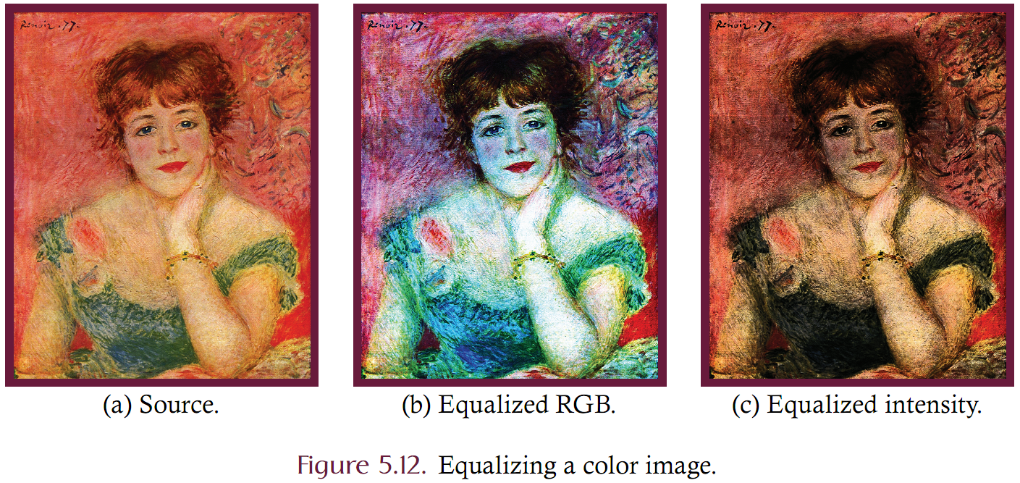
Histogram Equalizing Color Images
Consider equalizing a color image
(b) equalizing each band independently
(c) equalizing only the intensity

Slide 15
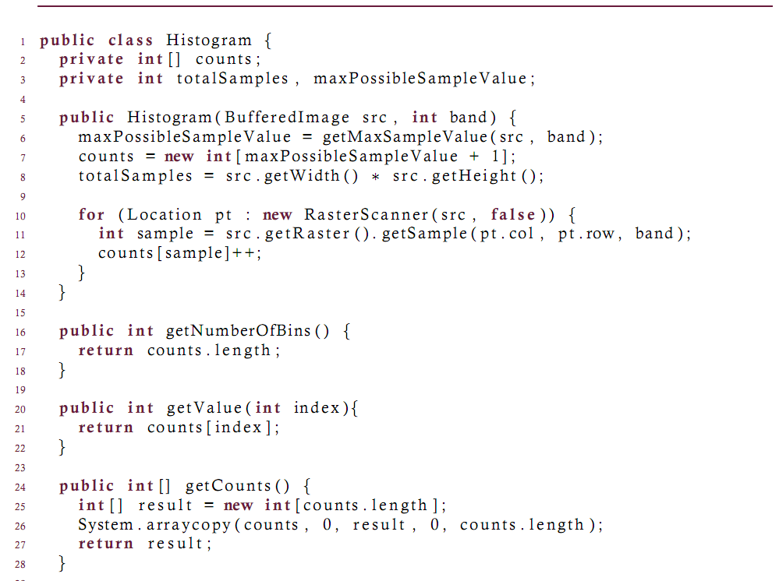
Implementation (Histogram)

Slide 16
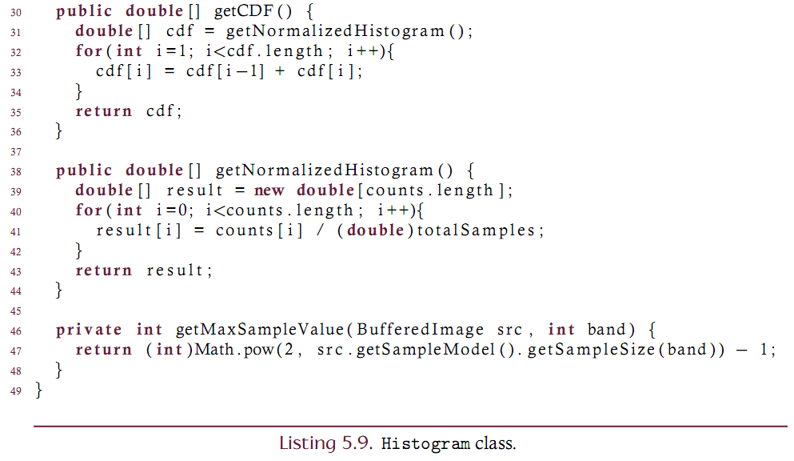
Implementation (Histogram) (Continued)

Slide 17
Local equalization
Histogram equalization can be performed on a “local” level.
Compute the histogram and CDF of a local region about each pixel and then use that CDF as a lookup table for that pixel alone.
Has the (possibly negative) effect of eliminating global contrast!
Original Image
Equalized Image
Locally Equalized Image

Slide 18
Color Histogram
A color histogram is a 3D entity where each pixel of an image (rather than each sample) is placed into a bin.
The color space is divided into volumetric bins each of which represent a range of colors.
Each axis of the color space may be divided independently of the others. This allows the axes to have different resolutions.
In YCbCr may want to allocate more resolution on Y than Cb or Cr
In RGB may want to allocation more resolution in G than R or B

Slide 19
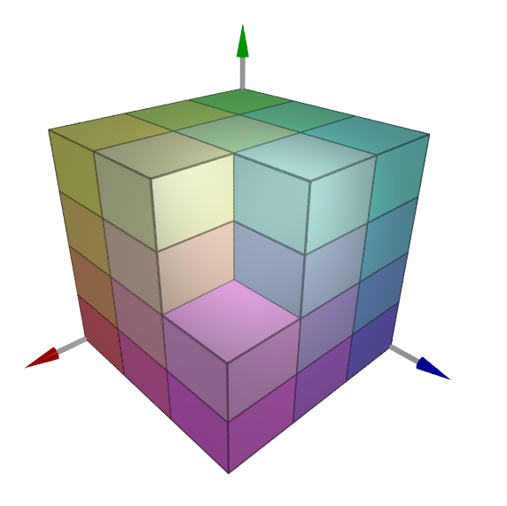
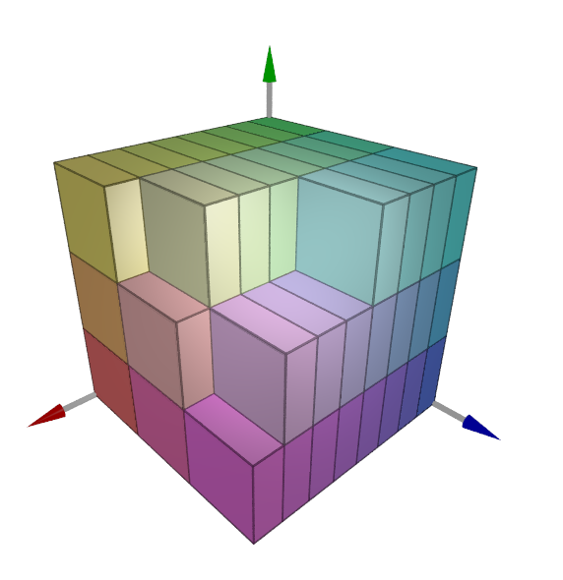
Color Histogram
3x15x3 resolution
3x4x3 resolution
8x3x3 resolution
Consider the resolution of various color histogram binnings in RGB space. The resolution of each axis may be set independently of the others.

Slide 20
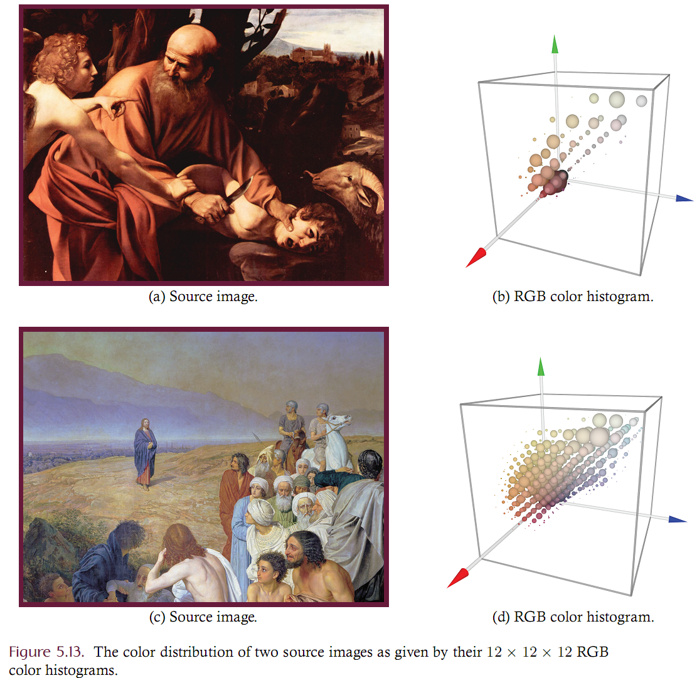
Example

Slide 21
Color Histogram Usage
Color histograms provide a concise but coarse characterization of an image
Often used in CBIR systems
Large database of images which can be searched by image content, not by keyword or metadata
Use color histograms to refine the search
Similar histograms are likely to reflect visually similar source images
Two very dissimilar source images may have two similar histograms, however

