Slide 1
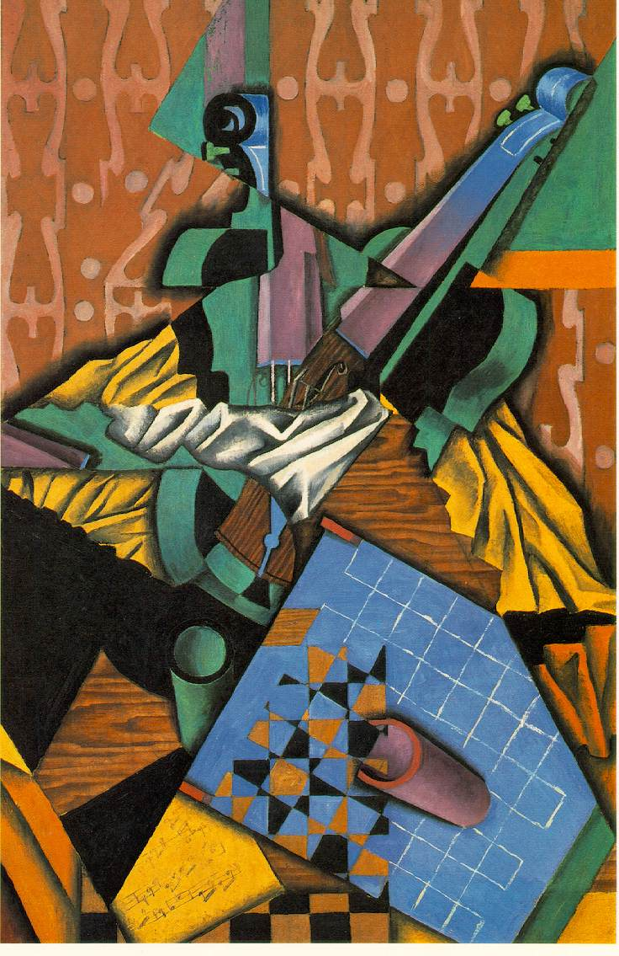
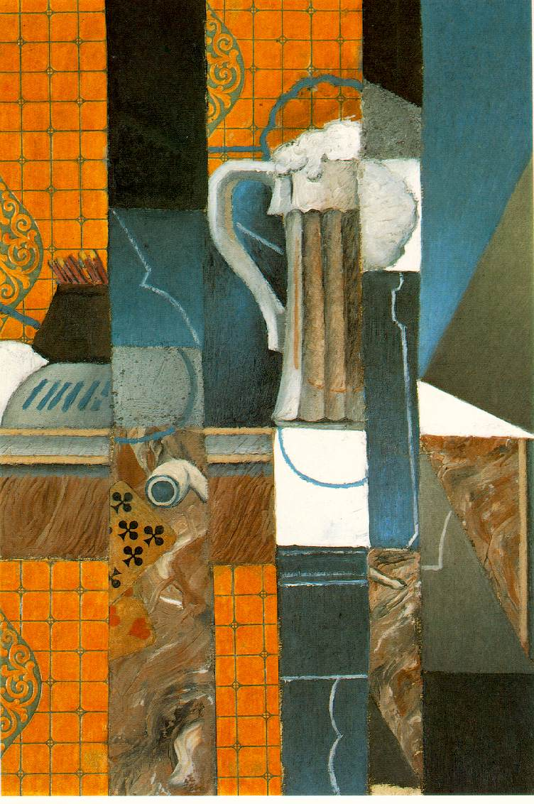
Digital Images in Java
The structure of code and concept
http://upload.wikimedia.org/wikipedia/commons/6/67/Juan_Gris_-_Violin_and_Checkerboard.jpg
http://upload.wikimedia.org/wikipedia/commons/8/8b/Juan_Gris_-_Glass_of_Beer_and_Playing_Cards.jpg

Slide 2
Image structure
Recall that:
An image is a 2D grid of pixels
Each pixel has multiple samples
Each image has 0 or more bands
The central task of writing object-oriented image processing software is to generate data structures and methods ﬂexible enough to represent images having different color and data models while still providing a uniform and efﬁcient way of manipulating them.
Implementation goals:
Computationally efficient
Small memory footprint.
Java’s imaging library involves many classes. It will help to understand the architecture if we first examine the problems that these classes are designed to solve.

Slide 3
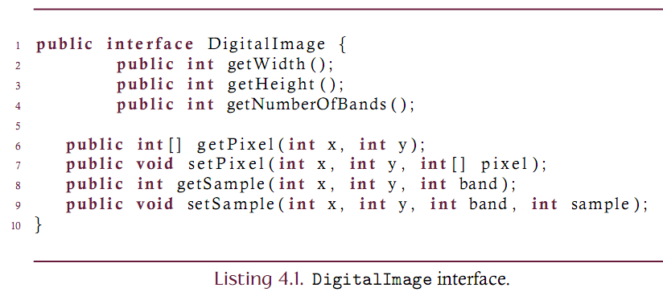
Define how an image is processed
Consider the DigitalImage interface that supports pixel and sample-level reads and writes.
Assumptions:
A sample is an ‘int’
A pixel is an array of samples
No other restrictions

Slide 4
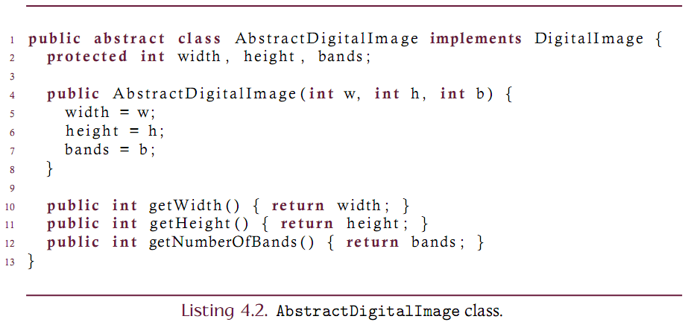
Develop a base class
Consider an abstract base class that services the simplest methods of the DigitalImage class. Full implementations will subclass this abstraction.
Servicing the sample and pixel handling methods is deferred to subclasses
Servicing the image properties of width, height, and number of bands are handled here.
Recall that abstract classes cannot be instantiated

Slide 5
Three dimensional array
Since samples are accessed by col, row and band – it is natural to implement the image as a three-dimensional array.
The entire image is then a 3D array of integers such that:
The first index is the row index (since Java is row-major)
The second index is the column index
The third index is the band index
The DigitalImage interface has column as the first and row as the second indices. Must interally manage the mapping here….

Slide 6
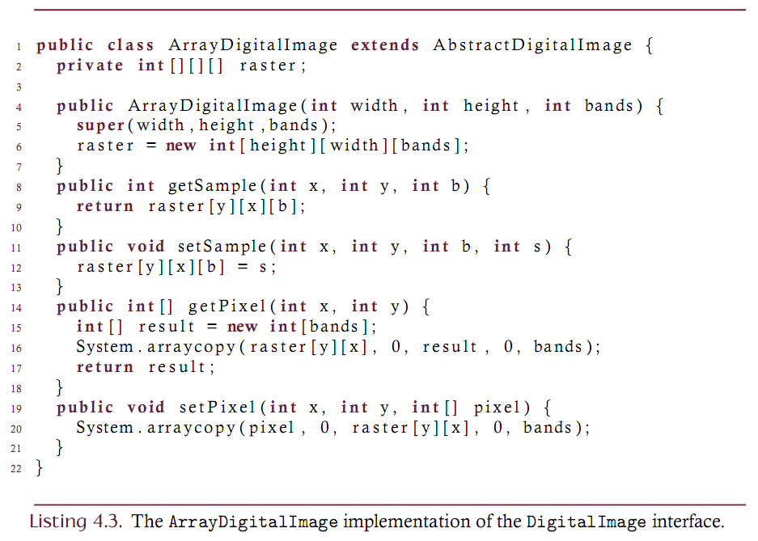
Three dimensional array implementation

Slide 7
Analysis
Computational efficiency?
Each of the methods is computationally efficient.
The getPixel method could be ‘faster’ by not copying
Small memory footprint?
Color depth is:
One int per sample or 32 bits per sample
This means 96 bpp for three-band image
Also, there is a large ‘invisible’ overhead due to Java’s array structure
A 2D array is a 1D array of arrays
Each array has a length attribute
Each cell is a ‘pointer’ variable and consumes memory

Slide 8
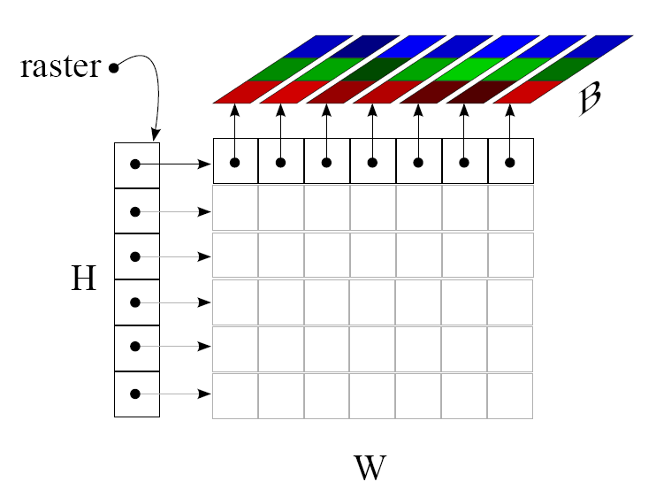
Analysis
Memory footprint of the 3D array structure of the raster
Each pointer-to-array cell is 4 bytes of memory:
There are H + W*H of these pointer cells
Each array has a length attribute which is 4 bytes:
There are 1 + W + W*H arrays
Total structural overhead is then
(H+W*H) * 4 + (1 + W + W*H)*4 bytes
Approximately equal to 8WH

Slide 9
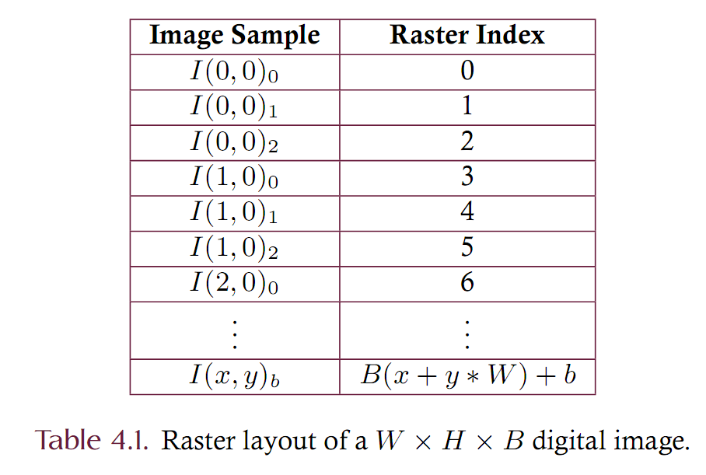
Linearization
Reduce the overhead by eliminating the multi-dimensional array. Pack the 3D array into a 1D array.
Problem: Take three indices (column, row, band) of a 3D array and uniquely map to a single index of a 1D array.

Slide 10
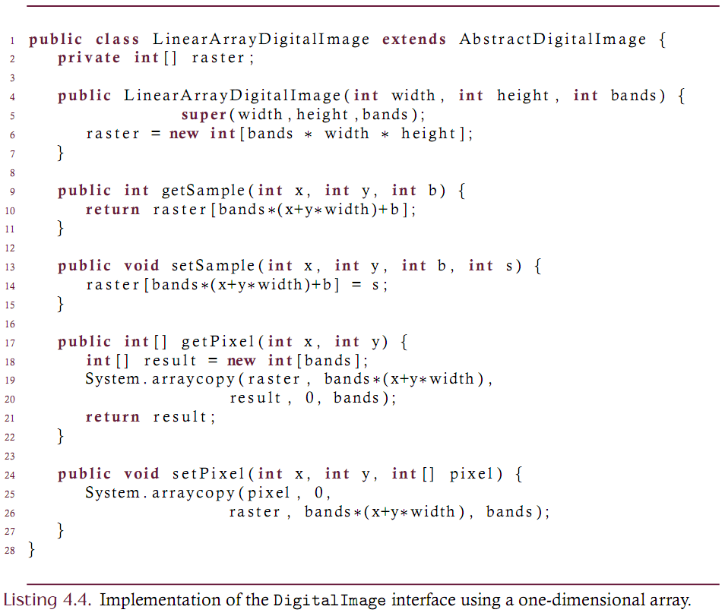
Linearized Raster

Slide 11
Analysis
There is no structural overhead in the linearized array implementation. We have saved 8*W*H bytes!
The color depth of the implementation is still too high
96 bpp is much higher than any practical application requires.
How can this be reduced?
For human perception, 24 bpp is sufficient. Why not use 24 bits for a pixel rather than 96?
The smallest primitive that has at least 24 bits is an int
Let’s put the three bands into the 32 bits of an int!
This is known as pixel packing.

Slide 12
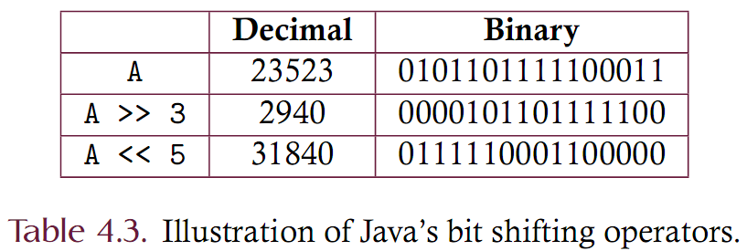
Pixel Packing : review bit operators
Java supports bit-level processing (bit twiddling).
Bit shift << and >>
Bitwise logical &, |, ^, ~
Bit shifting
The >> operator shifts each bit of the left operand to the right by the amount given by the right operand. Similar for <<.

Slide 13
Pixel Packing : review bit operators
Bitwise logical operators treat each bit as a logical value
A ‘1’ bit is ‘true’
A ‘0’ bit is ‘false’
Operations:
& AND/Conjunction
| OR/Disjunction
~ NOT/Negation
^ Exclusive OR

Slide 14
Pixel Packing
Must take a single int and partition into 4 bytes
Each byte corresponds to a band
Each band must be accessible as an 8-bit unsigned byte

Slide 15
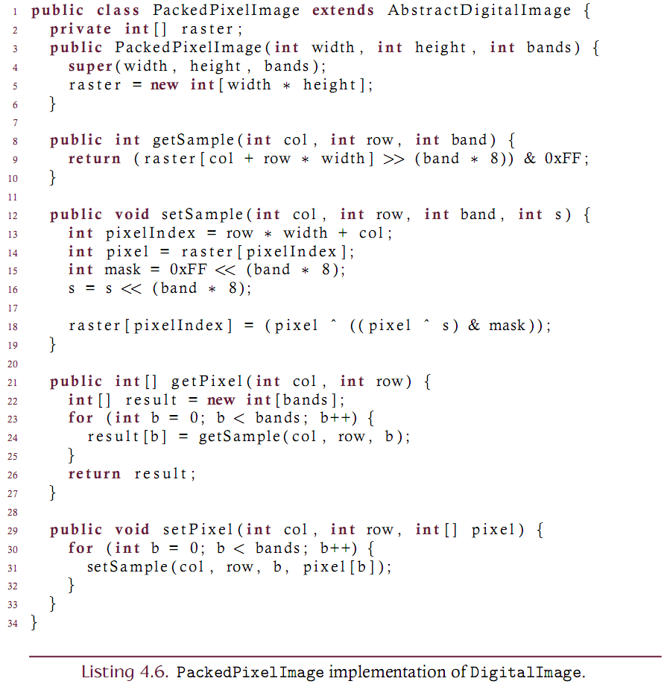

Slide 16
Packed pixel analysis
Computational efficiency?
Similar to the multi-dimensional array
Small memory footprint?
Very efficient use of memory.
Requires approximately 4WH bytes or 32 bpp
plus a handful for other things.
Does place a 24bpp color depth restriction on the image.

Slide 17
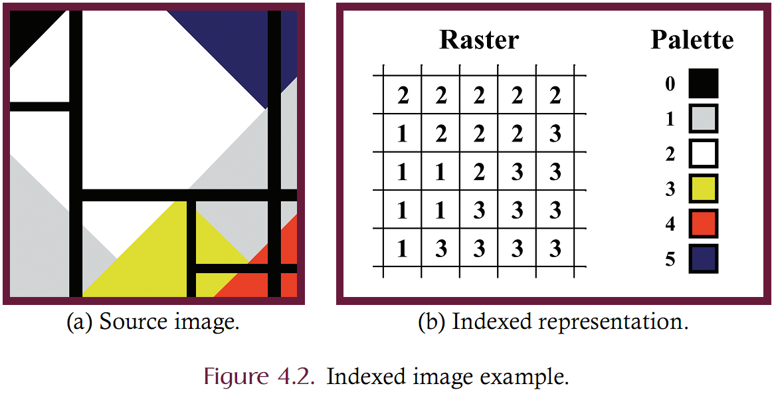
Index image
One alternative for true-color images having a small number of colors in the image. Use indexing.
Each pixel is a single byte.
This byte is an index into a color table (or palette).
The color is indirectly given by the pixel value.

Slide 18
Index Image
Computational efficiency?
Fast
Small memory footprint?
Very efficient use of memory.
Requires approximately WH bytes
plus a handful for other things (the palette)
Notes
The palette can be no larger than 256 colors
Processing issues: how to change all black to yellow?
Processing issues: how to change one pixel to a color not in the palette?

Slide 19
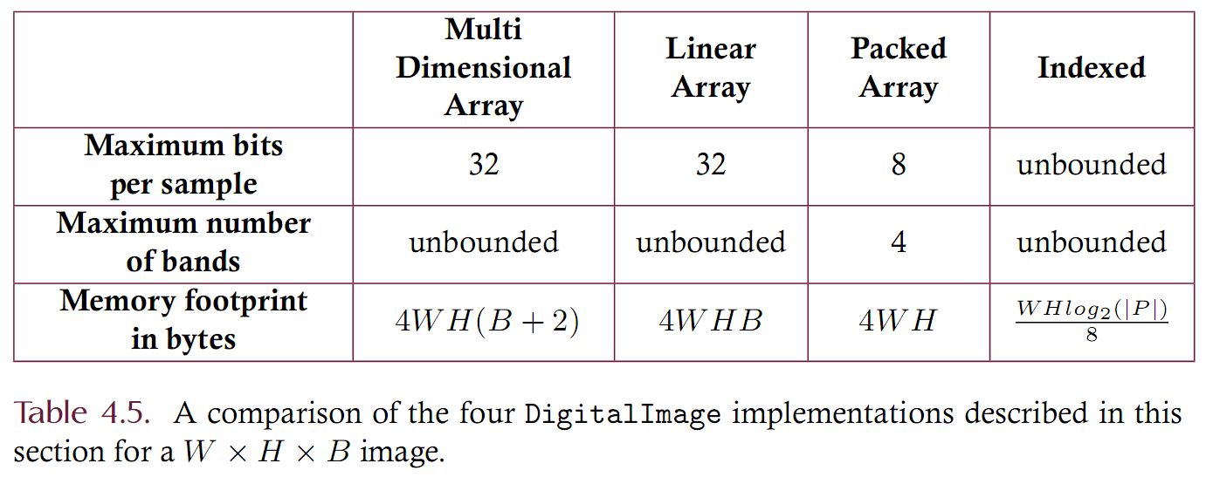
Implementation Summary

