Slide 1
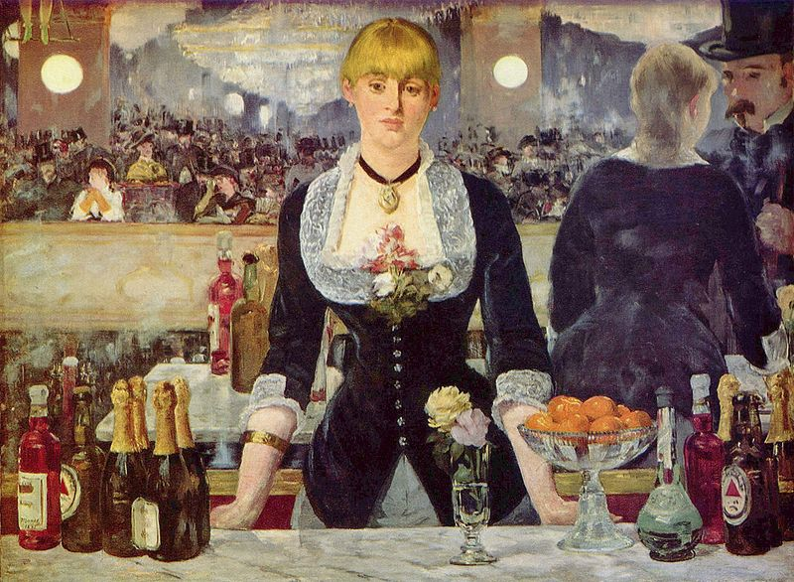
Digital Images
The nature and acquisition of a digital image

Slide 2
Image Types
All images can be thought of as “color” images since even black and white are colors
More commonly we distinguish between three types of images:
Color: an image containing any color
Grayscale: an image containing only those colors on the black-white RGB diagonal (or the brightness dimension of some other color space)
Binary: an image containing only black and white
Note:
Many people refer to a grayscale image as a “black and white” image. This is not really proper.
Many people refer to a “monochromatic” image. Such an image must properly contain only one color – but this term really means a binary image.

Slide 3
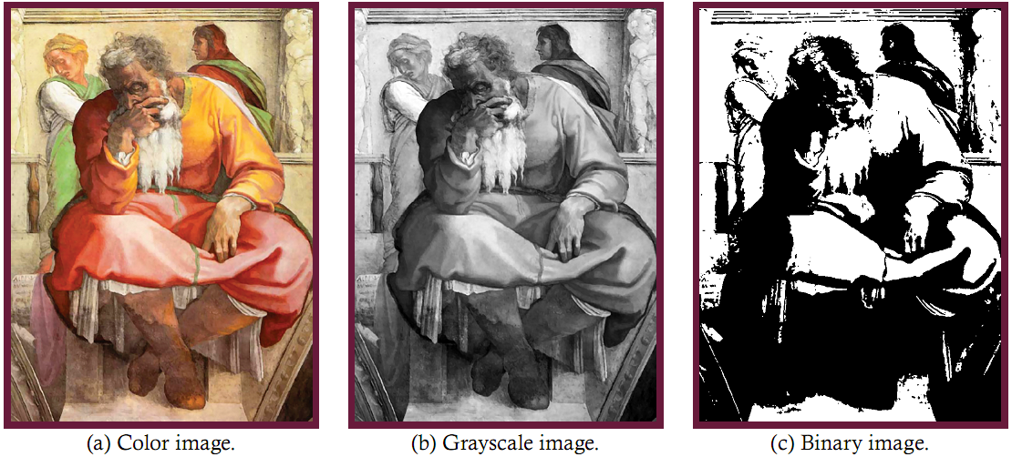
Image Types Example

Slide 4
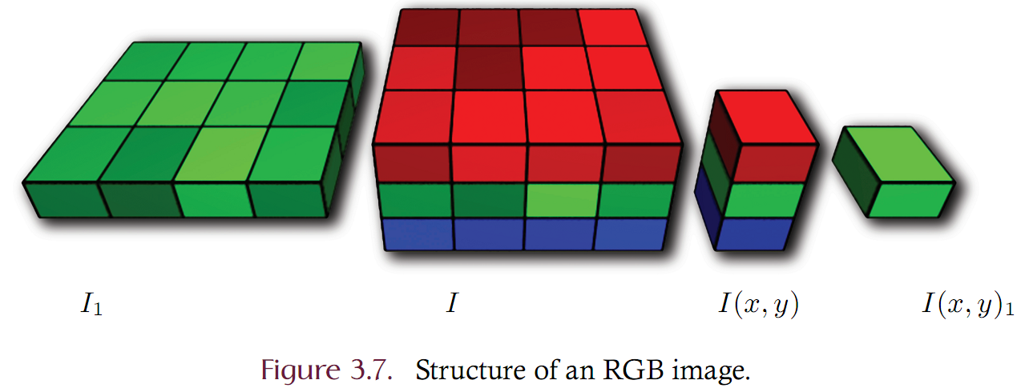
Digital Image Terms and Structure
Digital image: a 2D grid of colored picture elements (pixels)
pixel – the color of an image at a specific point. I(x, y)
sample – one dimension of a pixel. I(x, y)_{b}
band – all samples on the same layer. I_{b}

Slide 5
Color Depth
Describes the ability of an image to accurately reproduce colors
Given as the number of bits consumed by a single pixel
Otherwise known as bits per pixel (bpp)
Consider the following image types:
Binary images are ____ bpp?
Grayscale images are typically 8 bpp.
Color images are typically ____ bpp?
Most applications do not need more than 24 bpp. Specialized medical or scientific applications may use 30 bpp depth or greater.

Slide 6
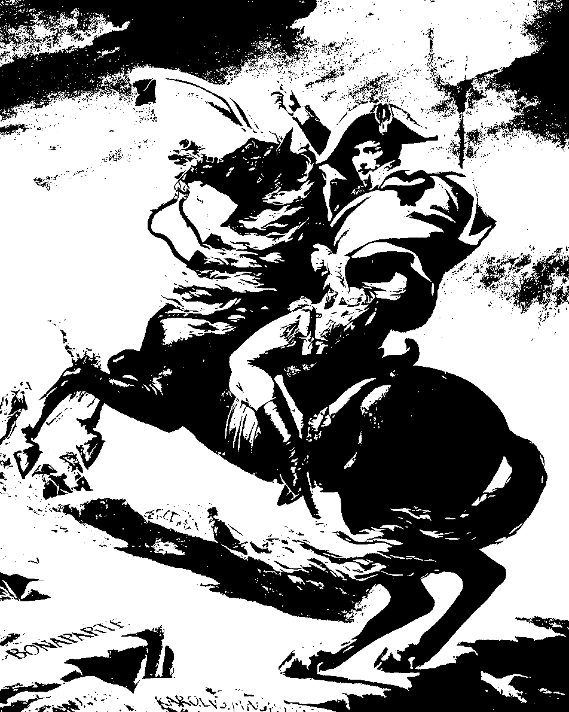
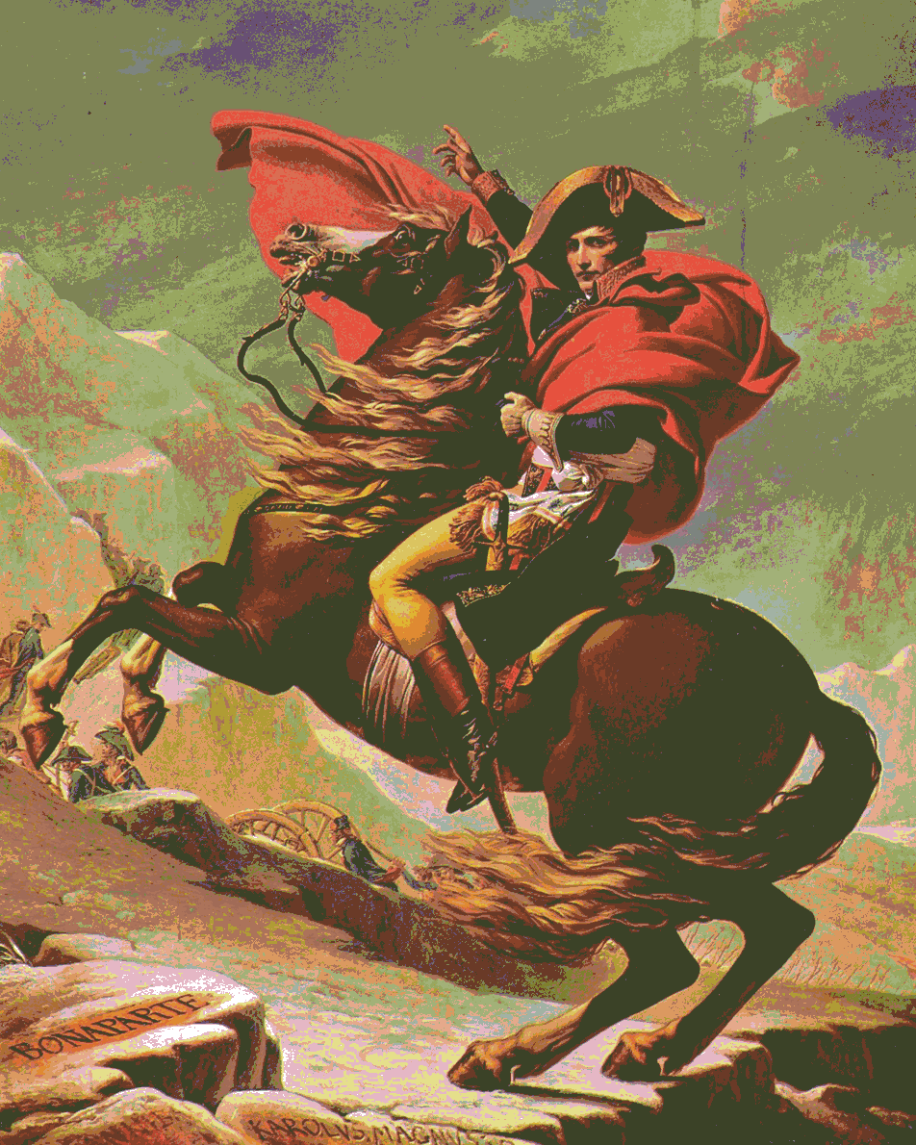
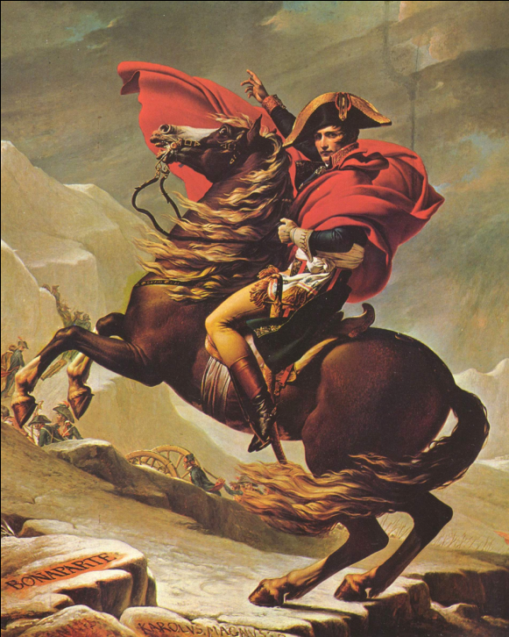
1 bpp | 2 bpp
5 bpp | 24 bpp
Effect of color depth on image quality

Slide 7
Digital images
Resolution measures the amount of visual detail that an image holds.
Higher resolution means greater capacity for visual detail
Defined as the number of columns and rows
Common: 640x480, 800x600, 1600x1200
Read as 640 by 480
Sometimes given as total pixel count such as
800x600 == 4.8 Megapixel resolution
Aspect ratio
Num of columns divided by rows
4:3 OR 1.33

Slide 8
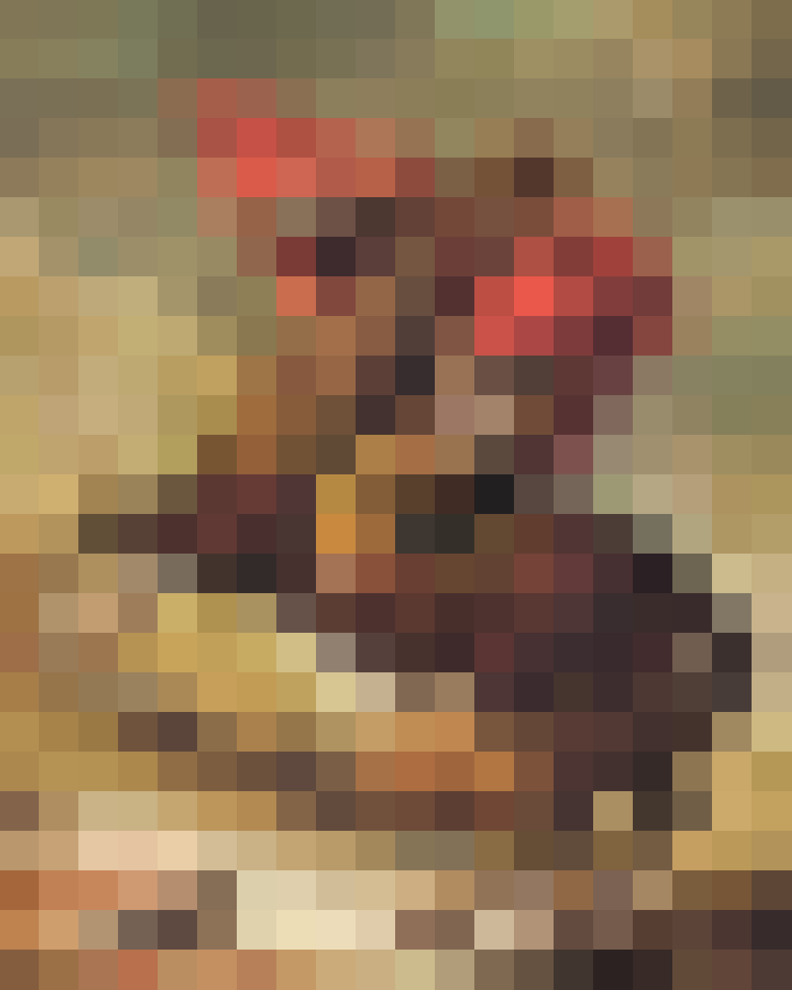
4x5 | 20x25
100x125 | 360x450
Effect of resolution on image quality

Slide 9
Image Frequency
Image frequency is a measure of the amount of change in color that occurs over spatial distance
Large intensity change over small distance is high frequency
Small intensity change over large distance is low frequency
Frequency is directly related to resolution.
Higher resolution images are able to represent higher frequencies than lower resolution images.
Higher resolution images do not necessarily contain high frequency content but they have the capacity.
Most images contain low and high frequencies in different regions

Slide 10
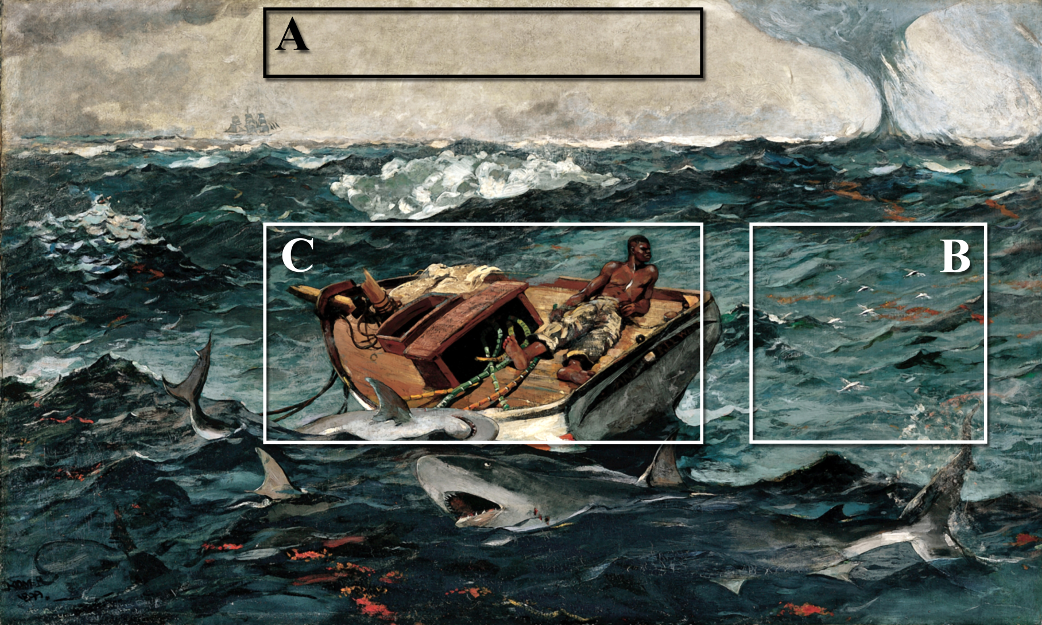
Image Frequency

Slide 11
Characterizing a Digital Image
In summary, a digital image can be characterized by
Its color model
Its color depth
Its resolution
Its frequency content
Each of these attributes must be understood to effectively construct an image processing system

Slide 12
Image acquisition
Imaging : the process of acquiring a digital image from some real-world scene
Acquired through imaging hardware
digital camera
digital copier
digital scanner
Most imaging systems use a CCD or CMOS sensor
Charge coupled device (CCD)
Complementary metal oxide semiconductor (CMOS)
Refers to the physical design of the sensor – both CCD and CMOS sensors produce the same result

Slide 13
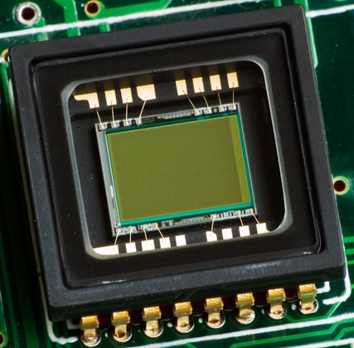
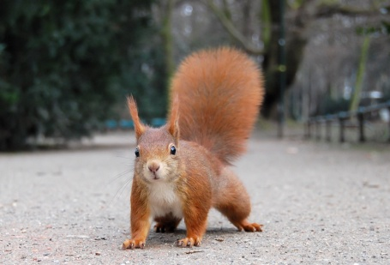
CCD
http://commons.wikimedia.org/wiki/File:Eichhörnchen_Düsseldorf_Hofgarten_edit.jpg
A CCD is an electronic circuit with a grid of small rectangular photo-cells.
The optical lens focuses a scene onto the sensors.
Each photo-cell measures the amount of light that falls onto it.
The collective data of the sensors represents an image when viewed from a distance.

Slide 14
Imaging
A digital image is an approximation of the continuous tone real-world scene
The digital image is approximate in both light and space
Sampling:
a partitioning of space
Directly corresponds to image resolution
Quantization:
a partitioning of light levels.
Directly corresponds to color depth

Slide 15
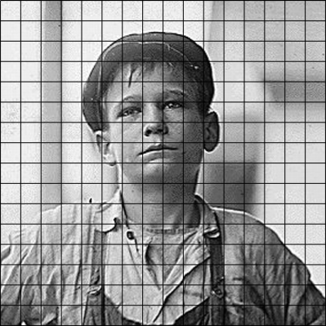
Sampling and Quantization example
continuous tone scene
sampled (partition space)
sampled and quantized (partitioned light levels)

Slide 16
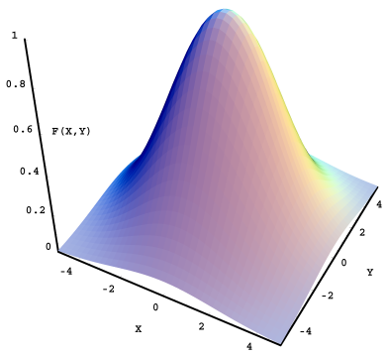
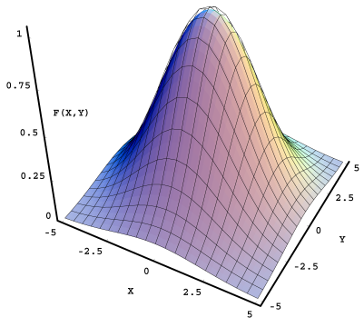
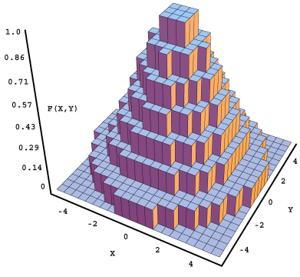
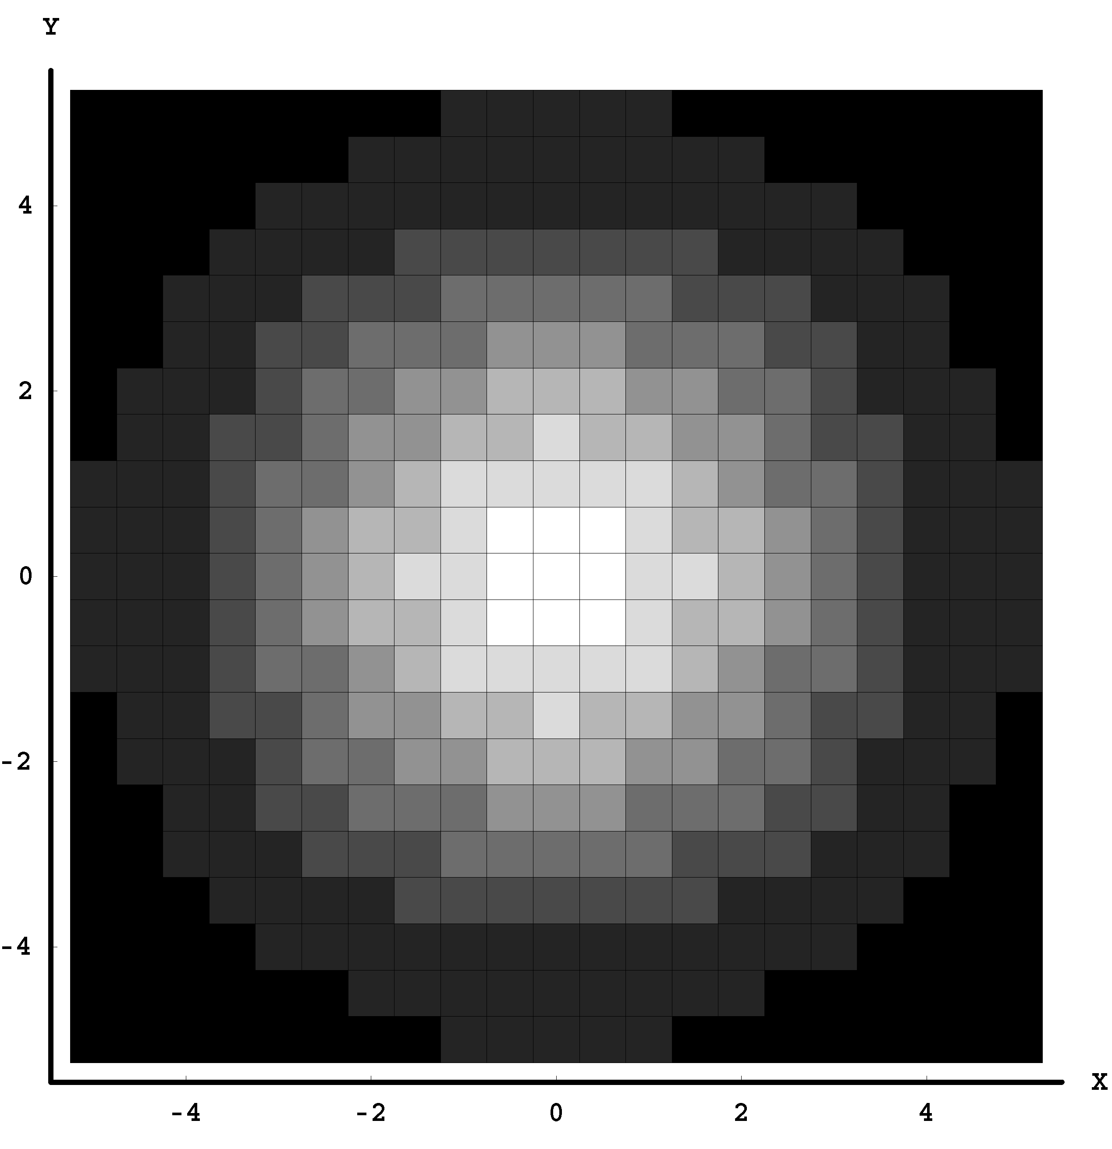
Sampling and Quantization example
Continuous function (upper left) is
Sampled (above) and then
Quantized (upper right) to form
Digital image (left)

Slide 17
Sampling and Quantization
Sampling is performed by the physical size and shape of the individual CCD/CMOS sensors
Typically rectangular.
An image sample represents a geometric point and has no size or shape although the sample was likely acquired by a square sensor
Quantization is determined by the sensitivity of the individual CCD/CMOS sensors

Slide 18
Sampling
As mentioned earlier, higher resolution allows more visual detail in an image.
How much resolution is required to adequately capture a particular image?
The Nyquist–Shannon sampling theorem provides the answer.
If the highest frequency component of the original continuous tone signal is B then a resolution of 2B is required. This is an informal definition which will be better understood by example and future discussion of the frequency domain.
Alisasing occurs when the sampling rate is inadequate. Aliasing may introduce false artifacts into the sampled image.

Slide 19
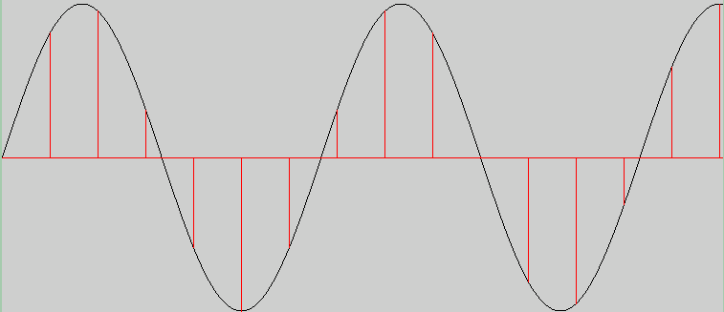
Sampling Rate and Aliasing
Nyquist Criterion Example: Adequate sampling rate

Slide 20
Sampling Rate and Aliasing
Nyquist Criterion Example: Inadequate sampling rate causes ‘aliasing’

Slide 21
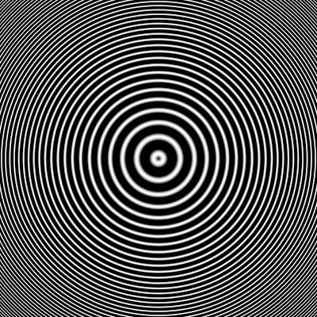
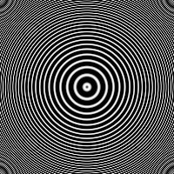
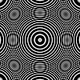
Image Aliasing Example
Left: Adequately sampled image
Above center: Image sub-sampled by 50%
Above right: Image sub-sampled by 25%
More aliasing occurs at the periphery since the image frequency is higher and the sampling rate is inadequate. Less aliasing occurs near the center since the frequency is lower and the sampling rate adequate.

Slide 22
Color image acquisition
A color camera must capture 3 samples for each pixel location. Somehow, each photosite must sense three different values.
Color digital cameras work in various ways:
A single CCD where each photosite measures red, green, OR blue
A single CCD where each photosite measures red, green, AND blue
A three-CCD system such that each CCD captures one band

Slide 23
Color image acquisition
Consider a single CCD color digital camera
Each individual photosite of the CCD is filtered to detect either red, green, OR blue light
Most filters mimic the cone density of the human eye
The Bayer filter uses 50% green and 25% red and blue sites.
If each green site is extracted – it forms a band with 50% gaps
If each red site is extracted – it forms a band with 75% gaps
If each blue site is extacted – it forms a band with 75% gaps
The ‘RAW’ data must be demosaiced (fill in the gaps) to produce a true-color image

Slide 24
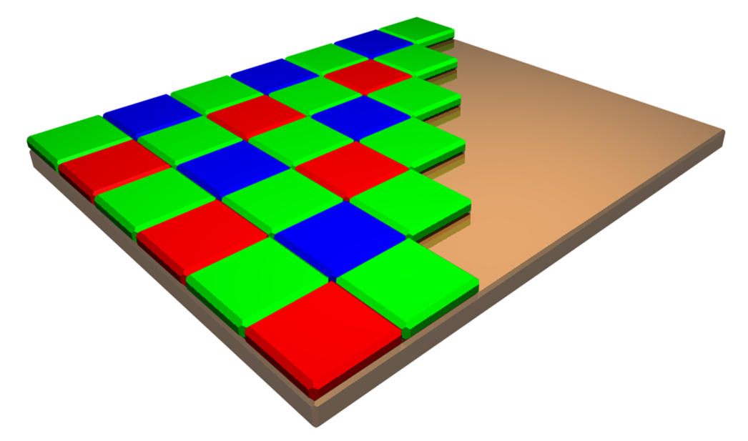
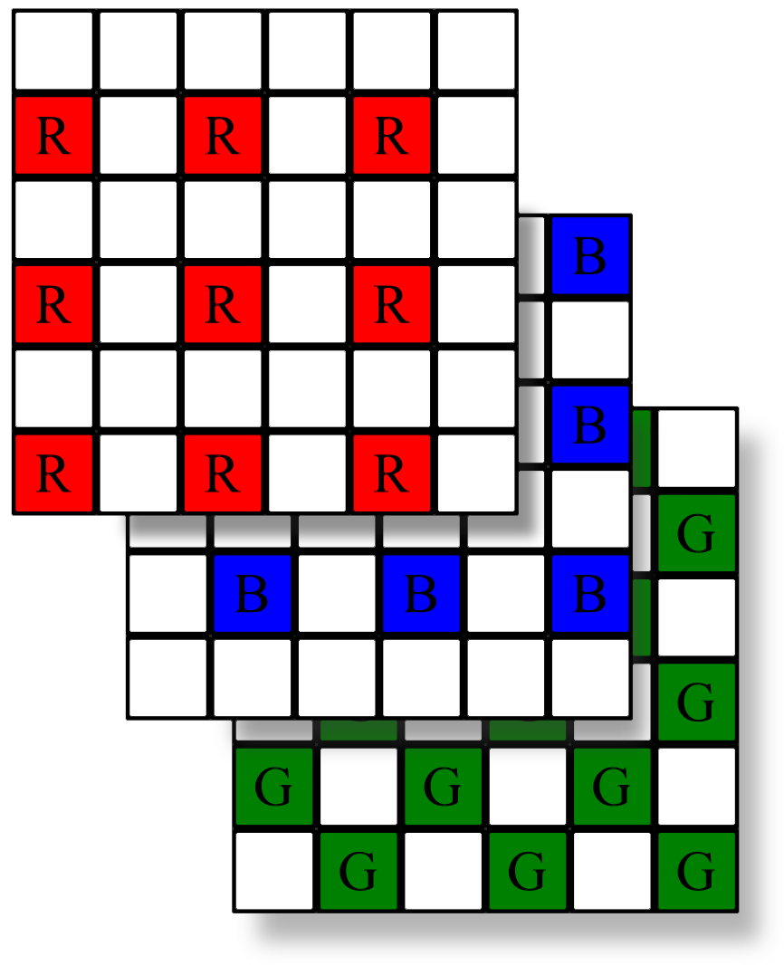
Bayer Filter

Slide 25
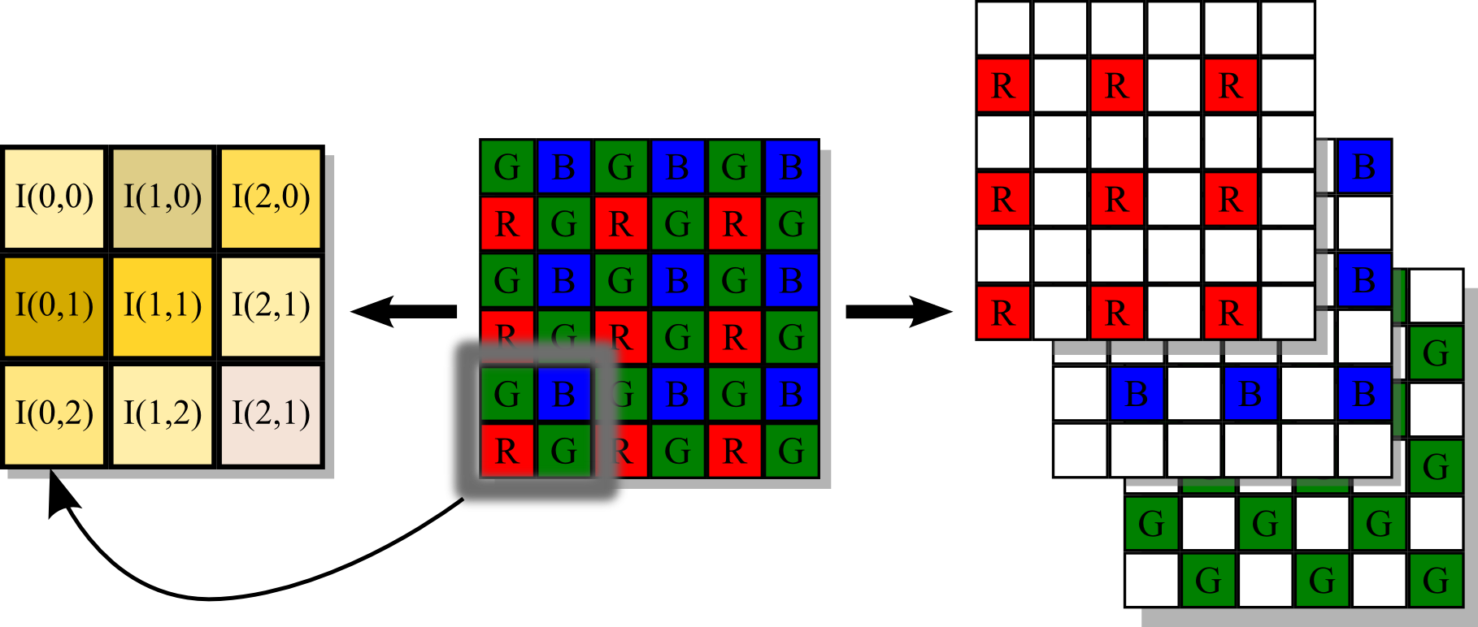
Demosaicing
Given an array of interlaced red / green / blue filtered grayscale images, create a single true-color image.
Demosaiced image
Raw CCD data
Separated ‘bands’

Slide 26
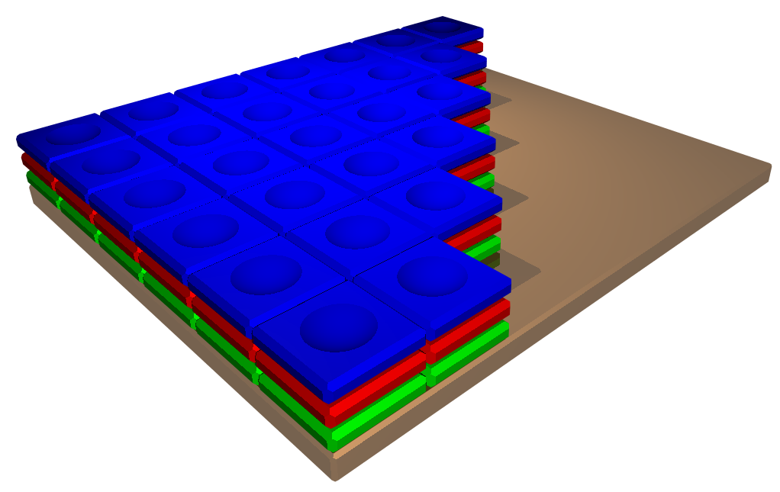
Color image acquisition
High-end color cameras contain a prism which divides the incoming light rays into their red, green and blue components. Each chip then samples a single color at full resolution.
A newer technology has emerged whereby each photosite is able to discriminate and measure red, green and blue light simultaneously. This technology does not require demosaicing.

