Slide 1
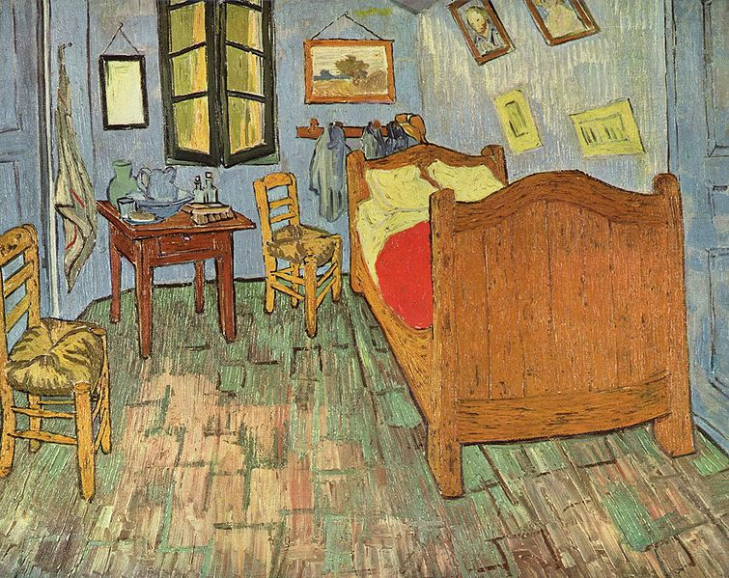
Digital Images
Color

Slide 2
Color
The human eye combines 3 primary colors using the 3 different types of cones to discern all visible colors. This suggests that color is a 3-dimensional entity.
Color Model
Is an abstract mathematical system for representing color.
Is a 3 dimensional abstractions.
Defines three primary colors along three dimensions
Is typically limited in the range of colors they can represent and hence often can’t represent all colors in the visible spectrum
Gamut or Color Space
The range of colors that are covered by a color model.

Slide 3
Color Models
Color models can be classified as either additive or subtractive.
Additive:
Assumes that light is used to generate colors.
Human perception is additive since black is the absence of light and white the presence of all wavelengths of light.
Devices: computer monitor, LCD screens, projectors
Subtractive:
Assumes that pigment is used to generate colors. White light is reflected off of an object which ‘absorbs’ or ‘subtracts’ certain wavelengths. The viewer then sees the light that is not absorbed.
The absence of pigment is “white” (blank piece of paper) while the presence of all types of pigment is “black”.
Devices: painting, pencils, pen, printers

Slide 4
Additive and Subtractive Color Models
Primary colors of light are additive
Primary colors are red, green, and blue
Combining red + green + blue yields white
No red, green or blue yields black (no light)
Primary colors of pigment are subtractive
Primary colors are cyan, magenta, and yellow
Combining cyan + magenta + yellow yields black
No cyan, magenta or yellow yields white (white paper)

Slide 5
RGB Color Model
RGB color model
A common way of representing color in computing systems.
The RGB model is additive.
Uses red, green, and blue as the primary colors.
A color can be obtained by combining different amounts of these three primaries.
Analogy :
Consider a ﬂashlight that has a slider that chooses the strength of light emitted.
Setting the slider to zero, the ﬂashlight is turned completely off
Setting the slider to one, the ﬂashlight generates as much light as it is capable of generating.
Consider three such ﬂashlights
Each light emits purely red; green; or blue light.
If all three ﬂashlights are aimed at the same spot on a white wall any color can be projected onto the wall by adjusting the slider values on the three lights in different ways.
If all sliders are set to zero: black
If all sliders are set to one: white
if all sliders are set to 0.5: gray

Slide 6
CMY Color Model
CMY color model
A common way of representing color in computing systems.
The CMY model is subtractive
Uses cyan, magenta, and yellow as the primary colors.
A color can be obtained by combining different amounts of these three primaries.
Analogy:
Consider an artist working with a pallette of three paint colors.
Consider mixing these colors together in various proportions:
Any color can be generated on the canvas by adjusting the ratio of the pigments in different ways.
If all pigments are thoroughly mixed together: black
If all pigments are completely absent: white
if all pigments are partially present on a white background: gray

Slide 7
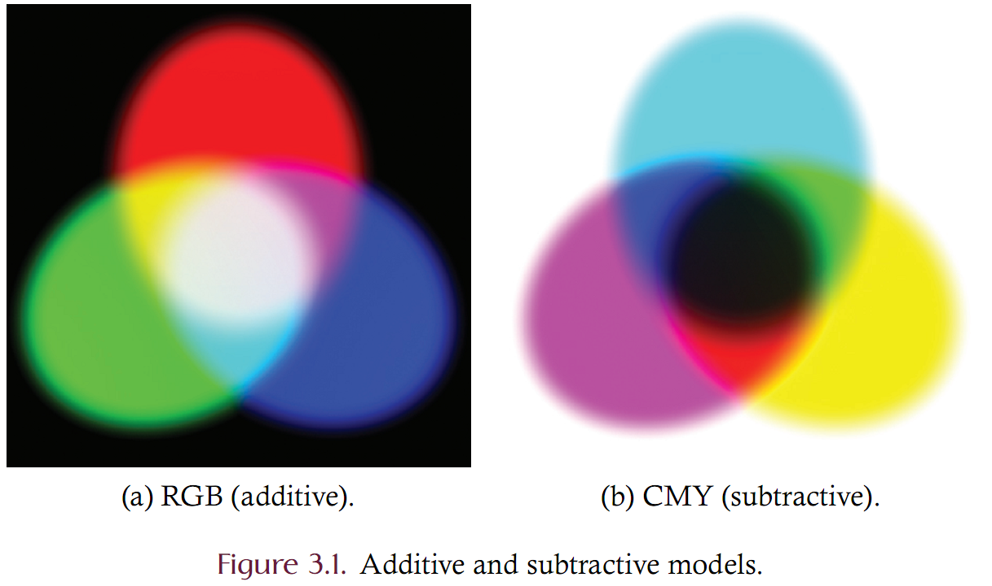
Illustration

Slide 8
RGB Color Model
RGB color model
Color is defined by a 3-tuple that gives the amount of red, green and blue light in the color.
Red is the first dimension
Green is the second dimension
Blue is the third dimension
The amount of each primary color is often given in normalized form as a value in the range 0 to 1
0 means “none”
1 means “maximum amount”
Examples:
Red is then given as <1, 0, 0>
Green is given as <0, 1, 0>
Blue is given as <0, 0, 1>
Define yellow, gray, magenta or dark green?

Slide 9
CMY Color Model
CMY color model is a subtractive model
Color is defined by a 3-tuple that gives the amount of cyan, magenta and yellow light in the color.
Cyan is the first dimension
Magenta is the second dimension
Yellow is the third dimension
The amount of each primary color is often given in normalized form as a value in the range 0 to 1
0 means “none”
1 means “maximum amount”
Examples:
Cyan is then given as <1, 0, 0>
Magenta is given as <0, 1, 0>
Yellow is given as <0, 0, 1>
Define yellow, gray, magenta or dark green?

Slide 10
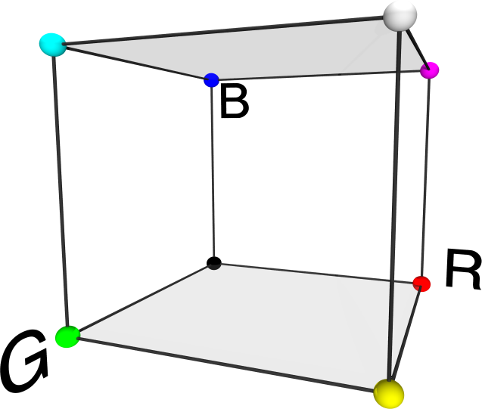
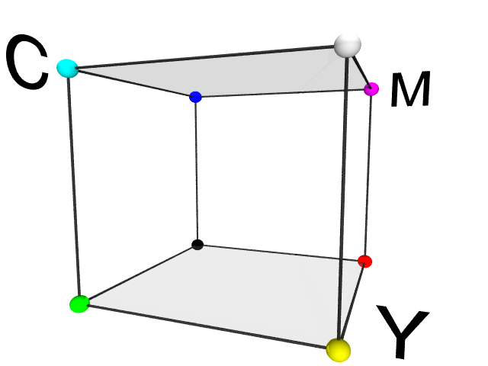
CMY
CMY
Similar to RGB and has the same color space but the coordinates are inverted such that the origin is white and black is at location <1,1,1>

Slide 11
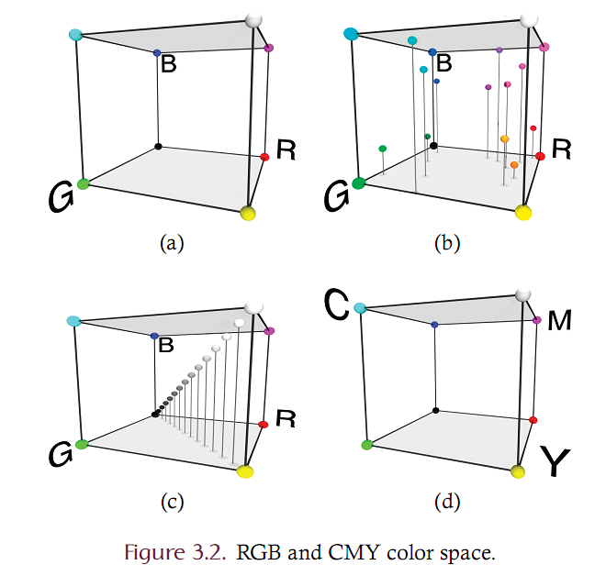
RGB Color Space

Slide 12
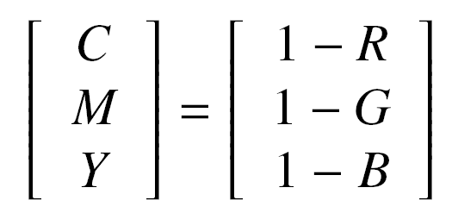
Conversion from RGB to CMY
Given a color in normalized RGB space as <R,G,B>, the same color in CMY space is given as <C,M,Y> where

Slide 13
CMYK
CMYK augments CMY by the addition of a black channel
CMY and CMYK are mathematically ‘equally expressive’
Color printers often user 4 or 5 colors
CMYK is of practical benefit
Conservation of ink. Many images have large black areas and it is wasteful to mix three pigments to form one black dot.
Creation of black pixels. In actual practice, mixing maximal amounts of cyan, magenta and yellow pigments creates a color that is not really black (dark muddy instead). Black ink is ‘blacker’.
Creation of crisp edges. Mixing three colors to create black will also yield blurred edges since the dots may not be precisely aligned with each other.

Slide 14
Conversion from CMY to CMYK
Given a color in normalized CMY space as <C’, M’, Y’> the same color in CMYK space is given by Equation 3.2 as <C,M,Y,K> where
K is a measure of the ‘blackness’ of the color and essentially serves as an offset after which the remaining amounts of cyan, magenta and yellow are ‘added’

Slide 15
HSB
HSB Color Model
Decomposes color according to perception rather than according to how it is physically sensed.
A point within the HSB gamut is deﬁned by
Hue (the chromaticity or pure color)
Saturation (the vividness or dullness of the color)
Brightness (the intensity of the color).

Slide 16
Color and Brightness
Any color can be decomposed into
A brightness component. This corresponds to the ‘grayscale’ version of the color
A color component. All other information is ‘color’ or ‘chroma’
In RGB and CMY space, the brightness and chroma are distributed over each of the three components
Other color spaces explicitly divide a color into one brightness dimensions and two chroma dimensions
HSB
YIQ
YCbCr
Others…

Slide 17
HSB Color Model
The HSB color space is a cylinder and hence HSB coordinates are given with cylindrical coordinates
hue=angle, saturation=radius, brightness=height
Hue is an angular measure [0-360] that is often normalized to be [0-1] where 1 correspond to 360 degrees.
Saturation is a percentage [0-1]
Brightness is a percentage [0-1]
Fully saturated colors are the most vivid
Fully de-saturated colors are grayscale (no color)

Slide 18
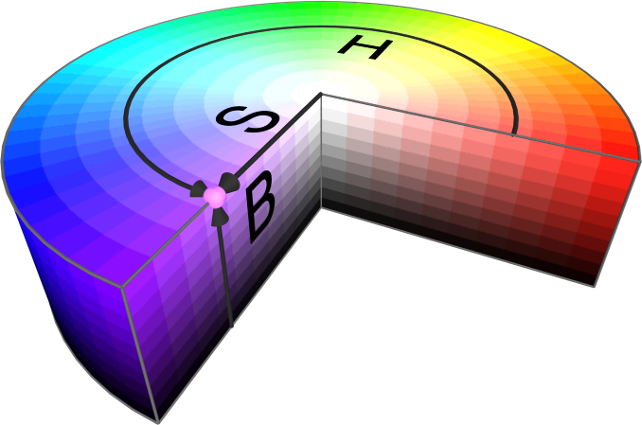
HSB Color Space

Slide 19
HSB Comments
Notes on the HSB model
The center of the cylinder is the grayscale
Red is given as <0, 1, 1> while gray is given as <0, 0, .5>
If intensity is zero then what do H and S mean?
HSB is computationally problematic since hue is cyclic. A hue value of 0 is equal to a hue value of 1.
HSB is useful since when filtering an image we often need to process only the brightness band. Using HSB space we can process only brightness without altering the color.

Slide 20
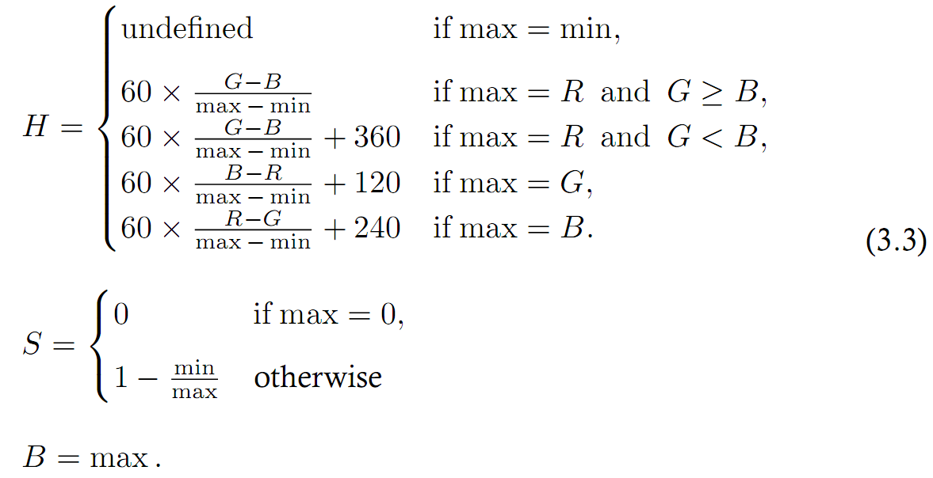
Conversion from RGB to HSB
Given a color in normalized RGB space, the corresponding color in HSB space is given as <H,S,B> where

Slide 21
YIQ Color Model
Like HSB, YIQ separates color into luminance and color channels
Y : is the luminance or grayscale component
I is the inphase component (amount of red-green)
Q is the quadrature (amount of blue-yellow)
Used for TV broadcasts – backward compatible with monochrome TV standards
Human visual system is more sensitive to changes in intensity than in color hence in NTSC, the bandwidth of YIQ is 4MHz in Y, 1.5 MHz in I, and 0.6 MHz in Q.
The YIQ color space is a rotation and distortion of RGB such that the Y axis lies along the RGB grayscale, the I axis is oriented roughly to red-green and the Q axis to blue-yellow.

Slide 22
Converting RGB to YIQ
Given a color in normalized RGB space, the corresponding YIQ color is then given as <Y,I,Q> where

Slide 23
YIQ comments
Note that the Y value is given as the weighted sum of RGB values such that
about 60% of the brightness comes from green
about 30% of the brightness comes from red
about 10% of the brightness comes from blue
This mirrors the human visual system since there are many more green cones than red and many more red cones than blue
Also note that while Y is in [0, 1] the values of I and Q are NOT in [0,1]

Slide 24
YCbCr Color Model
YCbCr is similar to YIQ : essentially a rotation around the Y axis
Y is luminance
Cb is a measure of ‘blueness’
Cr is a measure of ‘redness’
Often called YUV
Used in the JPEG file format and component video systems

Slide 25
Conversion from RGB to YCbCr
Given a color in normalized RGB space, the corresponding 8-bit YCbCr color is given as <Y, Cb, Cr> where
Note that Y is in [16, 235] while Cb and Cr are in [16, 240]. In practice, scaling is often used to convert into the full dynamic range of [0, 255].

Slide 26
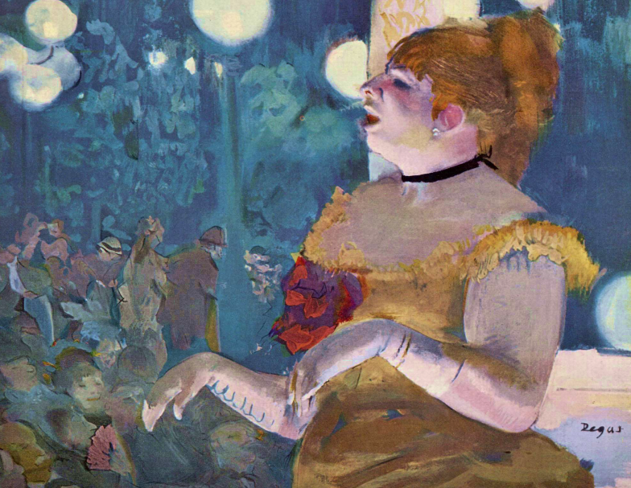
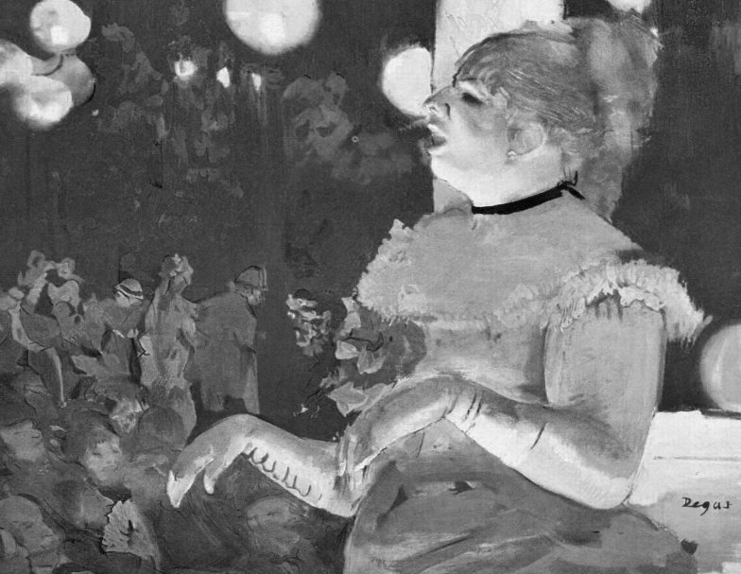
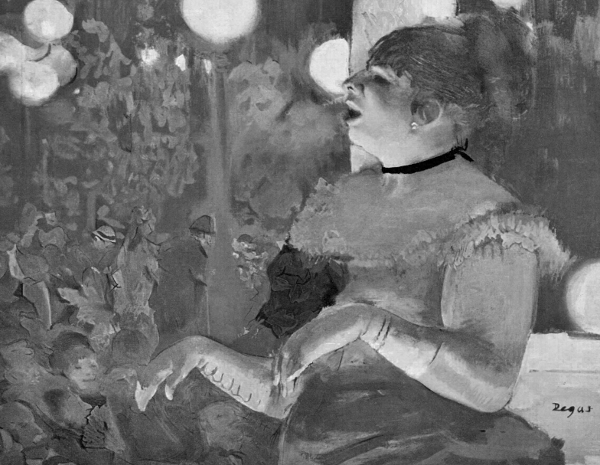
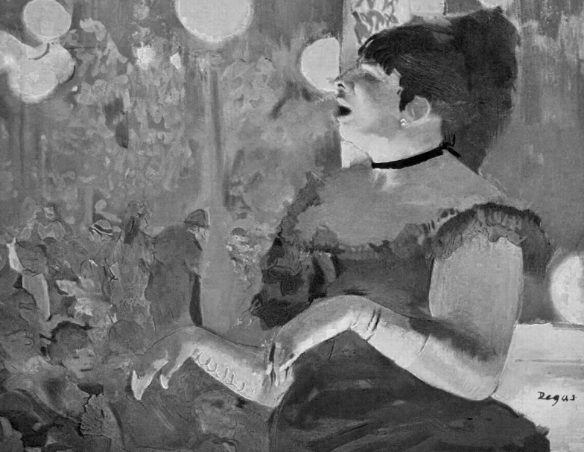
RGB Channels
Source | Red
Green | Blue

Slide 27
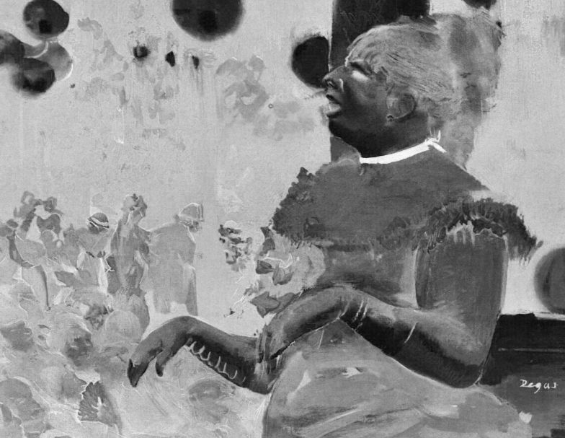
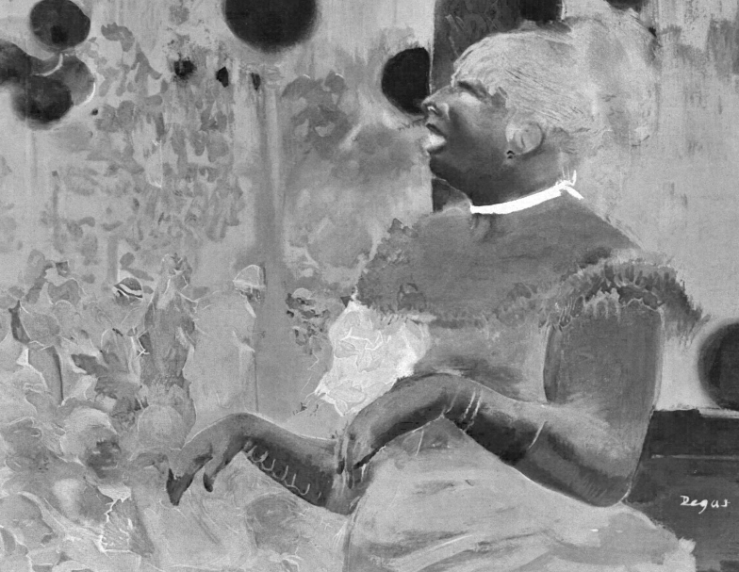
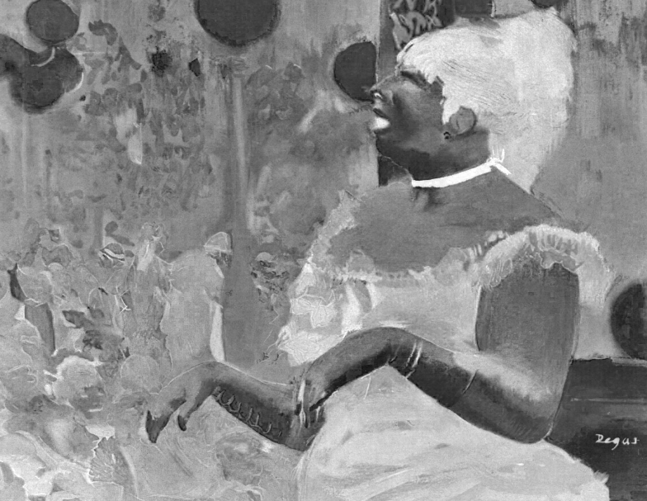
CMY Channels
Source | Cyan
Magenta | Yellow

Slide 28
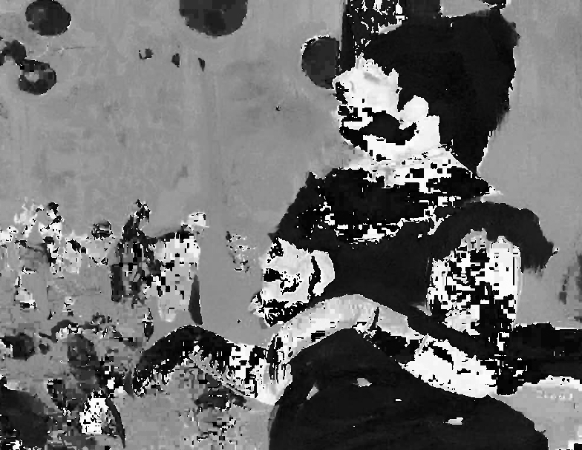
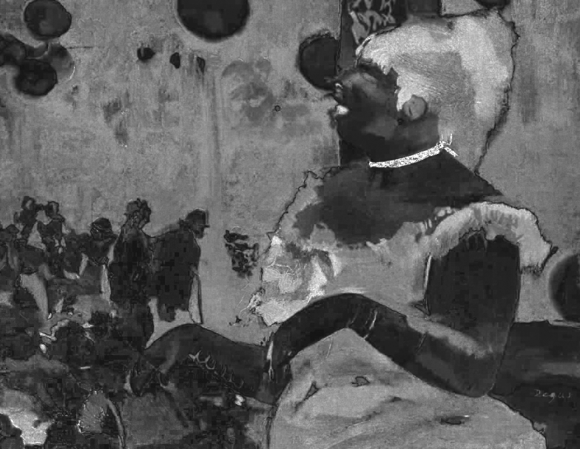
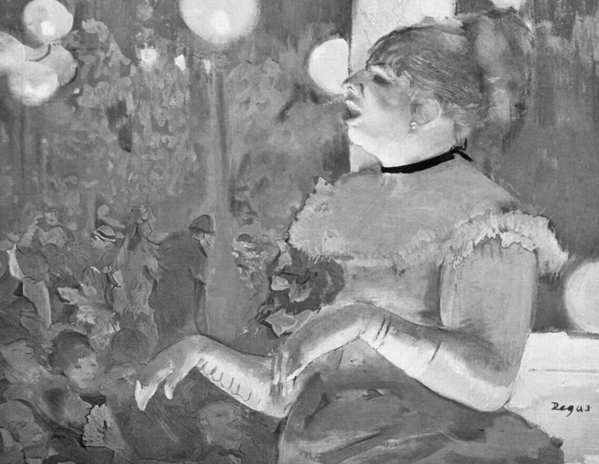
HSB Channels
Source | Hue
Saturation | Brightness

Slide 29
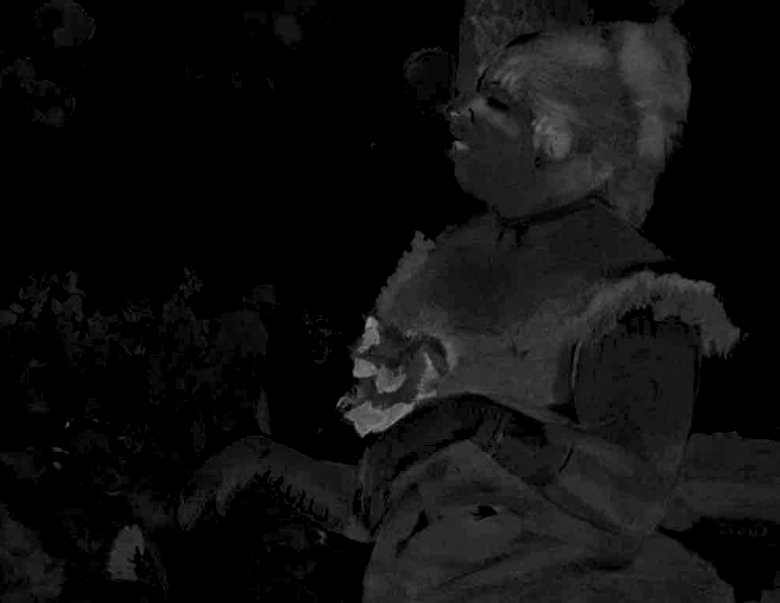
YCbCr Channels
Source | Y
Cb | Cr

Slide 30
Color Similarity
Quantifying the difference between two colors
L1 metric is the taxi-cab distance
L2 metric is the straight-line distance|
Distances are often normalized to the interval [0-1]
Compute the distance in normalized color space
Divide by maximum possible distance in that space
What is the max possible in RGB, CMY, YIQ, YCbCr, HSB?

Slide 31
Color Distance in RGB space

Slide 32
Color class in Java
Java has a class named “java.awt.Color”
Is able to represent a color in any color space
The default color space is RGB
Color
+Color(r:float,g:float,b:float)
+Color(r:int,g:int,b:int)
+getRed():int
+getGreen():int
+getBlue():int

Slide 33
Color class
Two constructors:
Color(float r,float g,float b): uses normalized coordinates such that r, g, and b are in [0,1]. If the values are outside of [0,1] only the fractional portion is used.
Color(int r, int g, int b): uses 8-bit coordinates such that r, g, and b are in [0, 255]. Values outside of those ranges are truncated.
Query methods
The getRed, getGreen and getBlue methods return the red, green, or blue component as an 8-bit value.

Slide 34
imaging.utilities.ColorUtilities
Consider writing a custom class that processes color information
The ColorUtilities class is a collection of static methods to process colors
Consider how to complete and use the following methods
package imaging.utilities;
public class ColorUtilities {
public static float taxiCabDistance(Color c1, Color c2) { …
}
public static float euclidianDistance(Color c1, Color c2 { …
}
}

