Slide 1
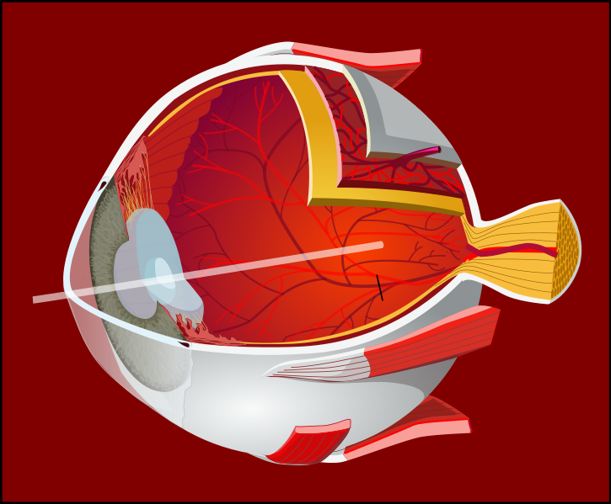
Optics and Human Vision
The physics of light
http://commons.wikimedia.org/wiki/File:Eye-diagram_bg.svg

Slide 2
Light
Light
Particles known as photons
Act as ‘waves’
Two fundamental properties
Amplitude
Wavelength
Frequency is the inverse of wavelength
Relationship between wavelength (lambda) and frequency (f)
Where c = speed of light = 299,792,458 m / s

Slide 3
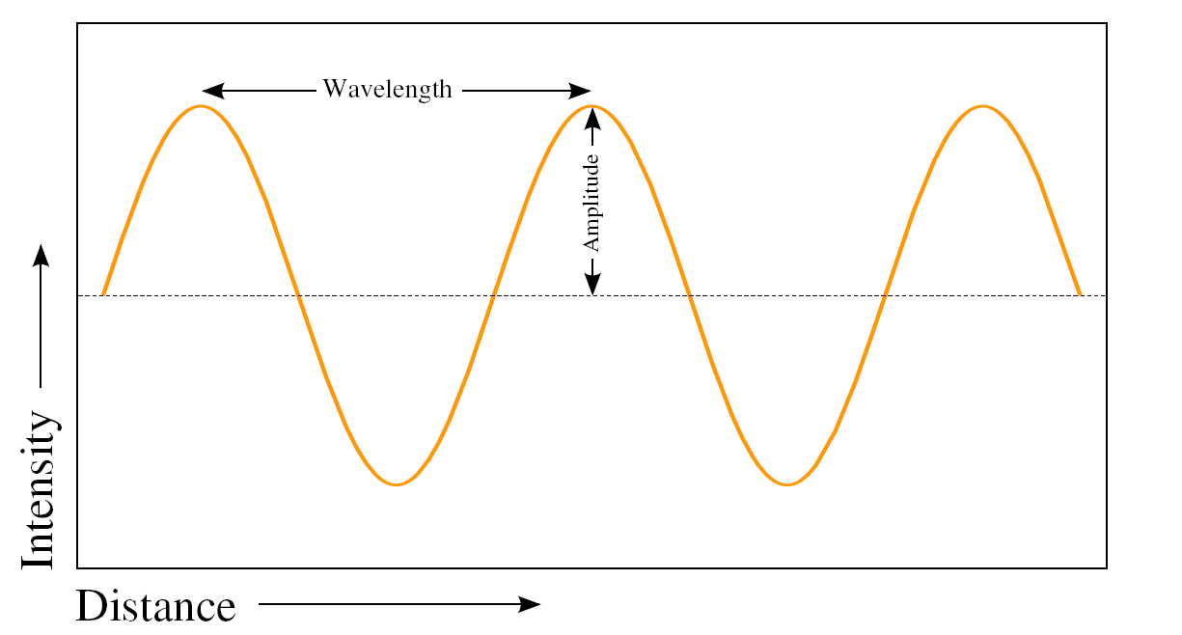
Light
Diagram of a light wave.

Slide 4
Light
Electromagnetic Spectrum

Slide 5
Thin Lens Equation
A lens is a transparent device that allows light to pass through while causing it to either converge or diverge.
Assume that a camera is focused on a target object using a single converging lens:
Let S1 be the distance from the lens to the target
Let S2 be the distance from the lens to the film
The focal length, f, is a measure of how strongly a lens converges light
The magnification factor, m, is another measure.
The optical zoom of a digital camera is usually larger than 1
The magnification factor of a single lens is usually less than 1

Slide 6
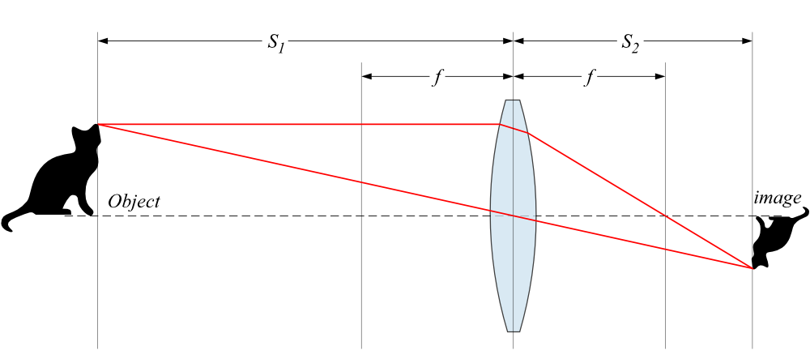
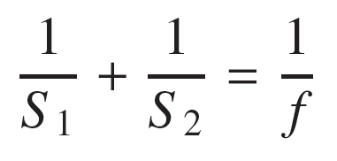
Thin lens equation

Slide 7
Optics and f-stop
F-number is the ratio of focal length to the diameter of the aperture (lens opening)
F-stops are pre-defined aperture settings that are typically factors of 2 with respect to amount of light allowed into the camera.
Doubling “area” of a circle implies scaling the aperture diameter by sqrt(2) or 1.4.
F-stops are geometric sequences involving powers of the square-root of 2.

Slide 8
Human Visual System
Human vision
Cornea acts as a protective lens that roughly focuses incoming light
Iris controls the amount of light that enters the eye
The lens sharply focuses incoming light onto the retina
Absorbs both infra-red and ultra-violet light which can damage the lens
The retina is covered by photoreceptors (light sensors) which measure light

Slide 9
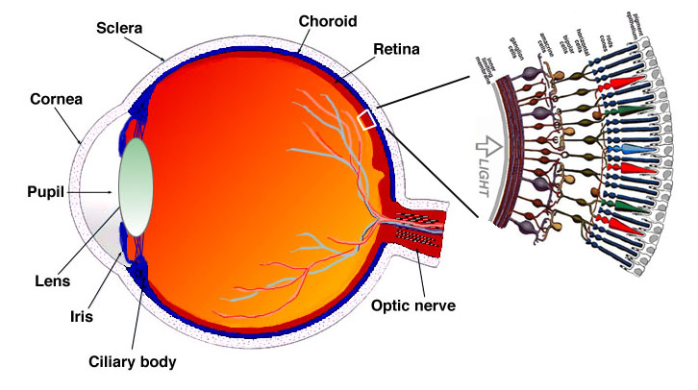
Anatomy of the Human Eye
Source: http://webvision.med.utah.edu/

Slide 10
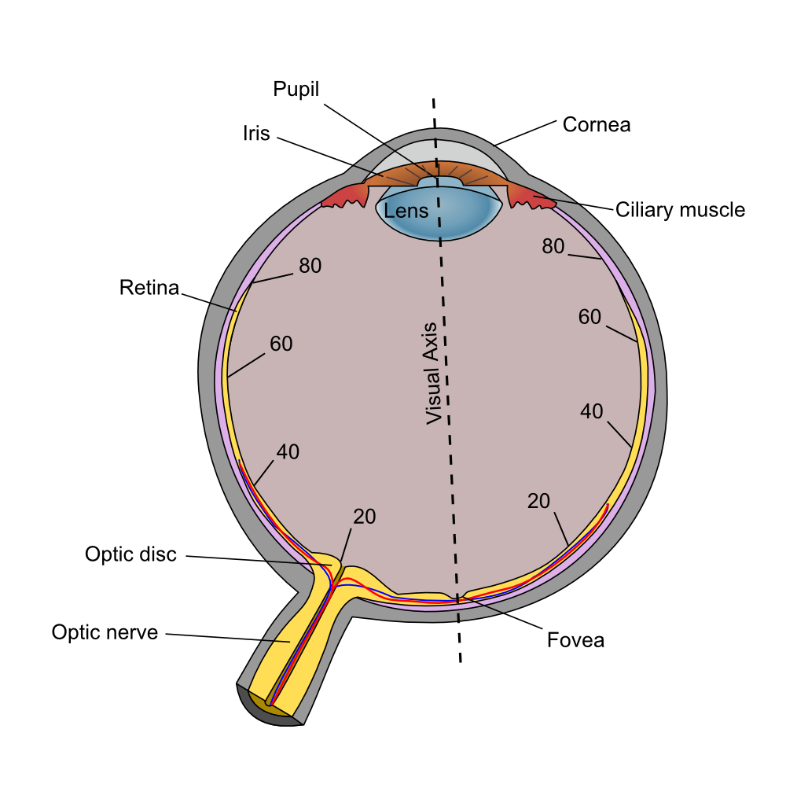
Human Eye

Slide 11
Photoreceptors
Rods
Approximately 100-150 million rods
Non-uniform distribution across the retina
Sensitive to low-light levels (scotopic vision)
Lower resolution
Cones
Approximately 6-7 million cones
Sensitive to higher-light levels (photopic vision)
High resolution
Detect color by the use of 3 different kinds of cones each of which is sensitive to red, green, or blue frequencies
Red (L cone) : 564-580 nm wavelengths (65% of all cones)
Green (M cone) : 534-545 nm wavelengths (30% of all cones)
Blue (S cone) : 420-440 nm wavelengths (5% of all cones)

Slide 12
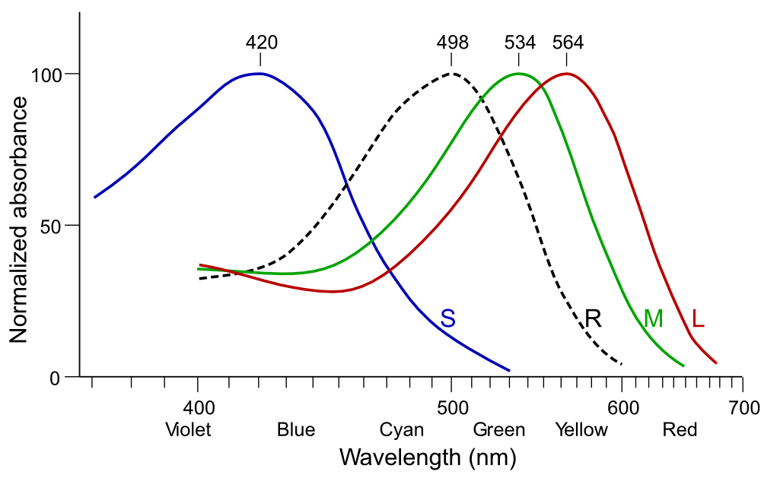
Cone (LMS) and Rod (R) responses
http://en.wikipedia.org/wiki/File:Cone-response.svg

Slide 13
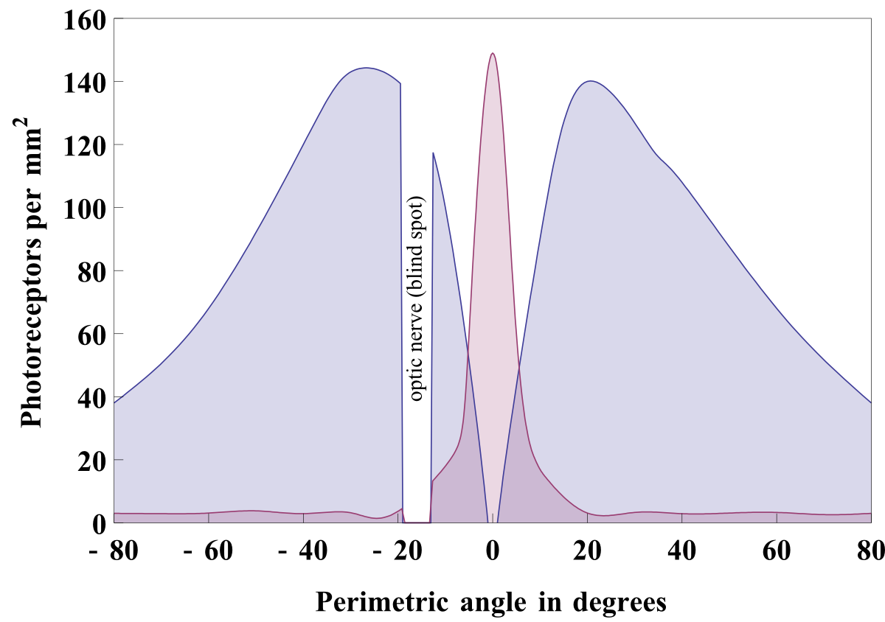
Photoreceptor density across retina

Slide 14
Comparison between rods and cones
Rods | Cones
Used for night vision | Used for day vision
Loss causes night blindness | Loss causes legal blindness
Low spatial resolution with higher noise | High spatial resolution with lower noise
Not present in fovea | Concentrated in fovea
Slower time response to light | Quicker time response to light
One type of photosensitive pigment | Three types of photosensitive pigment
Emphasis on motion detection | Emphasis on detecting fine detail

Slide 15
Color and Human Perception
Chromatic light
has a color component
Achromatic light
has no color component
has only one property – intensity

Slide 16
Human Visual Perception
Light intensity:
The lowest (darkest) perceptible intensity is the scotopic threshold
The highest (brightest) perceptible intensity is the glare limit
The difference between these two levels is on the order of 10¹⁰
We can’t discriminate all these intensities at the same time! We adjust to an average value of light intensities and then discriminate around the average.
Log compression.
Experimental results show that the relationship between the perceived amount of light and the actual amount of light in a scene are generally related logarithmically.
The human visual system perceives brightness as the logarithm of the actual light intensity and interprets the image accordingly.
Consider, for example, a bright light source that is approximately 6times brighter than another. The eye will perceive the brighter light as approximately twice the brightness of the darker.

Slide 17
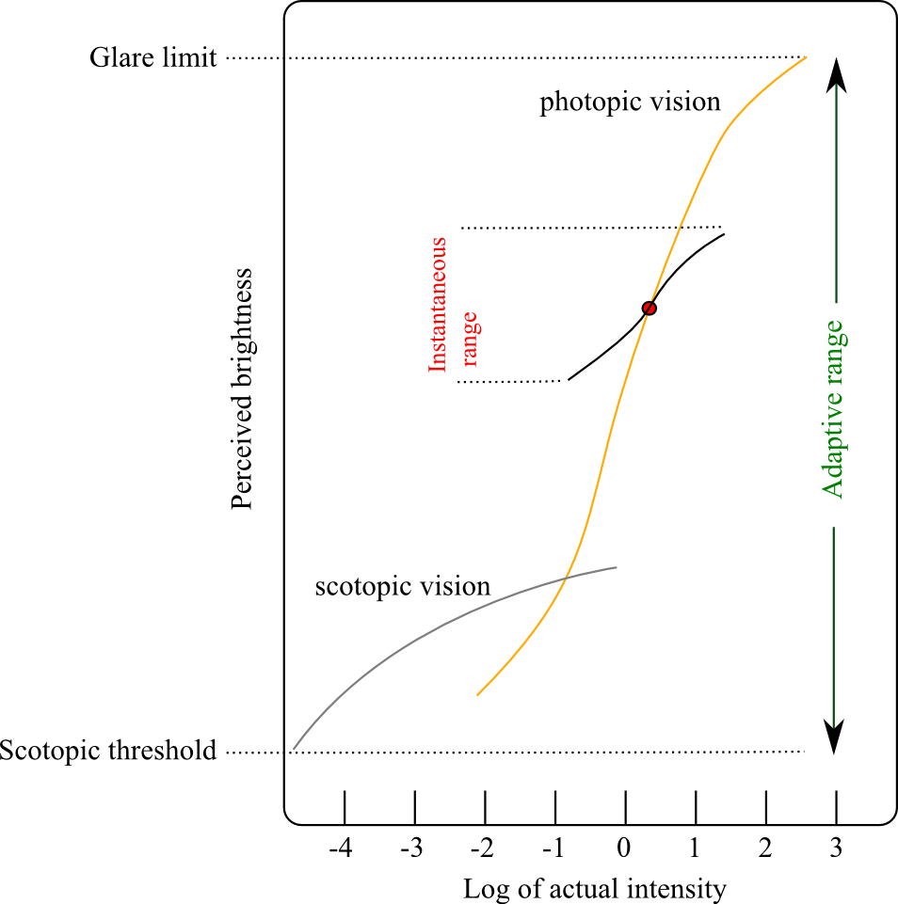
Brightness Adaptation
Actual light intensity is (basically) log-compressed for perception.
Human vision can see light between the glare limit and scotopic threshold but not all levels at the same time.
The eye adjusts to an average value (the red dot) and can simultaneously see all light in a smaller range surrounding the adaptation level.
Light appears black at the bottom of the instantaneous range and white at the top of that range.

Slide 18
Brightness Adaptation and Mach Banding
When viewing any scene:
The eye rapidly scans across the ﬁeld of view while coming to momentary rest at each point of particular interest.
At each of these points the eye adapts to the average brightness of the local region surrounding the point of interest.
This phenomena is known as local brightness adaptation.
Mach banding is a visual effect that results, in part, from local brightness adaptation.
The eye over-shoots/under-shoots at edges where the brightness changes rapidly. This causes ‘false perception’ of the intensities
Examples follow….

Slide 19
Brightness Adaptation and Mach Banding

Slide 20
Brightness Adaptation

Slide 21
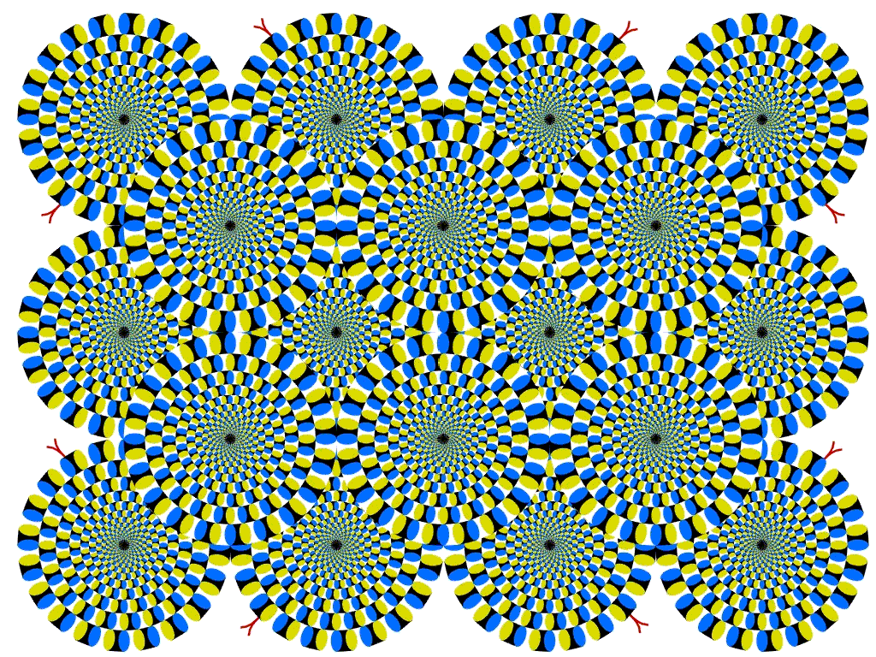

Slide 22
Simultaneous Contrast
Simultaneous contrast refers to the way in which two adjacent intensities (or colors) affect each other.
Example: Note that a blank sheet of paper may appear white when placed on a desktop but may appear black when used to shield the eyes against the sun.
Figure 2.9 is a common way of illustrating that the perceived intensity of a region is dependent upon the contrast of the region with its local background.
The four inner squares are of identical intensity but are contextualized by the four surrounding squares
The perceived intensity of the inner squares varies from bright on the left to dark on the right.

Slide 23
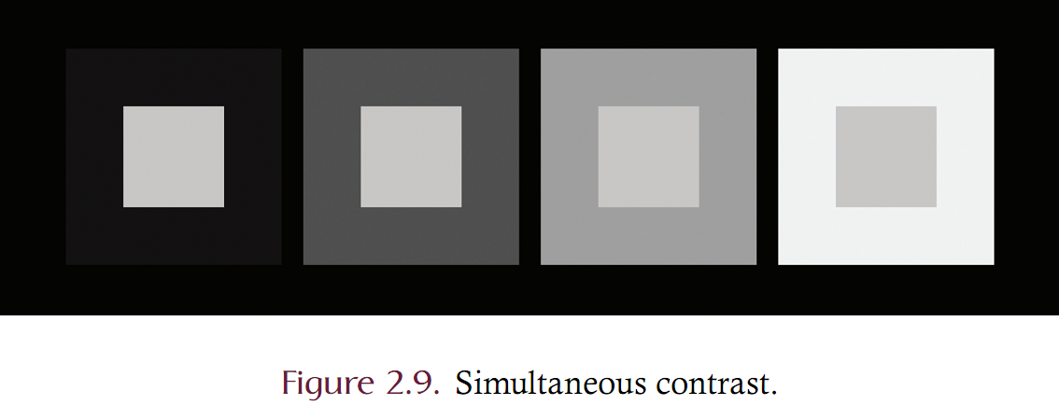
Simultaneous Contrast

Slide 24
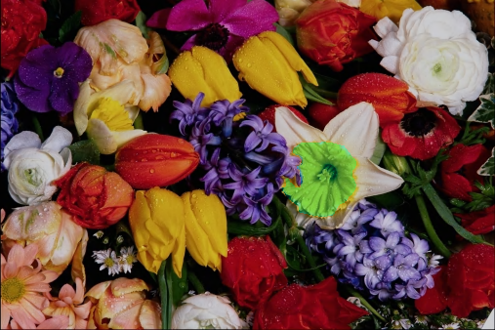
Chromatic Adaptation
What is the color of this flower?
The color above is actually green!
In the image to the right, the “yellow” region from the trick image was cut and pasted onto the original.

