Slide 1
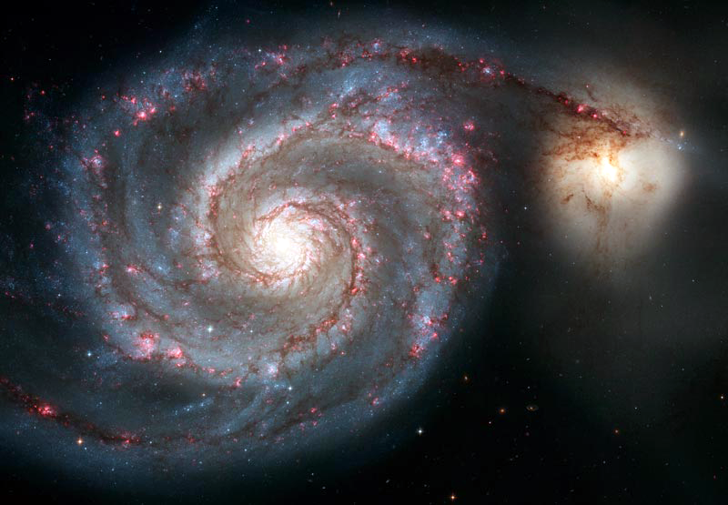
Introduction
The ubiquitous image

Slide 2
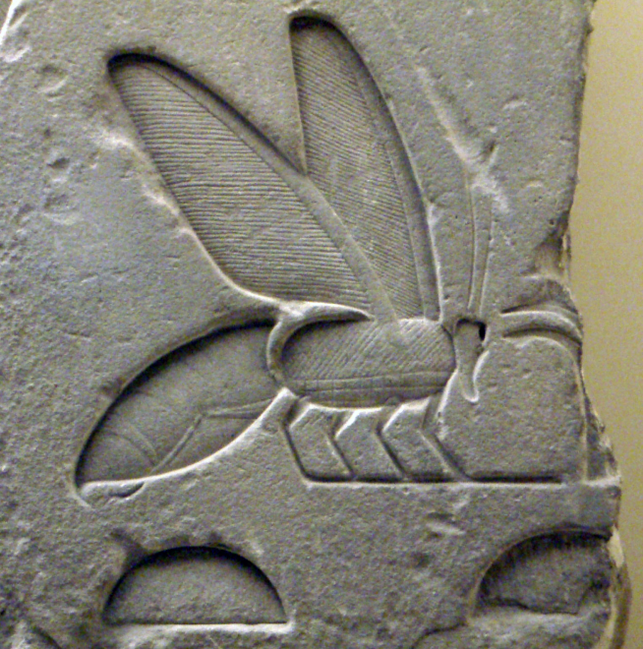
What are Images?
Images are pictures!
A picture that represents visual information.
How are non-digital images stored?
papyrus
paper
film
canvas
stone carvings
http://commons.wikimedia.org/wiki/File:AncientEgyptianRelief-BeeHieroglyph-ROM.png

Slide 3
What are Digital Images?
An image that can be stored in digital form
How are digital images acquired (generated)?
scanner
digital camera
software
How are digital images stored (saved)?
In memory using a specific file format PNG/GIF/JPEG/…

Slide 4
What is Digital Image Processing?
Digital image processing: the field of study that seeks to analyze or enhance a digital image.
Examples:
Improving the contrast of a picture
Applying noise-reduction filters to make the image clearer
Eliminating red-eye
Cropping or rotating an image

Slide 5
What are the benefits of Digital Images?
Contrast “digital” and “non-digital” images
Task | Non Digital | Digital
Creation | Rough approximation of reality | Accurate approximation of reality
Editing | Difficult: erase, over-paint, chisel, … | Easier: use a photo editing suite
Quality over time | Degrades with exposure to light and environment | No degradation
Copying | Slow process yields inexact copies | Fast process yields exact copies
Transmission | Slow | Fast

Slide 6
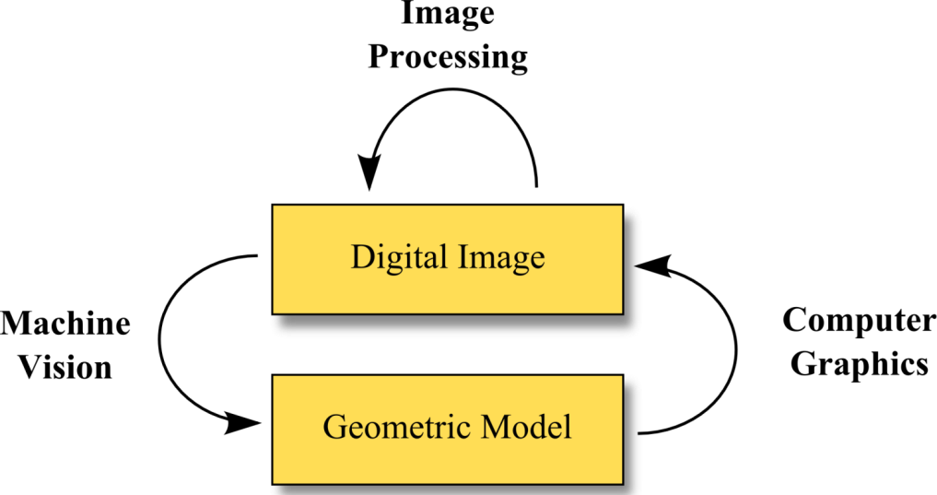
Related Disciplines
Machine vision: image in / information out
Computer graphics: information in / image out
Image processing: image in / image out

Slide 7
Image Processing Pipeline
Acquisition: creation of digital image
Processing: enhancement or other processing
Archival: storage of image
Transmission: exchange of digital image data
Display: visualization of digital image

Slide 8
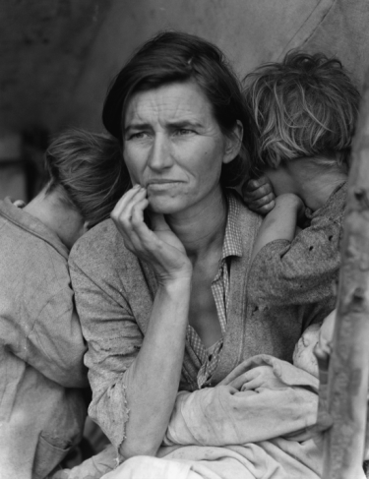
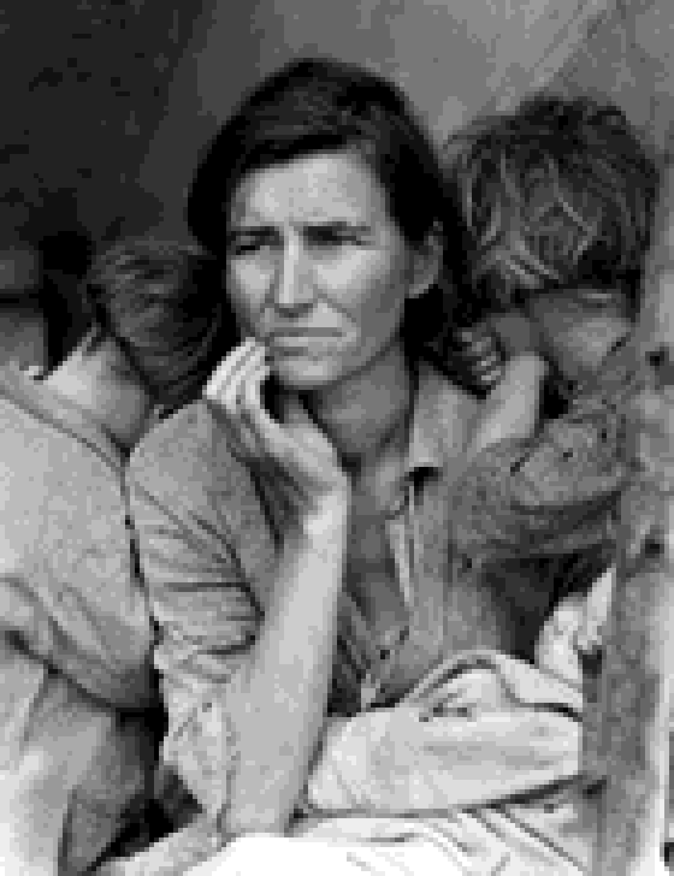
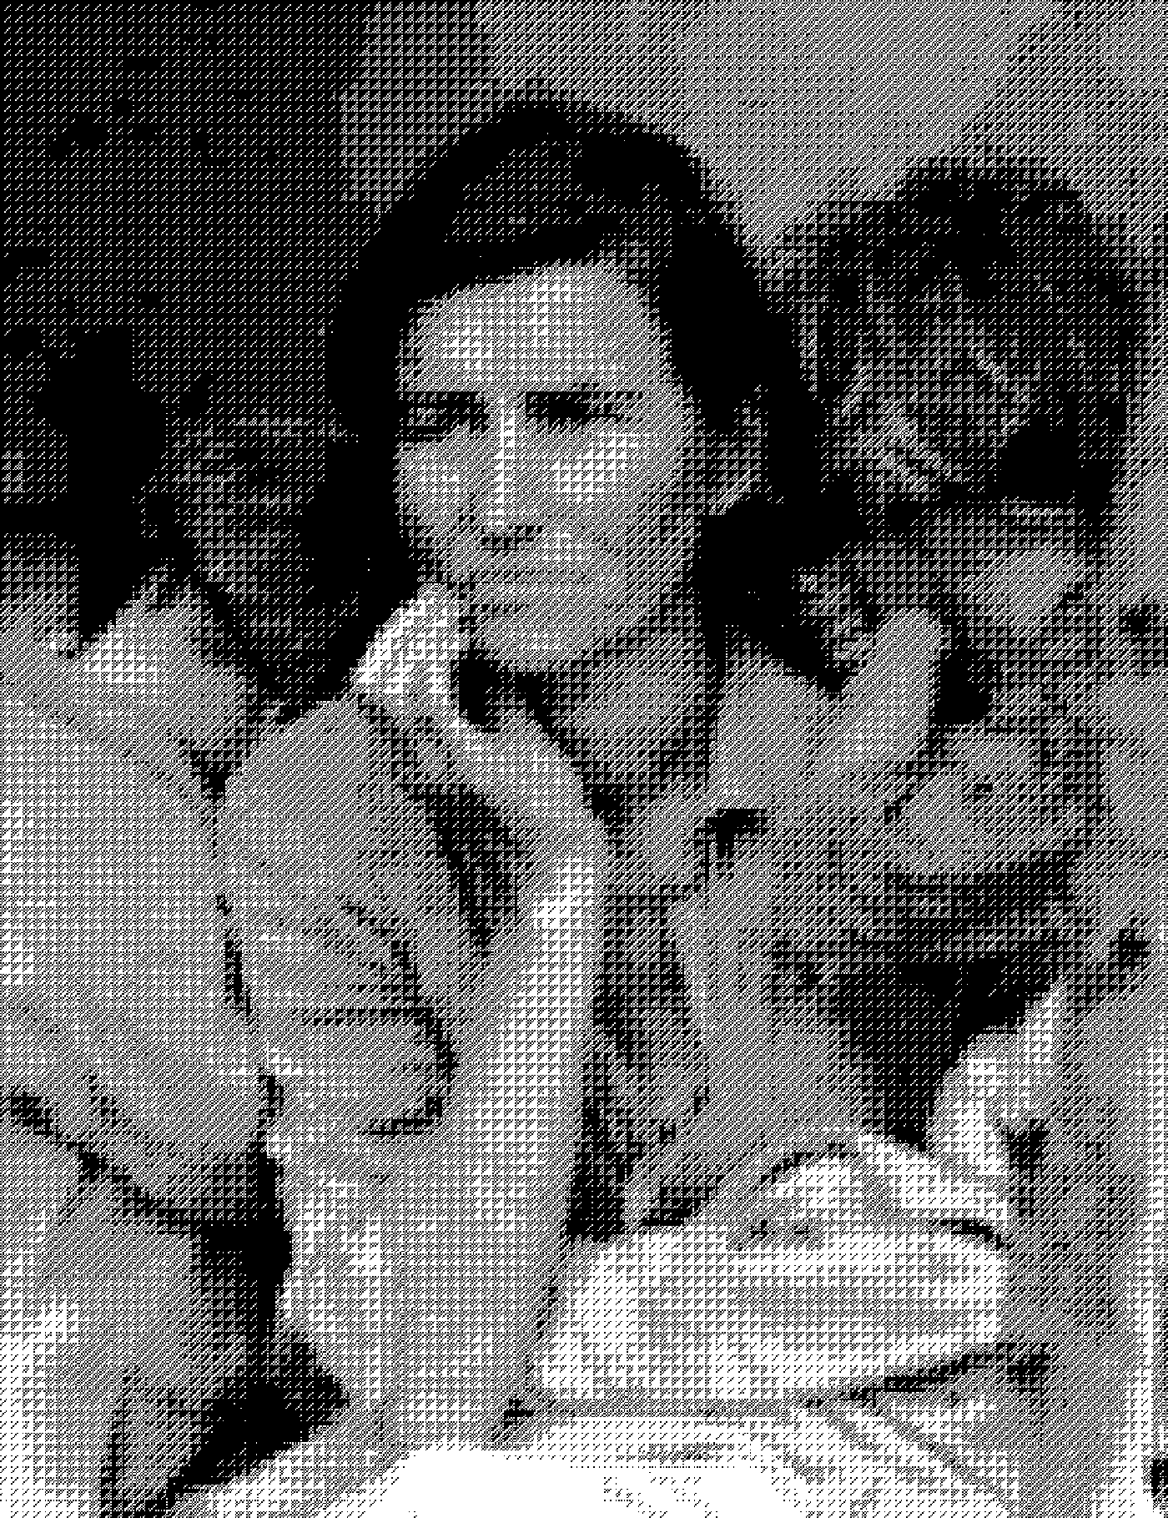
A | B
C | D
A: Scene
B: Acquired
C: Archived
D: Displayed

Slide 9
Topics of Study
Processing Stage | Topic of Study
Acquisition | Physical properties of light Human perception Mathematical models of color
Processing | Software architecture Data representation Algorithm design
Archival | Compression techniques Data representation
Transmission | Data representation Network protocols
Display | Digital halftoning Color models Human perception

Slide 10
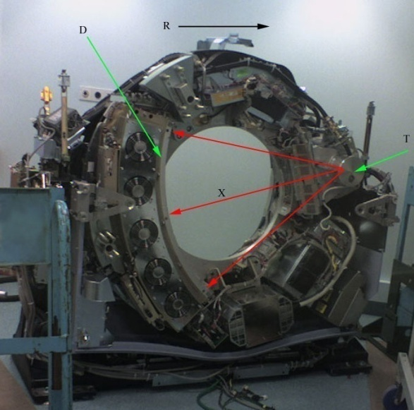
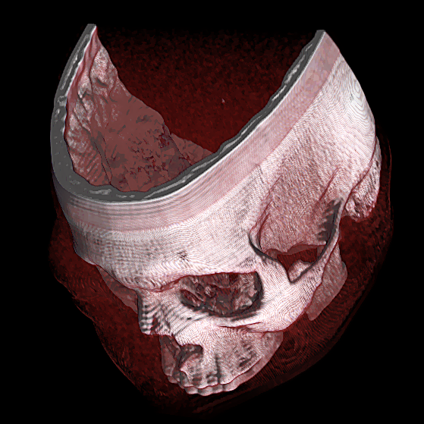
Applications: Medicine
Non-invasive 3D imaging of internal physical structure
Computed tomography (CT)
Magnetic Resonance Imaging (MRI)
X-Rays
Physicians must be knowledgeable of image processing as it relates to the display and interpretation of the visual data
http://en.wikipedia.org/wiki/File:Ct-internals.jpg

Slide 11
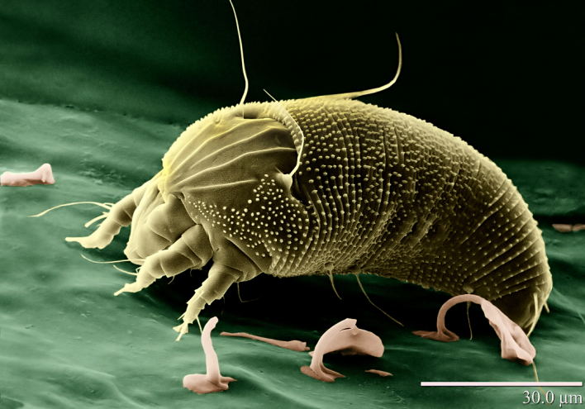
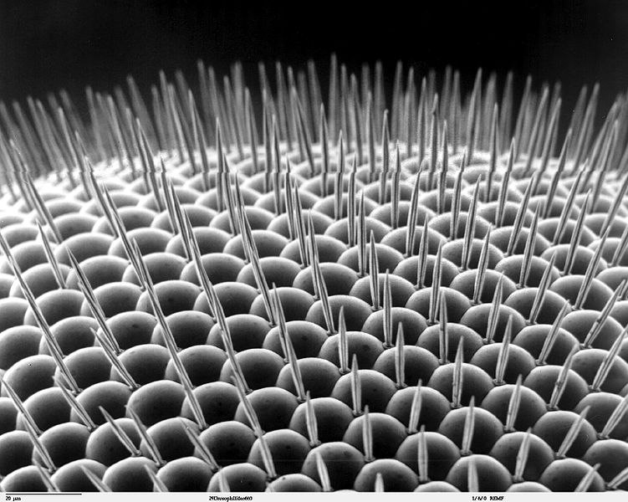
Applications: Biology
Biology: a natural science that studies living organisms
Includes a vast array of specialized sub disciplines such as botany, zoology, cell biology, microbiology and biochemistry.
Each of these disciplines relies to some degree on sophisticated computing systems to acquire and analyze image-based data
Biologists must be knowledgeable of image processing as it relates to the acquisition of image-based data and the automation of image-based analysis
http://en.wikipedia.org/wiki/File:Rust_Mite,_Aceria_anthocoptes.jpg , http://upload.wikimedia.org/wikipedia/commons/thumb/8/89/Drosophilidae_compound_eye_.jpg/751px-Drosophilidae_compound_eye_.jpg

Slide 12
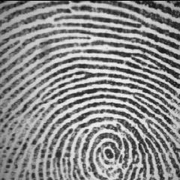
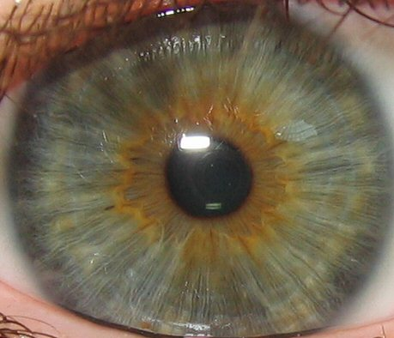
Applications: Biometrics
Biometrics: seeks to verify the identity of individuals by measuring and analyzing biological characteristics such as fingerprints, voice patterns, gait, facial appearance or retinal scans.
In most of these techniques, with the exception of voice recognition, the biological traits are obtained by analysis of a digital image

Slide 13
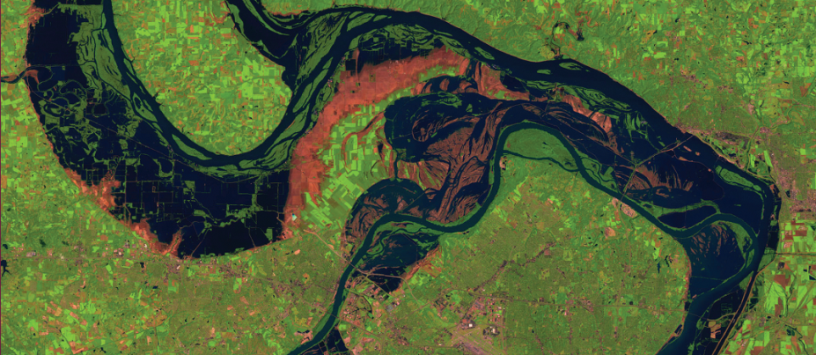
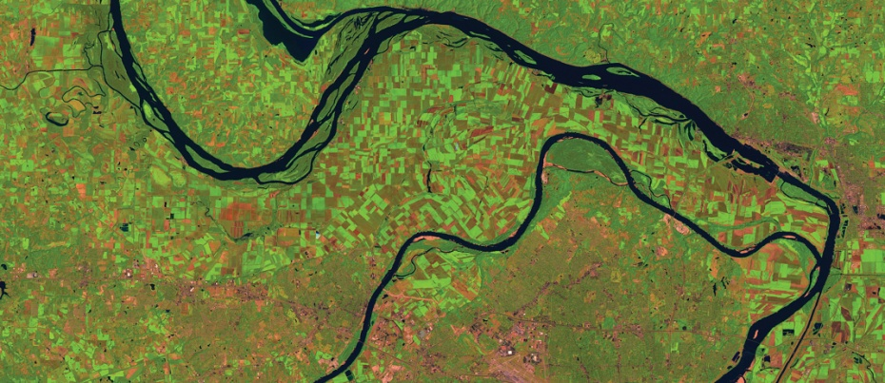
Applications: Environmental Science
Environmental science includes meteorology, oceanography, ecology and geosciences.
Each of these disciplines relies on satellite imaging and remote sensing
St. Louis Flood of 1993
St. Louis in 1994

Slide 14
Professional Sports
Football (American)
Uses instant replay from multiple angles to determine possession, in/out bounds
Telecasts project down markers on the field
Tennis and Major League Baseball (America)
use cameras to track ball trajectories

Slide 15
Applications: Astronomy
Heavy reliance on digital imaging.
Compton Gamma Ray Observatory captures digital images primarily in the gamma ray spectrum
Chandra X-Ray Observatory and the Space Infrared Telescope Facility (also known as the Spitzer Space Telescope) provide coverage of the x-ray and infrared portions of the spectrum respectively.
The Hubble Telescope, launched in 1990, orbits the earth with a reflector style optics system and a mirror of 2.4 meters in diameter. The focal length is 57.6 meters and it is able to take infrared images as well as images in the visible spectrum

Slide 16
Hubble Image
M51 spiral galaxy. 60,000 light years across.

Slide 17
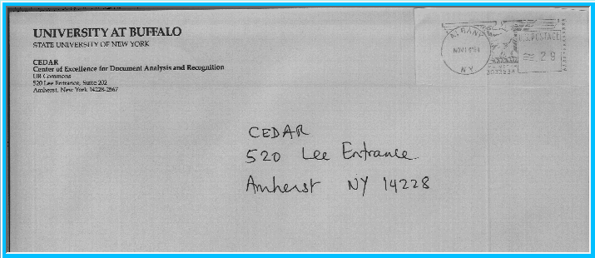
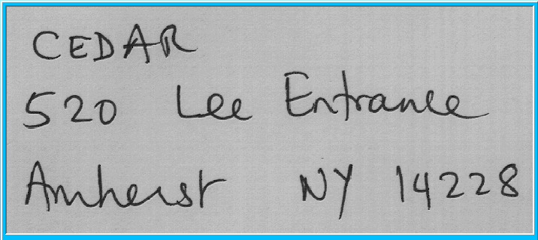
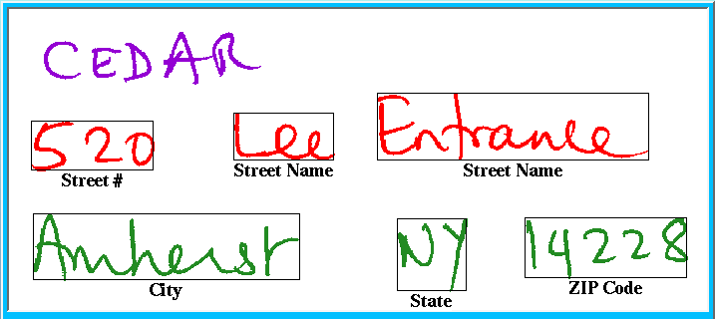
Application: Mail Delivery
Most parcels, letters are routed automatically
Letter is scanned
Destination address identified
Address is segmented
Segments are analyzed

